Slide 1

EEnnvviirroonnmmeennttaall SSttuuddiieess

Slide 2
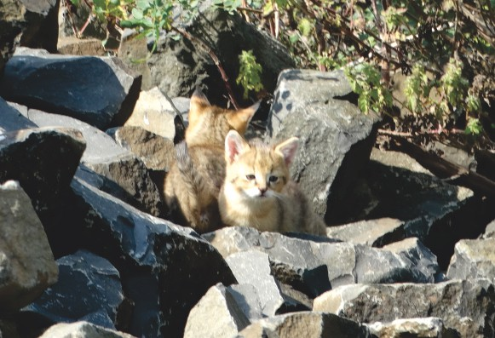
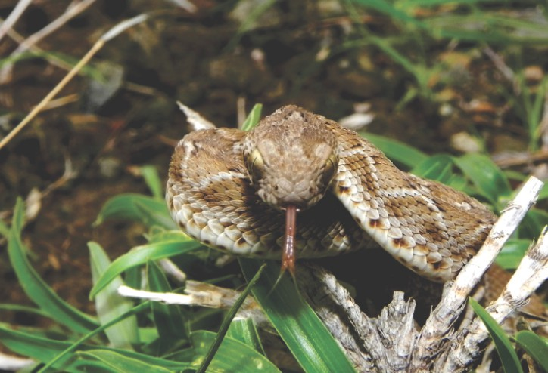
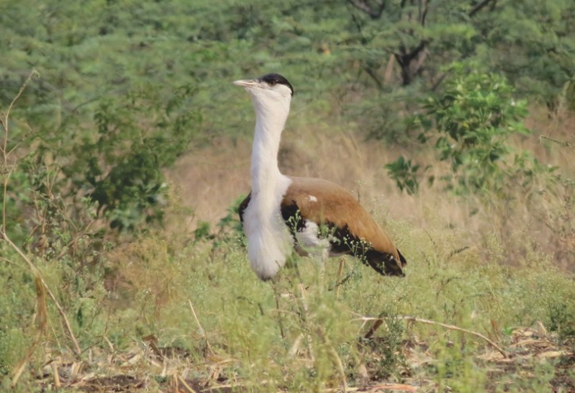
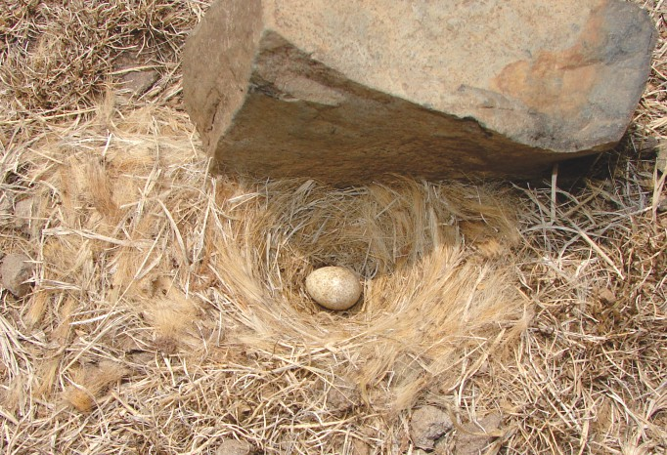

Slide 3

Environment Studies
STUDY MATERIAL ON
NAAC Accredited-2015
‘B’ Grade (CGPA 2.62)
By
SOLAPUR UNIVERSITY SOLAPUR

Slide 4
Environment Studies
Editorial Board
Dr. V. P. Dhulap (Chief Editor)
Department of Environmental Science, School of Earth Sciences, Solapur University, Solapur
First Edition:
March, 2018
Dr. P. U. Meshram
Department of Environmental Science, S.M. Mahavidyalaya and Research Academy, Sakkardara Square, Nagpur
First Edition:
As per new Revised Syllabus (UGC Model Curriculum
with effect from June - 2017)
Dr. M. N. Jagtap
Department of Botany, D.B.F Dayanad Arts, Science & Commerce College, Solapur
Dr. R. K. Narkhede
Department of Envi. Science, M.U.Mahavidyalay, Udgir- Latur
Dr. S. D. Kulkarni
Department of Environmental Science, (PG Dept), New Arts & Science College, Ahmednagar
Published by:
Registrar
SOLAPUR UNIVERSITY
Solapur
Dr. I. B. Ghorade
Department of Environmental Science, Kohinoor Arts, Science & Commerce College, Khultabad,
Auranagabad
Dr. N. G. Shinde
Department of Geography, D.B.F Dayanad Arts, Science & Commerce College, Solapur
Printed by:
Palavi Printers, Solapur
129/498, Vasant Vihar,
Near Old Pune Naka,
Solapur - 413001
(Mo.) 9637335551 / 7020828552
Dr. V. K. Pukale
Department of Geography, Sou. Suvarnlata Gandhi Mahavidyalaya, Vairag. Tal-Barshi, Dist- Solapur
Dr. D. S. Harwalkar
Department of Geography, Mauli Mahavidyalaya Wadala Tal - North Solapur, Dist- Solapur
Mr. W.A. Bagwan
Department of Biotechnology, Lokmangal
Biotechnology College Wadala, Tal - North Solapur, Dist- Solapur

Slide 5




CONTENTS
Unit 1
Introduction to Environment Studies
01
Unit 2
Ecosystem
06
Unit 3
Natural Resources- Renewable and non Renewable Resources
30
Unit 4
Biodiversity and Conservation
43
Unit 5
Pollution
67
Unit 6
Environmental Policies and Practices
119
Unit 7
Human Communities and the Environment
130
Unit 8
Field Work
138
References
142

Slide 6

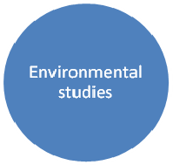




Unit 1: Introduction to Environment Studies
Unit 1
Introduction to Environment Studies
Everything which surrounds us may be referred to as the environment and the study which covers different aspects of environment, its quality, the maintenance of its quality including conservation of its living and non-living constituents can be collectively referred to as “Environmental science” or “Environmental studies”. The air, soil, water, all living and non-living things around us constitute the environment, which influences our lives. It is from the environment surrounding us that we get food to eat, water to drink, air to breath and all necessities of our daily lives. The environment around us constitutes a “life support system”.
The concern for environment is an expression of a fundamental change in human perception of
nature, natural resources and wildlife on our planet. The traditional concept, that natural resources are abundant for man to use or abuse, has responsible for massive degeneration of nature, natural systems, environment and wildlife. Department from the traditional perception of human dominance over nature, a more realistic view that man is just species among millions of species and his well being is intimately linked to well being of all other species has now emerged. Man cannot survive alone and aloof from other living beings. The natural systems in which man exists along with all other species must be maintained in a healthy and functional state.
Muliti-Disciplinary Nature of Environmental Studies
Existence and behavior of living and non-living constituent of environment are covered by laws of physical, chemical, geological and biological sciences. Human behavior and management of human
societies are covered by psychological, psychological, and political and social science. Rules framed for maintenance of environment in a healthy state come under jurisdiction of national legislation while agreements reached regarding common problems faced by two or more than two countries come under purview of international law. Different aspects linked with sciences listed above have to be taken into consideration for any study involving environment. The science of environment is, therefore, a multidisciplinary science, which may require attention of experts from different branches of science when decisions regarding environmental matters have to be taken.

Slide 7
Unit 1: Introduction to Environment Studies
Importance of Environmental Studies and the Necessity of Public Awareness
Man has long effected his local environment but it is in the 20th century only, particularly in the last
fifty years that the scope of his influence has expanded to a global state. Today we affect earth systems significantly extracting materials, using energy and emitting pollution in our quest to provide food, shelter and a host other products for the world’s growing population. Over-exploitation of natural resources and pollution of environment are corroding the vital life support systems on which all life depends for its subsistence. Ass natural systems degenerate, it will be difficult to maintain productivity of our agriculture and obtain necessities of our day-to-day life. Chemically altered environment shall make our lives more and more difficult. This is not a healthy sign. We have to reverse the damaging trends. The future of entire humanity is at stake.
The earth has already been committed to major environmental change in the years ahead. The raised concentration of green house gases already introduced in the environment shall persist for many centuries no matter what we do. The chlorofluorocarbons in the atmosphere today will continue to deplete ozone layer for centuries to come. Extinct species shall never come back. Tropical forest ecosystem we have cleared shall take decades to regenerate. The magnitude and rate of change shall depend on whether we decide to act now or do nothing. The steps required to slow down the pace of global change shall touch the lives of all and for adapting to it if needed, enormous efforts shall be required but so may be the consequences of our inaction.
Environmental Studies-definition
John Turk- ‘Environmental science provides an approach towards understanding the environment of
our planet and the impact of human life on the environment. It is also a search for solution to the environmental problems that confront us.
Purdon & Anderson-“Environmental science is an application of knowledge from many disciplines to the study and management of the environment. It deals with the analysis of the conditions, circumstances that influence life, and in turn how life responds to these circumstances.”
Benard Nebel- “Environmental study is the scientific study of maintenance of eco balance among the various eco system.”
Nature of Environmental studies:
Comprehensive – As it is concerned with all biotic and abiotic factors and the relationship among them, it covers almost the entire plant.
Interdisciplinary nature- Environmental science includes natural as well as social sciences. It deals with various problems and seeks solutions to them. Political and economic aspects of the problem
are also to be considered. To study different components of environment, knowledge of different disciplines such as geography, geology, zoology, botany, chemistry, microbiology, anthropology, medicine, psychology, history, politics, economics, sociology, physics, mathematics etc. is required.
Ever changing- The findings, concepts and conclusions may change in the course of time for some environmental components. It is seen that the intensity of natural as well as man made problems of ecology has increased. The nature of ecological problems such as different kinds of pollution, soil erosion, flood, drought, cyclones, tsunami, global warming, depletion of ozone change from tie to time so is the nature of environmental studies.
iii)

Slide 8
Unit 1: Introduction to Environment Studies
Complex- Various natural components are studies under this science. The study of correlationship between man and environment is also a part of it. Various components of nature are interdependent on one another. This relationship is very complex.
Beneficial- environment is everything for human. Therefore, a systematic study of natural resources, their utilization, problems arising from their overexploitation, probable solutions to these problems,
management of natural resource is needed for the well being of the human beings.
Scope of Environmental Studies:
Understanding nature – Nature of environment, its types, components, its relationship with other sciences, man and nature, ecology and ecosystems, ecological concepts and principles and also many allied things are included and studied under this category.
Use of natural resources-Environment is a treasure of resources. Because of population explosion and uncontrolled exploitation, these resources are nearing exhaustion. Proper use, distribution and
management of the resources are studied under this category.
Study of environmental problems- Increase in industrialization, population, urbanization and
overexploitation of resources and their mismanagement result in creation of several eco problems. All the aspects of various kinds of pollution as well as natural calamities like earthquake, volcano, flood, drought, tsunami, cyclones, land sliding, loss of bio diversity, global warming, acid rain and so many problems are studied under this science.
iv) Environmental management and planning- Natural balance is disturbed due to unplanned, uncontrolled use of various ecosystems. To avoid all this, a careful utilization of resources is needed
otherwise they would not be available for next generations. Eco-planning is a very important part of environmental studies.
iii)
Importance of environmental studies
Environmental studies reflect on the status of the natural resources on which our lives are dependent. It also helps in the development of area and protection of cultural heritage.
Awareness: Because of the increased interference of human beings in the environment, several
ecological problems have been created. Severity of these problems is increasing continuously.
Environmental studies help us to solve these problems by making the people, social groups and organizations aware of these problems.
Knowledge: Maintenance of healthy environment is very important for sustenance of life. As environmental studies are concerned with many science disciplines, one gets familiar with many scientific concepts.
Behavior: This science develops positive attitude towards conservation of environment in the people and make them eco-friendly.
Skill: Observation, research ability, etc. are required for the study of environment, which can be developed by studying this science.
Involvement: For preservation and conservation of environment, involvement of society/people is of
great importance. It is also a necessary step to solve the eco-problems.
Evaluation ability: we start thinking logically about the day to day problems due to the environmental studies. Skill of evaluation, role of oneself, society, institute etc. towards ecological field develops.

Slide 9
Unit 1: Introduction to Environment Studies
Need for public awareness:
Day by day environmental problems are getting severe due to population explosion,
industrialization and enormous deforestation, increase in transport vehicles, overexploitation of natural resources, superstitions, global warming and depletion of ozone etc. Public awareness programs are being organized world of fundamental or the basic needs. Pollution is creating many health problems.
We have to make people aware of
Eco-problems
Social ethics among students and common man.
The importance environment.
Maximum involvement of people in eco-development programs.
The interrelationship between man and nature.
Eco-case of public awareness
Silent valley project ( Kerala)
Chipko Anadolan (U.P.)
Save Western Ghat (Gujarat-Kerala)
Water crisis and Coca Cola
Concept of sustainability and sustainable development
The concept of sustainable development can be interpreted in many different ways, but at its core is an approach to development that looks to balance different, and often competing, needs against an awareness of the environmental, social and economic limitations we face as society.
In 1987, the Bruntland Commission published its report, Our Common Future, in an effort to link the issues of economic development and environmental stability. In doing so, this report provided the oft- cited definition of sustainable development as “development that meets the needs of the present without compromising the ability of future generations to meet their own needs” (United Nations General Assembly, 1987, p. 43). Albeit somewhat vague, this concept of sustainable development aims to maintain economic advancement and progress while protecting the long-term value of the environment; it “provides a framework for the integration of environment policies and development strategies” (United Nations General Assembly, 1987).
The appreciation of our natural resource constraints is also in our best interest. Truly rational and “effective governance requires a nation to consider and protect the environment and natural resources on which its current and future development depend. Any other approach is self-defeating. The connections between the environment and development thus provide a powerful rationale for environmental protection: enlightened self-interest.
Components of a healthy environment, such as clean air and water, are considered public goods in that they are non-rivalrous and non excludable. Thus, it is up to the public sector to maintain the provision of these goods and services. More recently, nations have moved towards the implementation of these market based mechanisms to internalize the complete costs of pollution and ensure long-term stability of the environment; in other words, to ensure sustainable development.

Slide 10
Unit 1: Introduction to Environment Studies
The goal of sustainable development (SD) is the long-term stability of the economy and environment; this is only achievable through the integration and acknowledgement of economic, environmental, and social concerns throughout the decision making process.
The key principle of sustainable development underlying all others is the integration of environmental, social, and economic concerns into all aspects of decision making. All other principles in
the SD framework have integrated decision making at their core (Dernbach J. C., 2003; Stoddart, 2011). It is this deeply fixed concept of integration that distinguishes sustainability from other forms of policy. Institutionally, government organizations are typically organized into sectoral ministries and departments. This works fairly well until the system encounters something very comprehensive and highly integrated in nature, such as sustainable development. In practice, sustainable development requires the integration of economic, environmental, and social objectives across sectors, territories, and generations. Therefore, sustainable development requires the elimination of fragmentation; that is, environmental, social, and economic concerns must be integrated throughout decision making processes in order to move towards development that is truly sustainable.

Slide 11
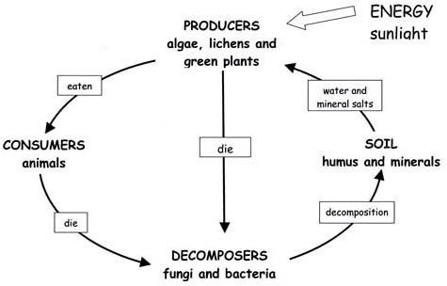
Unit 2: Ecosystem
Unit 2
Ecosystem
Introduction:
The system which is formed by a community of organisms interacting with their environment is an ecosystem. The study of inter-relationships among the living organisms, physico-chemical processes, and human activities in ecological communities is the science of an Ecosystem. The living and nonliving things interact with each other within a particular area, and together, these things form an ecosystem.
The term "ecosystem" was coined in 1935 by a British ecologist A. G. Tansley. Everything in an
ecosystem has an important role. Arthur Tansley devised the concept to show the importance of transfers of materials between organisms and their environment. The ecosystem is defined as; “It is a system that is formed by a community of organisms interacting with their environment”. Both living and nonliving things within a particular area forms the ecosystem. Ecosystems can be of any size but usually of specific, limited spaces. According to some scientists, entire planet is an ecosystem. Ecosystem was defined by Eugene Odum as, “an unit that includes all the organisms, i.e., the community in a given area interacting with the physical environment, i.e., exchange of materials between living and non-living, within the system”. An ecosystem is a very complex entity with many interactive components. It can be defined as "a system of complex interactions of populations between themselves and with their environment in a functional unit of variable size" (Odum, 1975; Ellenberg, 1973; Nybakken, 1982; Scialabba, 1998).
Structure and function of Ecosystem:
Concept and Types of ecosystem:
The ecosystem is a basic, functional unit of ecology. An ecosystem includes all of the living things
like plants, animals and microorganisms in a particular area, interacting with each other, and also with their non-living surrounding environments. Different types of ecosystem are present in different areas which consist of biotic and abiotic components interacting with each other. Energy transformation, circulation and accumulation take place in any ecosystem. The diagrammatic representation of the nutrient cycling amongst the living organisms and relationship between biotic and abiotic components is shown as follows:
Figure 2.1: Nutrient cycling in an Ecosystem

Slide 12
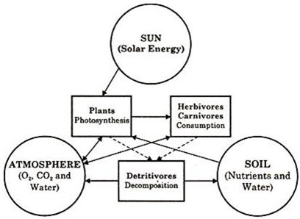
Unit 2: Ecosystem
Figure 2.2: Relationship within an Ecosystem
Smith (1966) emphasized the following general characteristics of most ecosystems:
The ecosystem is a major structural and functional unit of ecology.
The structure of an ecosystem is related to its species diversity in the sense that complex ecosystem have high species diversity.
The function of ecosystem is related to energy flow and material cycles within and outside the system.
The relative amount of energy needed to maintain an ecosystem depends on its structure. Complex ecosystems needed less energy to maintain themselves.
Young ecosystems develop and change from fewer complexes to more complex ecosystems, through the process called succession.
Each ecosystem has its own energy budget, which cannot be exceeded.
Adaptation to local environmental conditions is the important feature of the biotic components of an ecosystem, failing which they might perish.
The function of every ecosystem involves a series of cycles, e.g., water cycle, nitrogen cycle, oxygen
cycle, etc. these cycles are driven by energy. A continuation or existence of ecosystem demands exchange of materials/nutrients to and from the different components.
Alterations in the environments represent selective pressures upon the population to which it must adjust Organisms which are unable to adjust to the changed environment must needs vanish.
Both the environment and the energy fixation in any given ecosystem are limited and cannot be exceeded without causing serious undesirable effects.
Types of Ecosystems:
Ecosystems are broadly divided into natural ecosystems and artificial ecosystems. These two ecosystems are self regulating, open system with a free exchange of inputs and outputs with other systems.

Slide 13
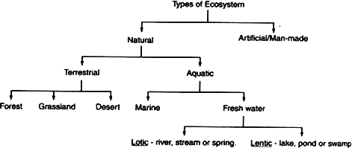
Unit 2: Ecosystem
Natural ecosystems- They are existing in nature and are further classified into terrestrial and aquatic. Terrestrial ecosystem includes desert, grass land, tropical and temperate rainforests. The aquatic ecosystem is further divided into fresh water ecosystem and marine ecosystem. The fresh water ecosystem may be lentic i.e. ecosystem in standing water (e.g. ponds, lakes, pools, ditch, swamps etc.) and lotic i.e. ecosystem in flowing water (e.g. river, streams,spring). The marine ecosystems are estuaries, oceans, mangroves, bays and deep sea etc.
Artificial ecosystems- These are unstable, simple and human-made. These are manipulated by man for different purposes e.g. crop field (crops of maize, wheat, mango etc.) agricultural land, artificial lakes and reservoirs, townships etc.
The terrestrial ecosystem e.g. Grassland ecosystem and the fresh water ecosystem e.g. pond ecosystem discussed briefly as follows-
Grassland Ecosystem-
In grassland ecosystem the vegetation is dominated by grasses. The various components of a grassland ecosystem are discussed below -
Abiotic components: The aerial environment, climate and edaphic factors like soil nutrients, soil water,
soil air, and soil texture are the main abiotic components. The nutrients such as hydrogen, oxygen,
nitrogen, phosphorous and sulphur required by plants are supplied by the soil and air in the form of CO₂, water, nitrates, phosphates and sulphates. The climate is also important abiotic component of a grassland ecosystem which includes the rainfall, temperature, wind flow etc. in an area.
Biotic components: The biotic components are producers (plants), consumers (animals) and decomposers (micro-organisms).
Producers: The primary producers are mainly grasses like cynadon,Desmodium,Setaria, Digitaria etc. of the family, Graminae and a large variety of herbs, some shrubs and scattered trees are also the producers.
Consumers: The consumers are of three types- primary, secondary and tertiary. The herbivores like cow,
goat, rabbit, deer, sheep, buffaloes etc. animals and many insects are the primary consumers. The carnivores animals like fox, jackals, lizards, frogs, snakes etc. are the secondary consumers and the hawks may be the tertiary consumers.
Decomposers: These include bacteria growing on dead and decaying organic matter, moulds and fungi as saprophytes like Mucor, Penicillium, Aspergillus, Rhizopus, Fusarium etc. These bring the minerals back to the soil to be available to the producers again and to increase the soil fertility.

Slide 14
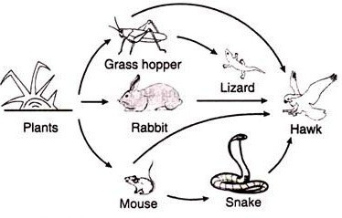
Unit 2: Ecosystem
Fig. 2.3: Grassland Ecosystem
Fresh Water Pond Ecosystem: The best example of fresh water ecosystem is a pond as it is a self regulating fresh water ecosystem. The abiotic and biotic components are as follows-
Abiotic components: The major components are heat, sunlight, water pH value and the basic organic and inorganic components of water like iron, magnesium, calcium, chlorides etc. The water also comprises of Colloidal suspensions, phosphate and nitrogen contents.
Biotic components: The biotic components of pond ecosystem are producers (plants), consumers (animals) and decomposers (micro-organisms).
Producers: The primary producers are the phytoplanktons. The majority of them are however
filamentous algae that float in water, e.g., Closterium, Cosmarium, Eudorina, Volvox, Spirogyra,Ulothrix, Oscillatria, Anabaena etc. The macrophytes which are mainly rooted larger plants like submerged and floating hydrophytes are the most important producers.These common plants include Trapa, Typha, Hydrilla, Lemna, Azolla, Sagittaria, Nymphaea, etc. Some photosynthetic bacteria are also present in the pond ecosystem.
Consumers: The Zooplanktons like Brachionus, Asplanchna, Lacane etc., protozoans like Dileptus, Coleps etc. and crustaceans like Cyclops, Stenocypris etc. are the primary producers which are the food for the secondary consumers like small fish, insect larvae, mollusks, mites etc. These secondary consumers are consumed by tertiary consumers like large fishes and birds like Herron, Cranes etc.
Decomposers: These are the micro consumers playing very important role in the decomposition of complex dead organic matter of both plants and animals to simple forms and thus returns the minerals to
the pond which can be used again by the producers. These include bacteria and fungal species like
Aspergillus, Cephalosporium, Cladosporium, Pythium, Penicillium, Fusarium,Alternaria, Rhizophora etc.

Slide 15
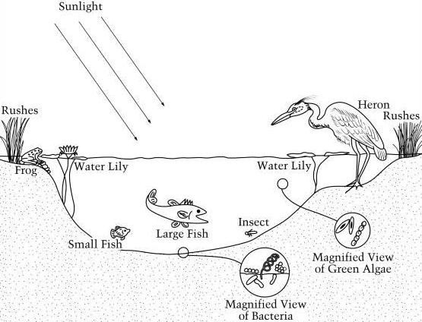
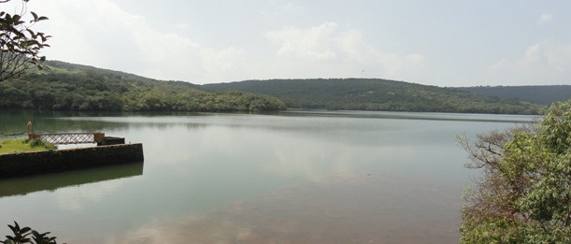
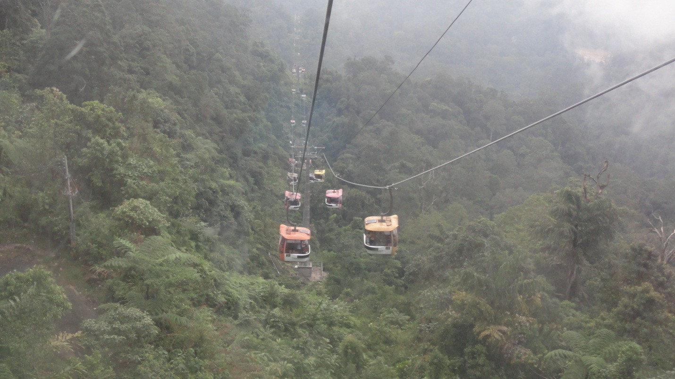
Unit 2: Ecosystem
Fig. 2. 4: Fresh water pond ecosystem
Kass lake Satara
Forest Ecosystem :

Slide 16
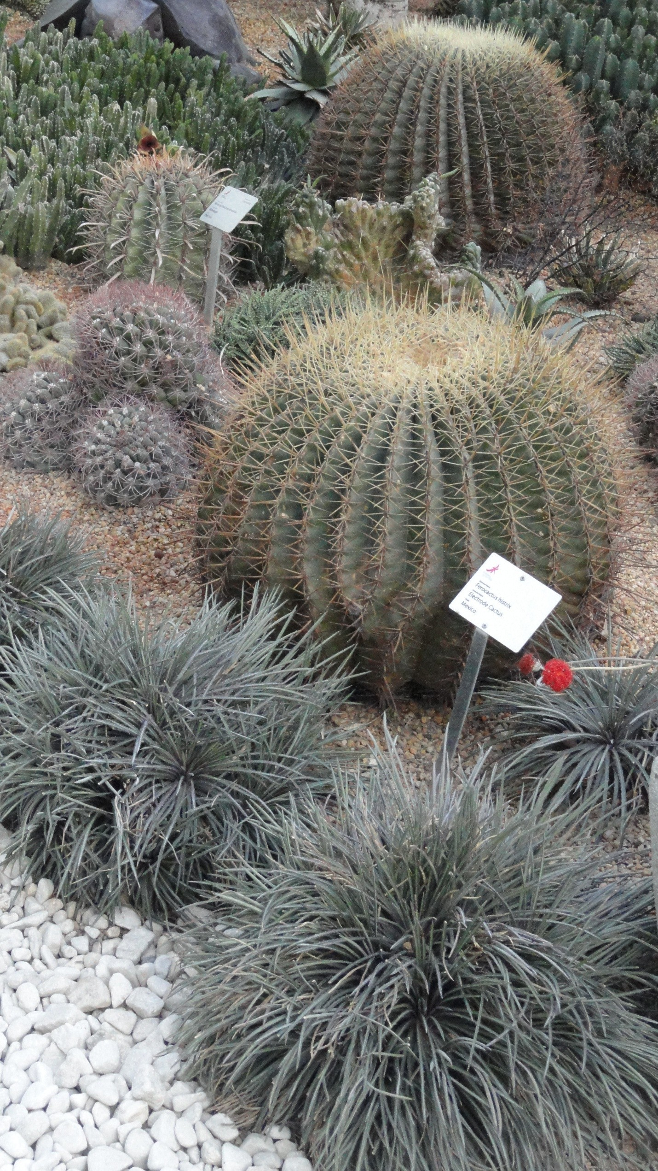
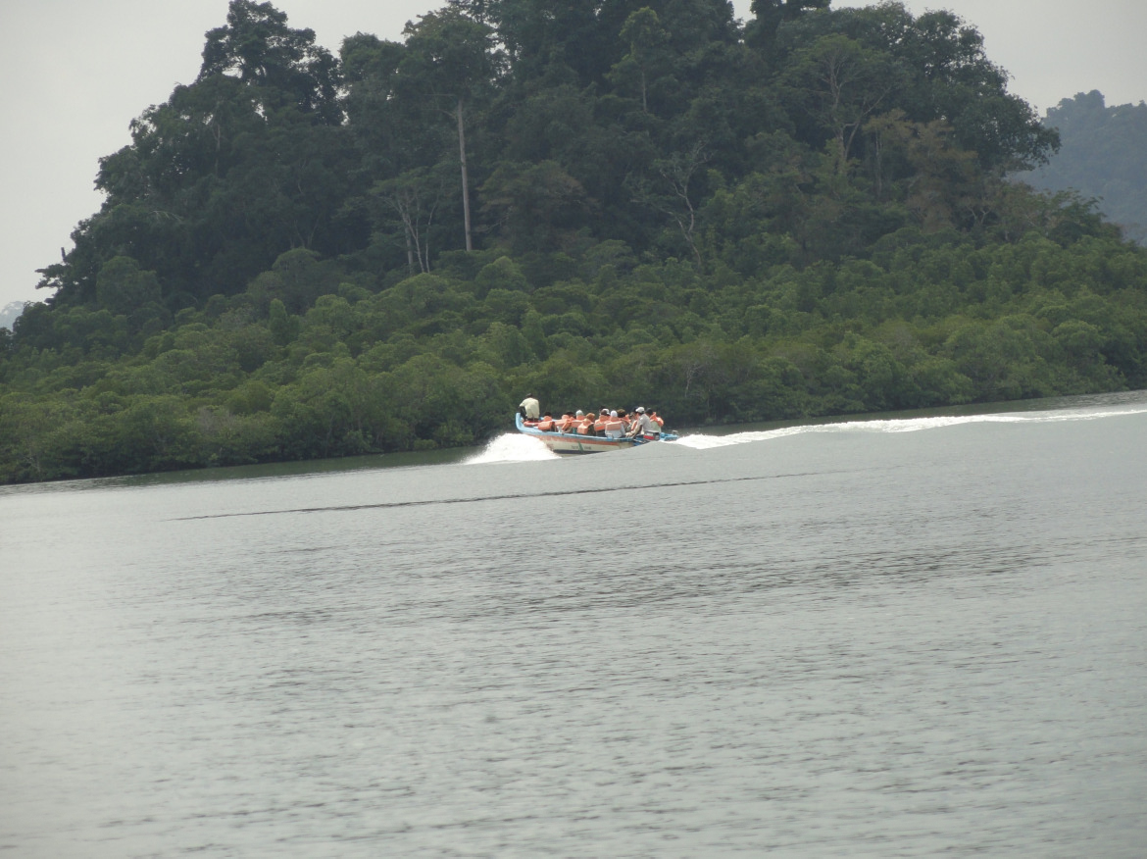

Unit 2: Ecosystem
Desert Ecosystem
Ocean Ecosystem

Slide 17
Unit 2: Ecosystem
Components and Organization of ecosystem:
Ecosystem is the biotic community together with the abiotic environment. Every ecosystem has
two basic components- i) Abiotic components (non-living) and ii) Biotic components (living) The relationship between the abiotic components and the biotic components of the ecosystem is termed 'holocoenosis'.
Abiotic components: These are the non-living components include climatic or physical factors edaphic factors and topographic factors. The climatic factors, including the climatic conditions with physical factors in the environment such as light, atmospheric temperature, wind, humidity, etc. while the edaphic factors are related to the composition and structure of the soil as well as chemical and physical properties of the soil - like the soil type, soil profile, organic matter in the soil, soil minerals, soil water, soil organisms, soil air and inorganic substances like water, carbon, sulphur, nitrogen, phosphorus etc. Topographic factors are related with geographical conditions of that particular area. These include altitude, latitude, mountain ranges, valleys, hilly regions and slopes etc.
Biotic components: These are the living organisms present in that particular ecosystem. These biotic components are differentiated into producers, consumers and decomposers also known as autotrophs, heterotrophs and saprotrophs respectively.
Producers: In any ecosystem, the plants are the producers or autotrophs which convert solar energy into chemical energy. They utilize sunlight as their energy-source and simple inorganic materials like water,
carbon dioxide and salts to produce their own food. The producers or a photosynthetic plant varies with the kind of ecosystem, e.g. In grassland ecosystem, grasses and herbs are main producers, in a dense forest the trees are the most important producers while in pond ecosystem, phytoplanktons usually algae and large rooted and floating hydrophytes are the producers.
Consumers: The animals are dependent on other living organisms for food , therefore, called
heterotrophs. These heterotrophs eat and consume the food which is made available by producers hence are called consumers. The primary consumers in an ecosystem are herbivores, which feed directly on the producers (green plants) e.g. grasshopper, rabbit, deer, cow, goat, sheep etc. and are called consumers of first order or primary consumers. However, primary consumers also vary with the kind of the ecosystem. For example, a deer or a giraffe is a primary consumer in a forest ecosystem, while a cow or a goat is a primary consumer in a grassland or crop ecosystem.
The carnivores feed on herbivores e.g. grasshopper is eaten by frog; frog is eaten by snake, and is the consumers of second order or secondary consumers. The hawk eats a snake, or a bird eats all types of fishes including carnivores. These are called the tertiary consumers or consumers of third order. Some ecosystems may have the top carnivores like the lion, tiger, eagle and vulture, which are not killed or rarely killed and eaten by other animals.
Decomposers: In every ecosystem, the role of decomposers is very important to maintain the nutrient cycle. Decomposers consume dead and decaying organic matter obtained from producers and consumers hence called as saprotrophs. The microorganisms like bacteria, some fungi, molds and mushrooms are the decomposers also known as scavengers. The microorganisms mainly the bacteria and fungi break down the complex compounds in simple substances usable by the producers. Decomposers are also called detritivores, when they break down animal and plant material called detritus.

Slide 18
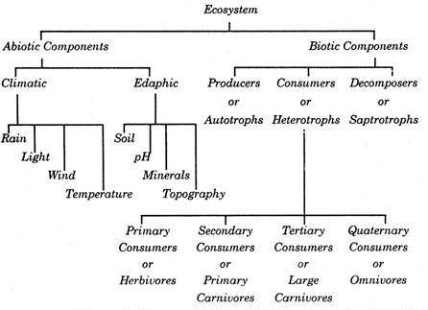
Unit 2: Ecosystem
Organization of ecosystem:
Thus, in the organization of any ecosystem four structural components are essential. In an
ecosystem, out of the four structural components three are composed of living things - green plants are the producers; animals, the consumers; and fungi and bacteria, the decomposers and another forth is abiotic component. These four components work together as a whole system to establish stable and self regulating ecosystem. The biotic components i.e. producers, consumers and decomposers (reducers) are related by the food mainly. In the process of photosynthesis, by using solar energy and inorganic substances, autotrophs or producers prepare their own food material. They not only make their food but also for the other organisms. The food and energy is transferred from producers to consumers of different orders. The heterotrophs or consumers obtain food from producers. The consumers are herbivores and carnivores type. The herbivores are the primary consumers or consumers of first order which feed on plants while carnivores are the secondary consumers or consumers of second order which feed on animals. The herbivore animals include grasshopper, rabbit, mouse, cow, deer and buffalo etc. The primary carnivore includes snakes, frog, jackal and birds. There are few organisms called third order consumers (tertiary consumers) which feed on the primary carnivore. It includes tiger, lion, and owl. There are few carnivores which are not consumed by any other organism and thus they are at top of the food chain also known as top carnivores. The reducers or decomposers are includes the bacteria and fungi. They decompose the food and act on dead plants and animals by secreting the digestive enzymes. The microorganisms absorb the digested food and the remaining food acts as a mineral back to the substratum. The detrivores are also known as scavengers which disposes the dead bodies. For the proper functioning of an ecosystem, abiotic factors are also very important. The climatic factors like sunlight, changes in the temperature and humidity, rainfall, mineral and substratum availability and edaphic factors related with the soil play a major role to determine the growth of ecosystem.
Fig. 2.5: Components of Ecosystem
Ecological pyramids: Ecological pyramid is a graphical representation to show the number of organisms, biomass and productivity at each trophic level in an ecosystem. The concept of ecological pyramid was developed by Charles Elton. Ecological pyramid begin at the bottom with the produces like green plants and they proceed through various trophic levels. Each ecological pyramid is represented by different

Slide 19
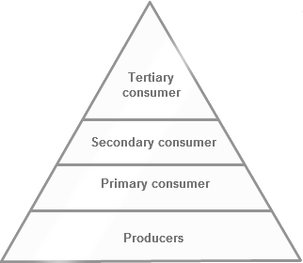
Unit 2: Ecosystem
trophic levels. The base of each ecological pyramid i.e. the first trophic level is represented by the produces (green plants). As the producer fixes the solar energy, there energy level is highest in the ecosystem. The primary consumers, like carnivores consume the producers represent the second trophic level. The primary carnivores consume the herbivores represent the third trophic level. The highest level is at the top represented by top carnivores which is the last trophic level in the trophic organization of the ecological pyramid. Ecological pyramid is also known as trophic pyramid or energy pyramid as it is very useful to understand the energy flow in the different ecosystems.
Fig. 2.6: Ecological Pyramid
In any ecosystem the trophic structure and the trophic function of the ecosystem may be shown graphically by means of ecological pyramids. In a food pyramid, the first trophic level forms the base and the last forms the apex. The base of ecological pyramid is generally formed by producers and successive trophic levels make up the apex. The ecological pyramids are of three types- pyramid of number, pyramid of biomass and pyramid of energy.
Pyramid of Number: The pyramid of number was advanced by Charles Elton (1927), who pointed out
the great difference in the number of the organisms involved in each step of the food chain. The pyramid of number shows numerical relationship and depicts the number of individual organisms at different trophic levels of food chain. The pyramid may be upright or inverted. The number of consumer decreases as the trophic level increases in upright pyramid of number (e.g. Pond ecosystem, grassland ecosystem, cropland ecosystem) while it increases in inverted pyramid of number (e.g. Single Tree ecosystem). Pyramid of numbers represents the total number of individuals of different species (population) at each trophic level. Depending upon the size, the pyramid of numbers may not always be upright, and may even be completely inverted.
Pyramid of Number: Upright
In this pyramid, the number of individuals is decreased from lower level to higher trophic level. This type of pyramid can be seen in grassland ecosystem, cropland ecosystem and pond ecosystem. In a
pond ecosystem, the base of the pyramid is occupied by producers, such as diatoms and algae, whose number is maximum. The second trophic level is represented by zooplanktons, which are primary consumers and are less abundant than the producers. The third trophic level is represented by medium- sized fishes which feed upon primary consumers, these are still smaller in number. The apex or fourth trophic level is represented by large fishes which are very few in number. Similarly in a grassland/cropland

Slide 20
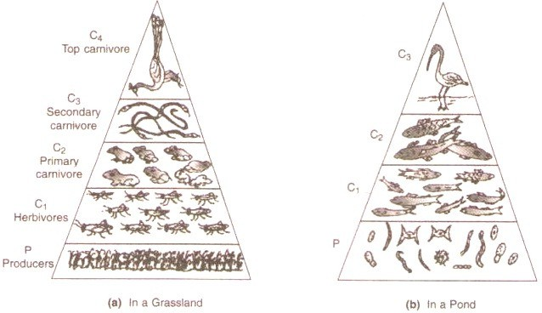
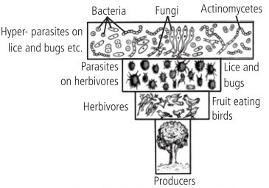
Unit 2: Ecosystem
ecosystem, the grasses and some herbs occupy the base of the pyramid i.e. first trophic level because of their abundance. The next higher trophic level is primary consumer – herbivore (example – grasshopper).The individual number of grasshopper is less than that of grass. The next energy level is primary carnivore (Ex: rat).The number of rats are less than grasshopper, because, they feed on grasshopper. The next higher trophic level is secondary carnivore (Ex: snakes). They feed on rats. The next higher trophic level is the top carnivore. Ex: Hawk. With each higher trophic level, the number of individual decreases.
Fig. 2.7: Upright pyramids of numbers
Pyramid of Number: Inverted
In parasitic food chains the pyramid of numbers is reversed. In this pyramid, the number of individuals is increased from lower level to higher trophic level. e.g. Tree ecosystem. In this single tree
ecosystem, a tree is a producer forms a base of pyramid and a large number of fruit or seed-eating birds are the primary consumers which in turn are infested by a large number of ecto- and endoparasites like bugs, mites, lice etc. These secondary consumers are large in number.
Fig. 2.8: Inverted Pyramid of Number

Slide 21
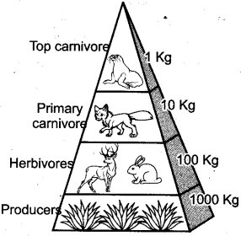
Unit 2: Ecosystem
Pyramid of Biomass: The biomass is the organic matter or the total dry matter of the members of the food chain present at any one time per unit area of an ecosystem. The pyramid of the biomass can be represented in terms of weight of organisms at each trophic level. The pyramid of biomass indicates decrease of biomass in each tropical level from base to apex. The biomass production varies in different ecosystems. The pyramid of biomass may be upright or inverted.
Pyramid of Biomass: Upright - Ex. Grassland ecosystem, Tree ecosystem.
In grassland ecosystem, the first trophic level is represented by the large numbers of grasses which
are the producers. So the biomass of grasses is maximum at first trophic level and it gradually decreases towards the next trophic levels as the number of consumers is decreased. The total biomass of the producers is consumed by primary consumers or herbivores. The primary consumers are eaten by secondary consumers. The biomass of producers is more than the biomass of secondary consumers. The greater biomass at the first trophic level makes the biomass pyramid upright in grassland ecosystem.
In the single tree ecosystem, a tree is a producer forms a base of pyramid and a large number of
fruit or seed-eating birds are the primary consumers which in turn are infested by a large number of ecto- and endoparasites like bugs, mites, lice etc. As the pyramid of biomass is considered, the biomass of the tree is maximum and the biomass of secondary consumers is the minimum though the number of secondary consumers is large so the pyramid of biomass in the tree ecosystem is upright.
Fig. 2.9: Grassland Ecosystem- An upright pyramid of biomass Pyramid of Biomass: Inverted - Ex. Pond ecosystem.
If the size of organisms at first trophic level is smaller than those of next trophic levels, the biomass pyramid may be inverted. In pond ecosystem, phytoplanktons are the producers. The size of producers is small than that of the primary consumers and secondary consumers. At the first trophic level, the biomass pyramid shows the phytoplanktons which are with less biomass than that of the primary consumers and secondary consumers which makes the pyramid inverted.

Slide 22
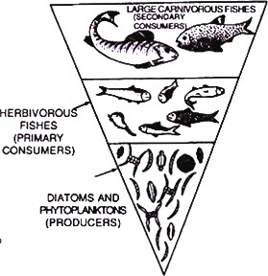
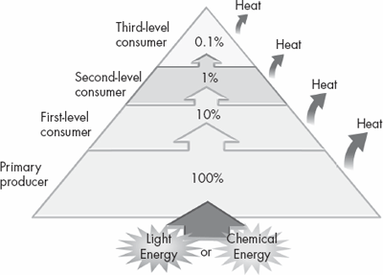
Unit 2: Ecosystem
The pyramids of biomass in aquatic habitats are of inverted type. In this pyramid, the combined weight of producers is smaller than the combined weight of consumers.
2.10: Pond Ecosystem- An inverted pyramid of biomass
A pyramid of energy shows the flow of energy at different trophic levels of a community and it describes the overall nature of the ecosystem. The shape of energy pyramid is always upright or triangular and vertical as it represents the amount of energy at each trophic level and loss of energy at each transfer to another trophic level. The pyramid of energy indicates not only the total amount of energy flow at each trophic but also the role of organisms in the transfer of energy in an ecosystem in limit area over a set period of time usually per square meter per year. This pyramid is most suitable to know the functional roles of the trophic levels of an energy pyramid. The energy flows from the producer level to the consumer level. During this flow of energy from one trophic level to other, considerable loss of energy at each transfer take place in the form of heat and respiration, etc. The maximum energy is available at the base of pyramid i.e. at producer level which decreases at each trophic level and minimum energy is available at tertiary consumer level.
In grassland ecosystem, grasses are the primary producers which fixes large amount of energy and
make it available to consumers of different orders and finally for top carnivores. In pond ecosystem, phytoplanktons are the producers. The maximum light energy is trapped by them. Then the amount of energy decreases towards consumer level.
Fig. 2.11: Energy flow in ecosystem

Slide 23
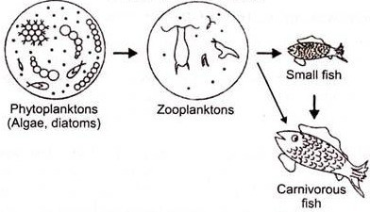
Unit 2: Ecosystem
Food chains and food webs:
Food chains: In any ecosystem, food relations are very complex. The flow of energy within ecosystem is
important as organisms of the ecosystem need energy in the form of food and sun is the ultimate source of this energy. The green plants are called producers as they produce their own food through photosynthesis. They convert sunlight energy into the chemical energy of food. Animals are consumers because they cannot produce their own food. The producers are eaten by primary consumers i.e. herbivores to get the energy. The primary consumer is then eaten by a secondary consumer. And the secondary consumer may be eaten by a tertiary consumer, and so on. In this way energy gets transferred from one consumer to the next consumer. The flow of energy in an ecosystem is one way process i.e. in a definite sequence or in a chain known as food chain. The food chain is defined as, “A series of organisms through which food energy flows in an ecosystem” or “Food chain is the sequence of organism through which the energy flows”. In simple way food chain is stated as “transfer of food energy from producers to consumers of different orders and decomposers as organisms eat and being eaten by other organisms”. Each food chain shows definite trophic levels and results in the establishment of food pyramids in the community. A food chain always begins with producers. Herbivores (plant-eaters) come next in the chain which is consumed by carnivores (flesh-eaters). A few food chains can be long and may extend to the fourth, fifth or even sixth order of consumers.
A food chain may be represented as –Green plants → Herbivores → Carnivores → Microorganisms or Producers → Primary consumers → Secondary consumers → Tertiary consumers→ Decomposers.
A food chain in grassland ecosystem begins with grasses, herbs passes through insects like grasshoppers
and animals like a Frog, Snake, and a Hawk.
Grasses and herbs → Grasshopper→ Frog→ Snake→ Hawk
A food chain in pond ecosystem starts with phytoplanktons as producers and passes through Zooplanktons, Small fish, large fish and a Bird.
Phytoplanktons → Zooplanktons → Small fish → large fish → Bird
The food chains are of three types like grazing or predator food chain, parasitic food chain and detritus or saprophytic food chain.
Grazing Food Chain or Predator food chain: In grazing food chain, the consumers utilizing plants as
their food. This food chain begins from green plants like herbs, shrubs and grasses. The primary
consumers are herbivores. This type of food chain in ecosystem is directly dependent on solar energy. Most of the ecosystem follows this type of food chain. Ex: grass → rabbit → fox, grass→ grasshopper → birds →falcon, Phytoplanktons → Zooplanktons→ Fishes etc.
Fig. 2.12: A grazing food chain in a pond ecosystem

Slide 24
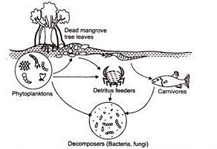
Unit 2: Ecosystem
Detritus food chain or Saprophytic food chain: In this type of food chain plant material is converted into dead organic matter, detritus. The food chain starts from dead organic matter of decaying animals and plant bodies to the micro-organisms and then to detritus feeding organism and to other predators. The food chain is less dependent on direct sunlight but is mainly depends on the influx of organic matter produced in another system. The organism of the food chain includes algae, bacteria, fungi, protozoa, insects, nematodes etc.
The mangrove ecosystem is the good example of detritus food chain. The saprophytic organisms
like bacteria, fungi, protozoa attacks on the fallen twigs, fruits and leaves of the mangrove plants. The pieces of litter are being eaten by smaller animals such as millipedes, copepods, insect larvae, nematodes, shellfish, snails crabs, marine worms and mollusks, which are detritus eaters and become ultimate food for large fishes which are being eaten by top carnivores like birds such as herons, sea-gull etc.
Fig. 2.13: A detritus food chain in mangroove ecosystem Significance of Food Chain:
The food chain is important to understand the feeding relationship and the interaction between organism and ecosystem.
It is also helpful to know the mechanism of energy flow and circulation of matter in ecosystem.
It also helps to understand the movement of toxic substance and the problem associated with biological magnification in the ecosystem.
Food webs: There are several interlinked food chains in a community. One food chain may be linked with
another and one animal may be a link in more than one food chain e. g. Snakes feed on mice (herbivores) as well as frogs (carnivores). Wild cats prey upon mice as well as birds and squirrels. A wolf eats not only fox but also rabbit and deer. Therefore, the concept of food web appears more real ecologically than the concept of a simple food chain.
The various interlinked food chains in a community constitute a food web, or food cycle which is
also known as consumer-resource system. Food web can be defined as; "a network of food chains which are interconnected at various tropic levels, so as to form all the feeding relationships amongst different organisms in an ecosystem ". or “ A Food Web is a combination of many different food chains, showing the interrelationships between and among many different producers and consumers in an ecosystem”.
In a food web, 3 types of food chains may be present such as-
Predator chains which begins with plants and proceeds from small to large animals.
Parasitic chains which proceeds from large to small organisms.

Slide 25
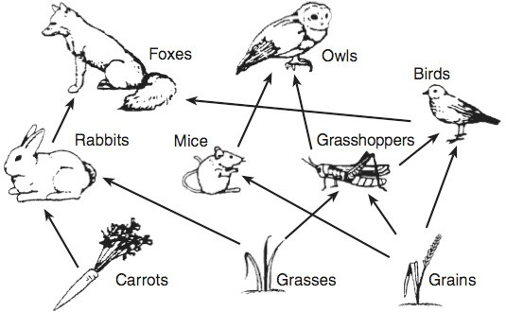
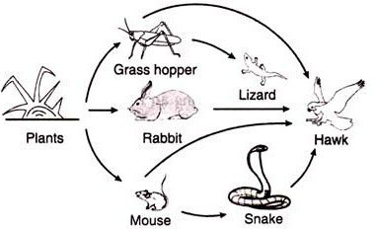
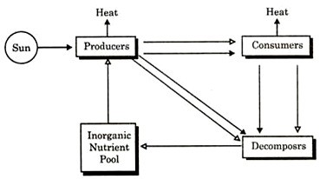

Unit 2: Ecosystem
Saprophytic Chains that proceeds from dead animals to microorganisms.
Significance of Food Web:
Food webs distinguish levels of producers and consumers by identifying and defining the importance of animal relationships and food sources, beginning with primary producers such as plants, insects and herbivores.
Food webs are important in understanding that plants are the foundation of all ecosystems and food chains.
The food web maintains the stability of the ecosystem.
Fig. 2.14: A food web in a grassland ecosystem
Fig. 2.15: A food web in a grassland ecosystem
Energy Flow in Ecosystem:
2.16: Energy Flow in Ecosystem

Slide 26
Unit 2: Ecosystem
Energy flow is the one of the most fundamental processes and it is common to all the ecosystems. In any ecosystem, flow of energy and cycling of nutrients is essential to stable the ecosystem. Energy flow is the movement of energy, starting with the sun, and passing from producers to consumers. It is basically the movement of energy in an ecosystem through a series of organisms. The sun is the only source of energy for ecosystems. The green plants absorb this solar energy and convert it into chemical energy in the process of photosynthesis to make food. The plant uses 90% of this chemical energy for different metabolic functions and remaining 10% is made available to the primary consumers i.e. herbivores. The herbivores uses 90% energy and remaining 10% passes to next trophic level. In ecosystems, the flow of energy is one way i.e. unidirectional flow of energy. Energy comes in the ecosystem from sun which captured by autotrophs does not go back to the sun. This energy then passes from autotrophs to herbivores does not revert back and as it moves progressively through the various trophic levels, it is no longer available to the previous levels. The progressive decrease in energy level occurs at each trophic level as most of the energy is released in the environment in the form of heat. Processes that reduce the energy transferred between trophic levels include respiration, growth and reproduction etc. Energy is not recycled during decomposition, but rather is released, mostly as heat. The amount of energy that made available to different consumers in various trophic levels in the system depends on the productivity of that ecosystem.
Productivity of Ecosystem: Primary, Secondary and Net Productivity!
The productivity of an ecosystem refers to the rate of biomass production i.e., the amount of dry matter produced per unit area of land, per unit time. Productivity in ecosystems is of two types, i.e., primary, secondary and net productivity.
Primary productivity: Primary productivity is the rate of energy capture by producers. Green plants absorb sunlight energy and accumulate it in organic forms as chemical energy and this is the first and basic form of energy storage. The rate at which the energy accumulates in the green plants or primary producers is known as primary productivity. Primary productivity is defined as “the rate at which solar energy is stored by photosynthetic and chemosynthetic activities of the primary producers.” Primary productivity is the rate of energy capture by producers.
Primary productivity= the amount of new biomass of producers, per unit time and space. Primary productivity is further divided into following types-
Gross primary productivity: The gross primary productivity (GPP) is the total solar energy trapped in the organic matter in plant tissues by photosynthesis. This is also referred as Total (Gross) Photosynthesis or Total Assimilation. However, a good fraction of gross primary productivity is utilized in respiration of green plants.
Gross primary production (GPP) = total amount of energy captured.
Net primary productivity: The net primary productivity (NPP) is the amount of energy- bound organic matter created per unit area and time that is left after respiration. This is also known as Apparent Photosynthesis or Net assimilation. The rate of biomass production is increased. Thus net primary productivity refers to balance between total photosynthesis and apparent photosynthesis. Net primary productivity (NPP) results in the accumulation of plant biomass, which serves the food of herbivores and decomposers. Net productivity of energy = GPP — Energy lost in respiration.
Net primary production is thus the amount of energy stored by the producers and potentially available to consumers and decomposers.

Slide 27
Unit 2: Ecosystem
Secondary productivity: Secondary productivity is the rate of production of new biomass by consumers, i.e., the rate at which consumers convert organic material into new biomass of consumers. The secondary productivity simply involves the repackaging of energy previously captured by producers, no additional energy is introduced into the food chain. The accumulation of plant biomass serves as the food of herbivores, carnivores and decomposers. The consumers only utilize already produced food material in their respiration, simply converting the food matter to different tissues. Odum (1971) prefer to use the term assimilation rather than ‘production’ at this consumer’s level. The secondary productivity depicts only the utilization of this food for the production of consumer biomass. The secondary productivity is the rate of energy storage at consumer’s levels i.e. heterotrophic organisms which keeps on moving from one organism to another. Hence, secondary productivity is the productivity of animals and saprobes in ecosystem.
Net Productivity: All the synthesized organic matter is not consumed by the heterotrophs which has been left over by the consumers or heterotrophs. It is thus the rate of increase of biomass of the primary
producers during the unit period, as a season or year etc. It refers to the rate of storage of organic matter not used by the heterotrophs or consumers, i.e., equivalent to net primary production minus consumption by the heterotrophs during the unit time. Net productivity of ecosystem is equivalent to the net amount of primary production after the costs of respiration by plants, hetertrophs, and decomposers are all included. Therefore, NEP (Net Ecosystem Productivity) = GPP - (R_{p}+ R_{h}+R_{d}). Where- R_{p}=Respiration by Plants, R_{h}= Respiration by Heterotrophs, and R_{d}= Respiration by Decomposers
Ecological Sucession :
Concept and Process Concept
Plant communities are not stable but dynamic. They keep changing more or less regularly over time and space. One community is constantly replaced by other community. Gradual replacement of one type of plant community by other is known as “Plant succession”. The sequence and direction of change is generally from simple to complex. . This process continues till a stable community gets established. The succession is defined as, the occurrence of relatively definite sequence of communities over a period of time in the same area”. It is also described as “the gradual replacement of one type of plant community by the other”. Halt (1885) used for the first time the term succession for the orderly changes in communities. Clements (1916) defined succession as “the natural process by which the same locality becomes successively colonized by different groups of communities”.

Slide 28
Unit 2: Ecosystem
Process:
Nudation
Invasion
Competition and co-action
Reaction
Climax
Succession is a series of processes. It is completed through a number of sequential steps viz.: (I) Nudation, (II) Invasion, (III) Competition and co-action, (IV) Reaction and (V) climax (stabilisation ).
Nudation:
It is a canvas for new painting , the formation of bare area. The causes of nudation may be
Topographic factors: These include erosion, deposition of sand, land slides, volcano etc.
Climatic factors: Glaciers, storm, frost, fire etc. may destroy vegetation.
Biotic factors: Disease and pest attack, destruction of forests, grass lands for industry, housing, and roads.
Invasion (Entry): This refers to entry of new organisms and formation of community. It is completed
by:
Migration:It is the transfer of genetic load from one place to another in the form of seeds, spores, propagules in the new area by winds, water, animals etc.
Ecesis: The new migrants adjust with new climate and establishment occurs. This is known as ecesis.
Aggregation: The increase in number of individuals by colonization and reproduction is known as aggregation.
Competition and Co-action: Due to aggregation, competition starts between the species or within the species (Inter or Intra) for space, light, food etc. In competition those which can adjust will survive and increase in population. The weaker ones will gradually disappear. Individual species affect each other’s life in various ways. This is called co-action.
Reaction: It is the mechanism of modification of the environment through the effect of living
organism on it. As a result of reactions, changes take place in soil, water, light conditions, temperature of environment. These changes become unfit for the existing community which sooner or later is replaced by another community.

Slide 29
Unit 2: Ecosystem
V) Stabilization: Due to ‘reaction’ the climate changes, it becomes less favorable for the existing and more favorable for new invaders. The old ones are replaced by new. As plant succession progresses the animals in the community also change. In this way gradual evolution takes place and finally a stable or permanent community is formed. Such a condition is called stabilization. The stabilized community is called climax community of ecological succession. Community and climate are in complete harmony.
Primary and Secondary Succession
Succession is the concept that communities proceed through a predictable, step-by-step process of change over time. Through the process of succession, the original species colonizing site may be replaced completely or they simply become less numerous as different species emerge. For the development of succession bare area is necessary. Depending upon the nature of bare area the succession is divided into two types.
Primary Succession: The succession which starts on a bare area and one that was not occupied
previously by any vegetation is called primary succession. e.g. rock, sand dunes or lake. In primary succession the growth of an ecosystem takes place gradually over a long period of time. The example of primary succession may be a new land formed after volcanic eruption and cooling of lava. This new land will be barren without any living organism. But after some time, simple plants will begin to colonize the new land. The plants that are first to grow and aggregate are called ‘Pioneers’, primary community or primary colonizers. Typical pioneer species may be lichens, algae and fungi. These plant species carry out their life processes, they produce waste and some die. This leads to the formation of organic material that will become soil. After the formation of soil on the top of cooled lava, these simple organisms interact with the environment and make it suitable for the later introduction of more complex species like vascular plants including herbs, shrubs and trees.
Secondary succession: Secondary succession begins on an area, which was previously occupied by well developed communities. The communities might have been lost due to fire, cyclones, land slide, drought, flood etc. The area is usually rich in nutrients hence secondary succession is faster and takes place in shorter period. For example, revival of a forest after a fire, the forest fire destroys different plant species that are growing in the forest. However their seeds, underground organs like bulbs, tubers , some aerial shoots and roots remain in and on the soil. After receiving rain showers gradually the plants and trees begin to grow again and eventually return to the state of the original ecosystem.

Slide 30
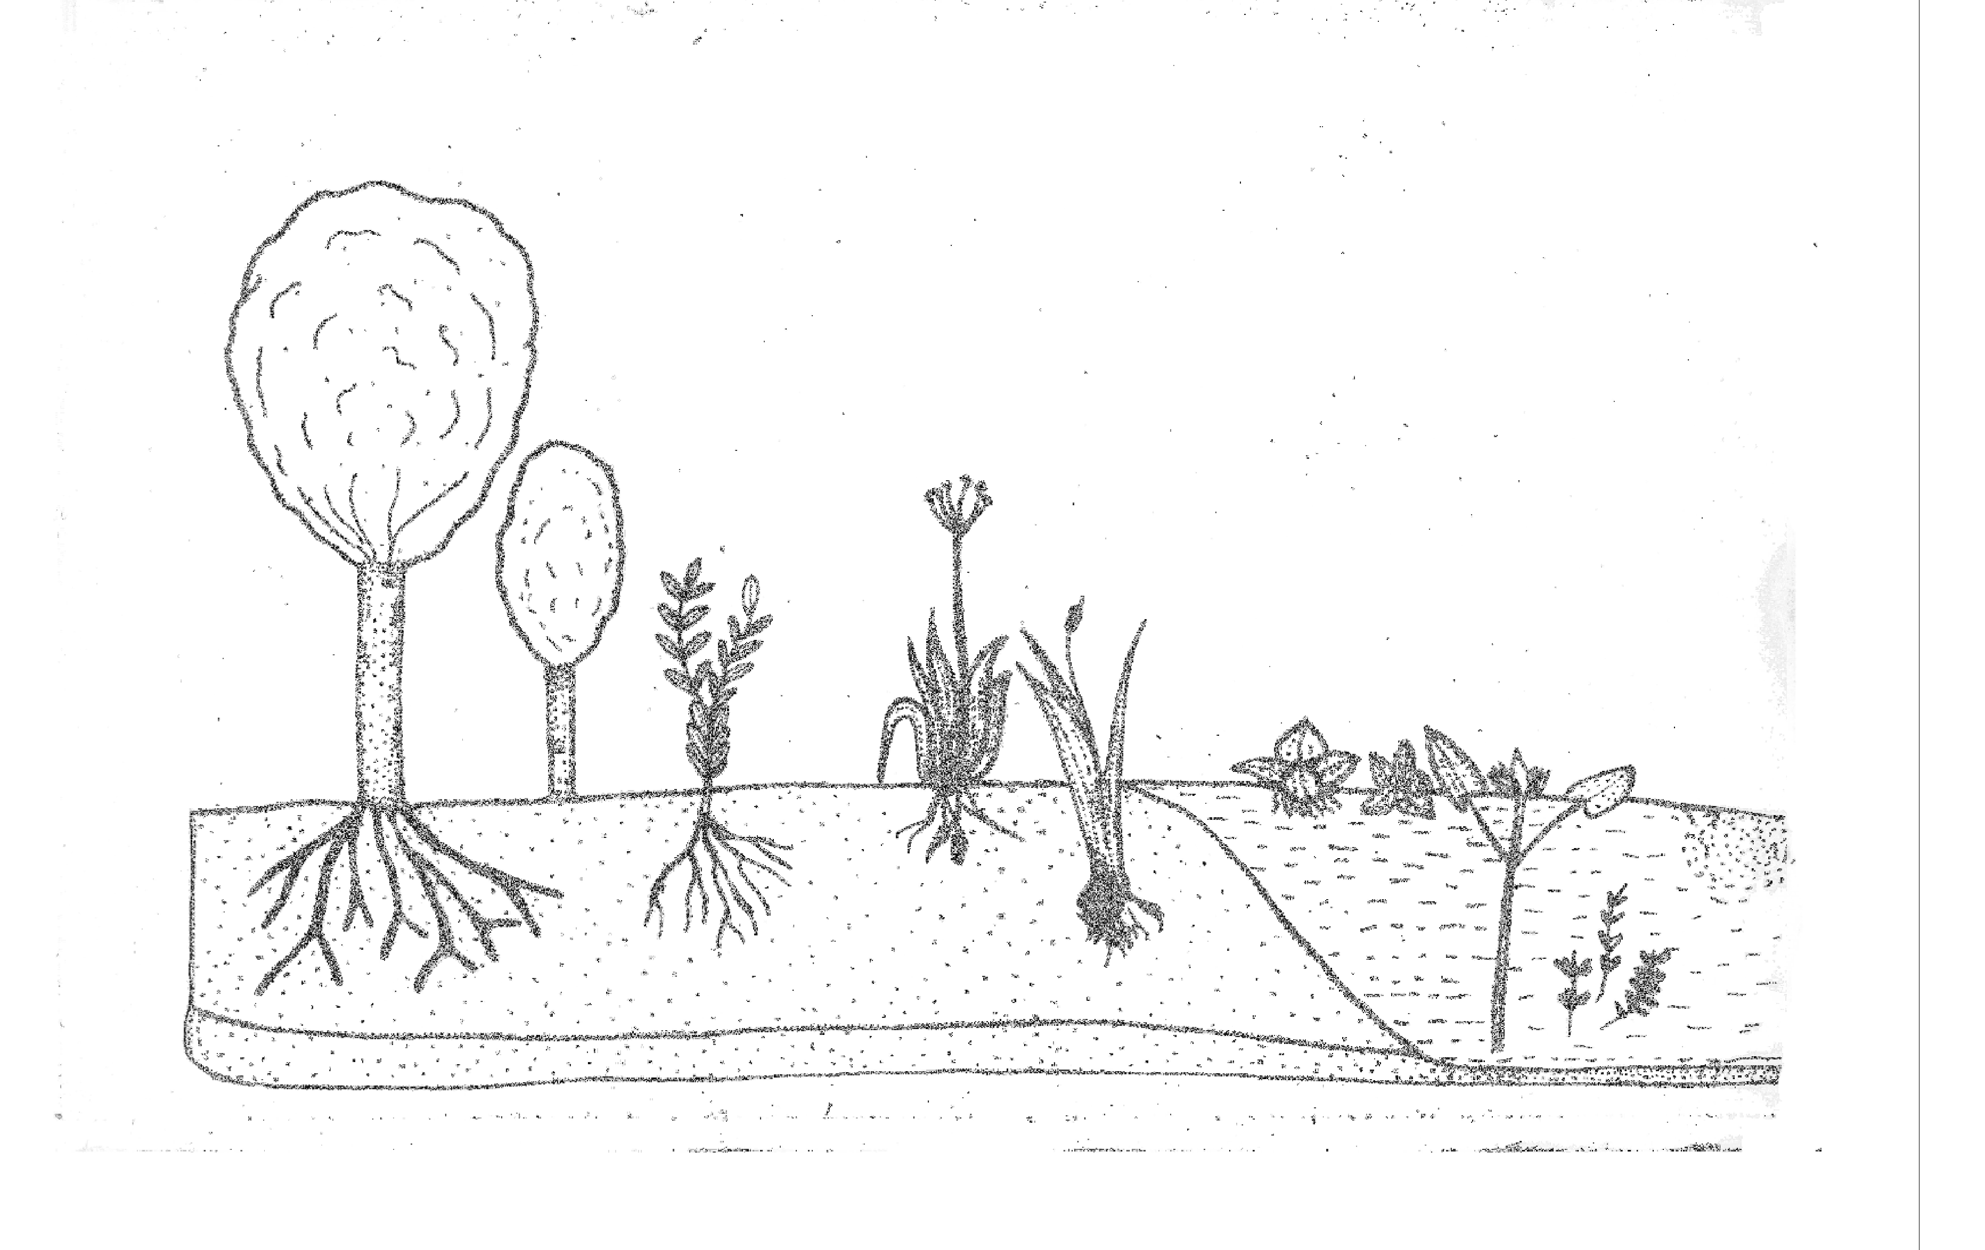
Unit 2: Ecosystem
Hydrosere and Xerosere
Hydrosere : Fig.2.17
CLIMAX
7
6
5
4
3
2
1
Fig. 2.17: HYDROSERE
Succession beginning in aquatic environments like ponds, lakes etc. is called hydrarch succession. The different stages of hydrarch succession are called hydroseres and are as follows:
Phytoplankton Stage
In the hydrarch succession phytoplanktons and zooplanktons are the pioneer colonisers. Blue green algae, green algae, diatoms and bacteria are the first organisms to colonise. All these organisms add large amount of organic matter after their death. This matter settles at the bottom of pond and forms organic manure. These phytoplanktons occur at a depth of 20 to 10 feet in water.
Submerged Stage
The phytoplankton stage is followed by submerged stage. Due to sedimentation, the soil settles at
the bottom of the pond and organic matter is added to this soil. As a result the soil level increases and water depth decreases. This condition, replaces phytoplanktons by submerged hydrophytes like Chara, Vallisneria, Elodia, Hydrilla, Potmogeaton, etc. The submerged hydrophytes form a tangled mass and have marked effects upon the habitat. When these plants die their remains add at the bottom of the ponds and form fertile soil. This process makes the pond shallow and becomes unfit for the survival of submerged plants.
Floating Stage
Decreased water level and the accumulation of sediments, dead organic matter leads to the
appearance of fixed floating hydrophytes like Lotus, Nelumbo, Trapa, etc. as well as some free floating hydrophytes like Azolla, Eichhornia, Pistia, etc.

Slide 31
Unit 2: Ecosystem
The sedimentation of soil particles and deposition of organic matter further continues and pond becomes shallow. This habitat is unfit for floating plants and they disappear. This area is now fit for the growth of reed swamp plants.
Reed Swamp Stage
The amphibious plants like Typha, Sagittaria occupy and become dominant by replacing floating
plants. These plants have well developed rhizomes and form dense vegetation. This vegetation makes the area still shallower due to high transpiration, evaporation, sedimentation and deposition of organic matter. The habitat is more suitable for marshy plants. The animals like water scorpion, beetles, ducks, kingfishers, etc now start appearing.
Sedge Meadow Stage or Marsh Meadow Stage
Due to the action of reed-swamp plants, deposition of organic matter and sedimentation of soil leads to loss of reed swamp plants and invasion of sedges like Juncus, Carex, Polygonum, Cyperus, Grasses, etc. They aggregate and establish. These plants again react upon the habitat. They transpire enormously as a result the water in the soil becomes less. Marsh-meadow plants cannot survive in such dry soil. These are gradually replaced by shrubs later by trees.
Wood-land Stage
Due to the disappearance of marshy vegetation the area is invaded by terrestrial shrubs and trees and wood-land stage is developed. Some medium sized trees like Cassia, Populus, Terminalia appear and
form wood lands. These plants produce more shade, thus shade loving herb and shrub plants invade. The humans content in the soil increases with rich flora of micro organisms. In this fertile soil, herbs, shrubs, trees, climbers, etc. will start invading and establishing.
Forest Stage
This is the climax community. It is represented by all types of plants. The area is completely covered by herbs, shrubs, trees and climbers. Innumerable animals, like herbivorous, carnivorous, will
invade and form climatic climax.
In tropical climates with heavy rainfall tropical evergreen forest develops, whereas in temperate regions temperate forests develop. In tropical moderate rainfall area tropical deciduous forests are formed.
Xerosere (Fig.2.18)
Succession beginning in dry conditions is called xerarch succession. The different stages of xerarch
succession are known as xerosers. Here, crustose lichens are the pioneers. The sense of successive changes finally form climax forests.

Slide 32
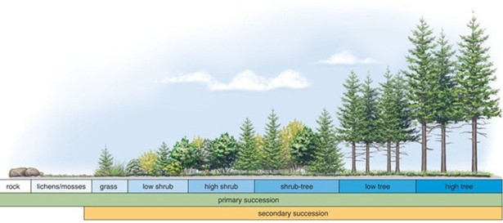
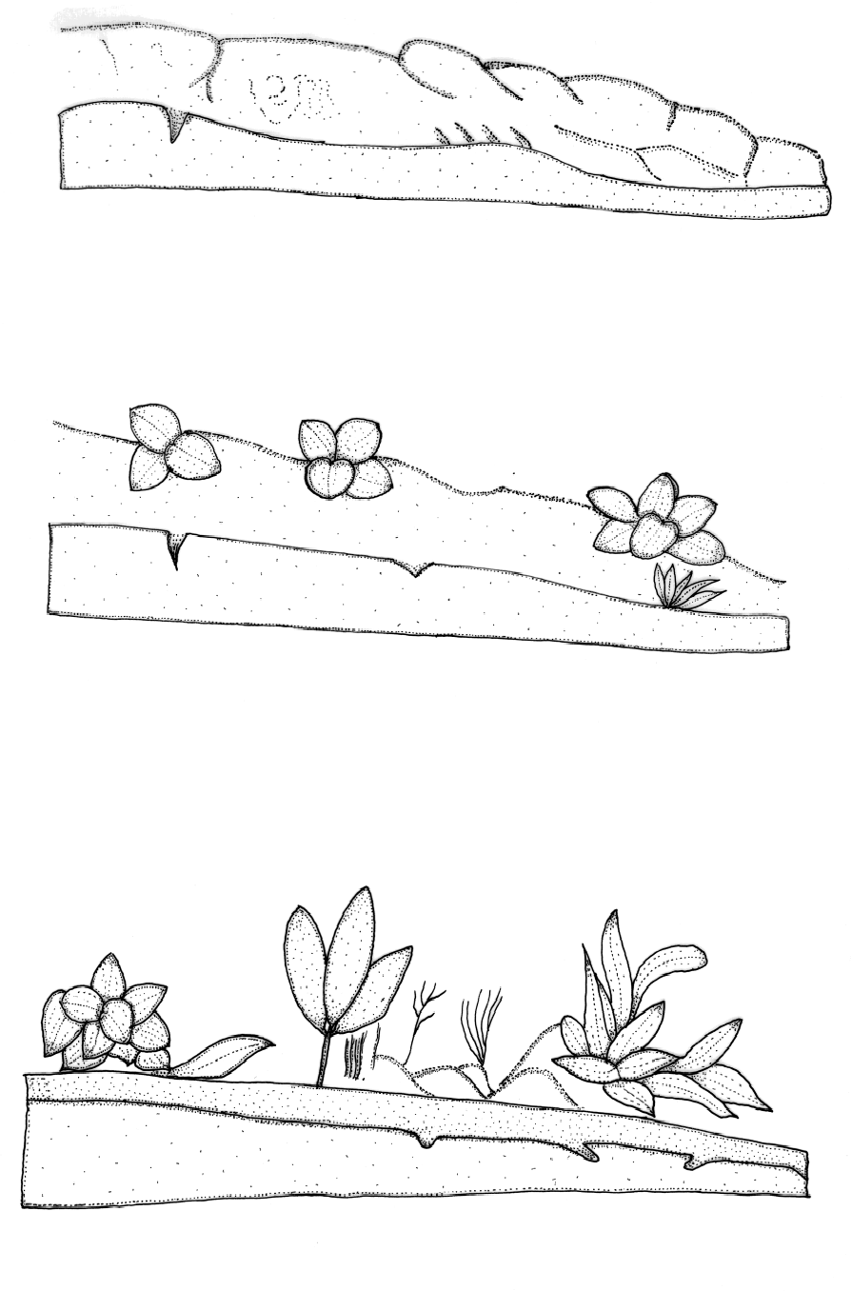
Unit 2: Ecosystem
Fig. 2.18: Xerosere
CRUSTOSE LICHEN STAGE
MOSS STAGE
HERB STAGE

Slide 33
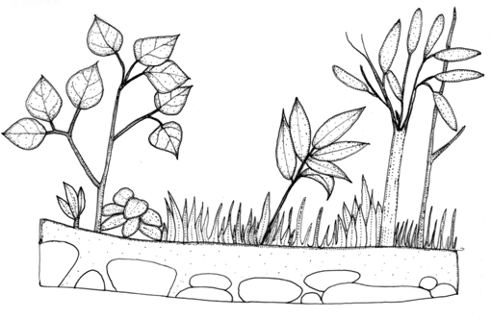
Unit 2: Ecosystem
CLIMATIC CLIMAX TREE STAGE
Fig. 2.19: Stages in Xerosere
Crustose Lichen Stage
Crustose-lichens are the pioneers of xerarch succession. These grow on bare- rocks. They tolerate
extreme deficiency of water, nutrients,high light intensity and high temperature . The spores, soredia or fragments of these lichens migrate to rocks through air. These lichens obtain minerals from rock by secretion of carbonic acids. It dissolves rock surface and loosens the rock particles. These particles with decaying lichen thalli from the first thin layer of soil on rock surface.
The crustose lichens like Rhizocarpon, Rinodina, Laconora, etc. grow on rocks. These crustose lichens are gradually replaced by foliose lichens, when some amount of soil forms on the rock surface.
Foliose lichen Stage
Foliose lichens develop on the rock partially covered by soil particles and crustose lichen. Foliose
lichens like Parmelia, Dermatocorpon completely cover crustose lichens. As a result light is cut off to crustose lichens which leads to the death and decay of crustose lichens. Thus organic matter is added to the soil. The foliose lichens secrete acid which causes disintegration of rock and formation of fertile soil. The water holding capacity of soil also increases due to the addition of humus (organic matter). Such area is unfit for foliose lichen and conducive for mosses.
Moss Stage
Mosses like Polytrichum, Funaria, Bryum, etc. invade humus-rich soil where foliose lichens are growing. The mosses compete with foliose lichen and they are completely replaced by moss. The mosses
form a thick mat, their rhizoids secrete acid and help in the rapid degradation of rock. The addition of dead matter increases humus in the soil. This leads to the formation of fertile soil with more water holding capacity. This habitat later becomes unfit for the mosses and fit for herbaceous plants.
Herb Stage
The seeds of xerophytic plants like grasses brought by wind or birds germinate and grow with
mosses. Later the mosses die due to the shade resulting from the growth of herbs. Thus, herbs dominate. The disintegration of rock and formation of soil further increases. As a result rich soil with many micro- organisms favors the entry of shrub plants.

Slide 34
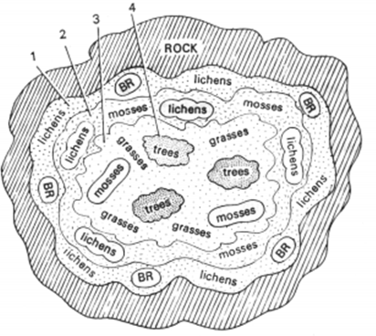
Unit 2: Ecosystem
Shrub Stage
The changed habitat and climatic condition lead to the invasion and establishment of shrubs. This
further enhances the soil formation due to disintegration of rock. Humus also increases due to the addition of dead herbs and parts of shrubs. The climate becomes cooler and soil becomes more fertile. Such climate is fit for xerophytic trees.
Forest Stage
In this stage some xerophytic trees invade. The increasing soil formation, humus content, cool
climate favor the invasion and establishment of more trees. The mesophytic plants completely occupy and develop the forest. Below the big trees, shade loving small trees and shrubs grow and replace the previous xeric plants. The forest floor is covered by some bryophytes, ferns, shade loving herbs, shrubs, climbers, epiphytes, etc. Thus finally climax community establishes.
Climatic Climax
In the succession, the competition starts among different group of plants. Only those species
which adjust to the environment will survive and multiply. The plants interact with the habitat and modify the environment. Once illuminated areas become shaded and dry area becomes moist. Thus changed climate becomes less favorable for the existing species and fit for the invaders. Old vegetation is replaced by the new one. Gradual changes occur and finally a stable community establishes and reaches climax. Here, no further changes occur. This stable community is called climax community and the existing climate is said to be attended climatic climax.
Fig. 2.20: Diagrammatic representation of Xerosere

Slide 35
Unit 3: Natural Resources- Renewable and non Renewable Resources
Unit 3
Natural Resources- Renewable and non Renewable Resources
With phenomenal rise in human population, natural resources are being heavily taxed all over the world. No doubt at present, total global production is nearly enough to match the human demands for energy and materials if we judiciously distribute the resources available to us. However, looking forward to future scenario, the situation appears pretty grim. Nearly all-agricultural production, produce to animal husbandry, the world fisheries etc. have to be diverted to support the human society. While the number of mouths to be fed is regularly rising, degradation of natural ecosystems, deterioration of fertile soils and pollution of environment threatens world food production. In near future, it will be difficult for the world food production to keep pace with the growing demands.
Whit Is A Natural Resource ?
Anything, which is useful to man, or can be transformed into a useful product or can be used to produce a useful thing, can ebb referred to as a resource. A natural resource is the resource obtained from
nature. It is these natural resources, which form the very basis of entire life on this planet. A natural resource can be of the following two types:
Biotic Resource
Abiotic resource
A biotic resource is the resource, which is directly or indirectly derived from photosynthetic
activity of green plants. Food, fruits, wood, fiber, milk and milk products, fish meat, leather etc. are termed as biotic resource. Coal, oil and natural gas are also biotic resources as they were produced by photosynthetic activity of plants which occurred millions of years ago. Mineral material, fresh water rocks, salts and chemicals etc. are termed as abiotic resources as biological activity is not involved in their formation.
Renewable and Non-Renewable Resources:
A resource can be renewable or non-renewable. Renewable resources are those resources, which
can be regenerated, whereas non-renewable resources are those, which cannot regenerate once they are exhausted. Our high-grade mineral deposits and deposits of fossil fuels are non-renewable resources as a finite quantity of mineral elements, coal, oil and natural gas is present on our planet, which may be consumed completely. There formation requires millions of years, which cannot occur within the human scale time. Unlike fossil fuels, mineral elements are inexhaustible, i.e., we cannot consume them irrecoverably, yet the concentrated deposits, which occur today, can disappear at some point of time in future.
Wood fiber, fodder, fruits, vegetables, meat, milk and milk products etc. resources that are
developed directly or indirectly by recent photosynthetic activity are renewable resources. They can be generated again and again as long as photosynthesis continues on this planet. However, it does not mean that these resources are unlimited. Consumption faster than their regeneration not only causes their depletion but also tend to damage the very system, which is responsible for their production.

Slide 36
Unit 3: Natural Resources- Renewable and non Renewable Resources
Basic Human Requirement:
The biosphere is largely composed of about a dozen of lighter elements with molecular weights
(lower than 40) which are linked together by chemical bonds during the formation of which energy is used. It is primarily the green plants which are the starting point for the entry of both materials and energy into the biosphere. The requirements of greens plants are few and simple. They need an inorganic carbon source, water mineral nutrients and light. All animals do man can also satisfy almost all of his basic requirements from biosphere around him e.g. from plants, animals and microbes.
However, in addition to food and water the modern man also requires a large number of other things. Shelter, clothing, transportation, entertainment, defense, medicines etc. are some of the necessities of human life for which man needs both material and energy resources of different kinds often in huge quantities. Therefore, resources importance to man of today can be grouped as:
1. Food Resources
3. Energy Resources
5. Forests and Wildlife
2. Water Resources
4. Mineral Resources
These resources are not equally distributed throughout the world. We tend to recognize the value of a resource only when it is rather scarce. With plenty of rains and fresh water, all around us we do not realized its significance. But in dry, semi-desert regions no one can ignore the importance of fresh water- simply because it is in short supply. When a resource is in abundance, it division, distribution and conservation is often meaningless. It is only when per capita consumption approaches per capita availability of by resource that competition develops and the resource acquires its true importance. However, over exploitation threatens most of our natural resources now. It will be wise policy to practice economy, equitable distribution and start conservation efforts with future demands in mind so as to make our natural resources last longer.
According to Zimmermann, ‘the word ‘resource’ does not refer to a thing or a substance but to a function which a thing or a substance may perform or to an operation in which it may take part. “in fact,
resource is an abstraction reflecting human appraisal and relating to a function or operation. In the process of utilization of natural resources man often misuses its availability, thus affecting the natural ecosystem. Earlier this aspect was not considered properly by man, which resulted in the overexploitation of natural resources, but soon he realized that these resources are not unlimited and unless properly used the day is not far off when he will not only be deprived of some of the natural resources but he will not only be deprived of some of the natural resources but he will have to face ecological consequences. This apprehension has given the concept of ‘conservation’. Prior to a detailed discussion on conservation, it is necessary to know the types of resources.
Natural Resource Classification
Any element of our natural environment such as soil, water, forest, wildlife, minerals, etc., that man can utilize to promote his welfare may be identified as a natural resource. Natural resources vary greatly in
quantity, mutability and reusability, therefore, can be classified into following categories:
Inexhaustible
Immutable: Seemingly incapable of much adverse change through man’s activities, such as:
Wind power
Precipitation

Slide 37
Unit 3: Natural Resources- Renewable and non Renewable Resources
Tidal power
Atomic energy
B. Miserable: Little danger of complete exhaustion, but when improperly used their resource quality may be impaired, such as:
Solar power
Atmosphere
Ocean
Water power of flowing streams
C. Exhaustible
A. Maintainable: Those resources in which permanency is dependent upon method of use by man:
1. Renewable: The living or dynamic resources whose perpetual harvest is dependent upon proper planning and management of man. These are:
Water in place
Soil fertility
Products of the land- agricultural products, forests, forage land wild animals
Products of lakes, streams and impoundments- fresh water fish, black bass, lake trout, catfish.
Human resources
2. Non-renewable: Once gone there is no hope of replacement:
Mineral resources
Fossil fuels
Species of wildlife
In general, the concept of conservation was started for non-renewable resources but for renewable resources but for renewable resources also proper management is necessary, which is a part of conservation.
Concept of Resource Conservation
The word ‘conservation’ is derived two Latin words, ‘con’ meaning ‘together’ and ‘server’, meaning to ‘keep’ or ‘guard. Literally therefore, coined by Gifford Pinchot shortly after the White House
Conference of 1908. Some of the definitions of resource conservation are:
Resource conservation is the scheduling of resource use so as to provide the greatest yield for the greatest number over the longest time period ( P. Haggett).
Conservation means a sacrifice of the present generation to future generations, whenever it is carried for,
this conflict beginning far before the ideal is reached which conservations are inclined to advocate (Ely).
The optimum allocation of natural, human and cultural resources in the scheme of national development, where by maximum economic and social security will be assured (Harold M. Rose).
Conservation of Important Natural Resources
Where geographical conditions permit vegetation to take the form of trees, the forest is one of the
major forms of the natural landscape. The forest resources are valuable as an integral part of the ecosystem, from the commercial point of view, and as providers of shelter to wildlife. Today forests provide the raw materials for over 5,000 products worth about 23 million dollars. They support industry

Slide 38
Unit 3: Natural Resources- Renewable and non Renewable Resources
which employs 1.3 million people. In fact, forests are still the natural habitat of several species of plants and animals, as well as of several tribal groups of the world. But the most unfortunate setback came in the form of commercial exploitation, which resulted in mass destruction of forest cover year after year. Originally, over two-fifths of the land area of the earth, exclusive of the Polar Regions, or about 1,200 million hectares was covered with nature forests. But now more than one-third of this area has been robbed by man of its natural protective cover and has been turned into barren land.
The history of the exploitation of forests is as old as man himself, but during earlier times it was
balanced through a natural growth process because at that time forest cutting was done for personal or community use only. But with the expansion of agriculture, forest lands have been cleared. More destruction has been done after industrial revolution and urbanization. During the commercial period commercial exploitation began and this was the main cause of the depletion of forests. The commercial use of forests nowadays has reached such an extent that it has became a threat to the environment in the form of :
I)
II)
III) IV)
V)
VI)
Increase in temperature, Lesser precipitation, Increased rate of soil erosion,
Increase in frequency and volume of floods, Oss of soil productivity,
Extinction of several species,
Non-availability of several essential forest products, and
Imbalance ecosystem.
The harmful effects of deforestation are so much that all lover the world people and authorities have realized that forest resources must be conserved properly in order to protect the ecosystem.
The forest is a national resource and a social asset. It yields a great social profit which lies wholly outside the realm of business. But, at present, most of the forests of the world are so used that experts dire
calamities in the not-too-distant future and irreparable damage on a catastrophic scale. If properly used and put on a sustained-yield basis, it will be one of man’s greatest resources and for this conservation of forest is the only alternative.
Land Resources and Land use change; Land degradation, soil erosion and desertification: Land as a Resource:
Land is a storehouse of valuable resources upon which man depends for food, shelter, clothing, movement, security and many others of his needs and greed. The surface layer of the land is called soil.
About four-fifth of the land area is covered by the soil. The word soil has been derived from the Latin word solum – means upper crust of the earth. The soil in general is defined as the upper layer of the earth which is differentiated into various horizons and is capable of supporting plant life. The top horizon the fertile region of the solid is classified as a renewable resource because it keeps on continuously regenerating, changing or developing by natural processes at a very slow rate. The soil is formed by wear and tear of the earth’s crust, a process which has been going on through the ages. Many biogeochemical cycles operate in the solid due to presence of a variety of microorganisms including many forms of bacteria, fungi, plants and animals. The upper limit of the soil is water or air and the lowest limit is

Slide 39
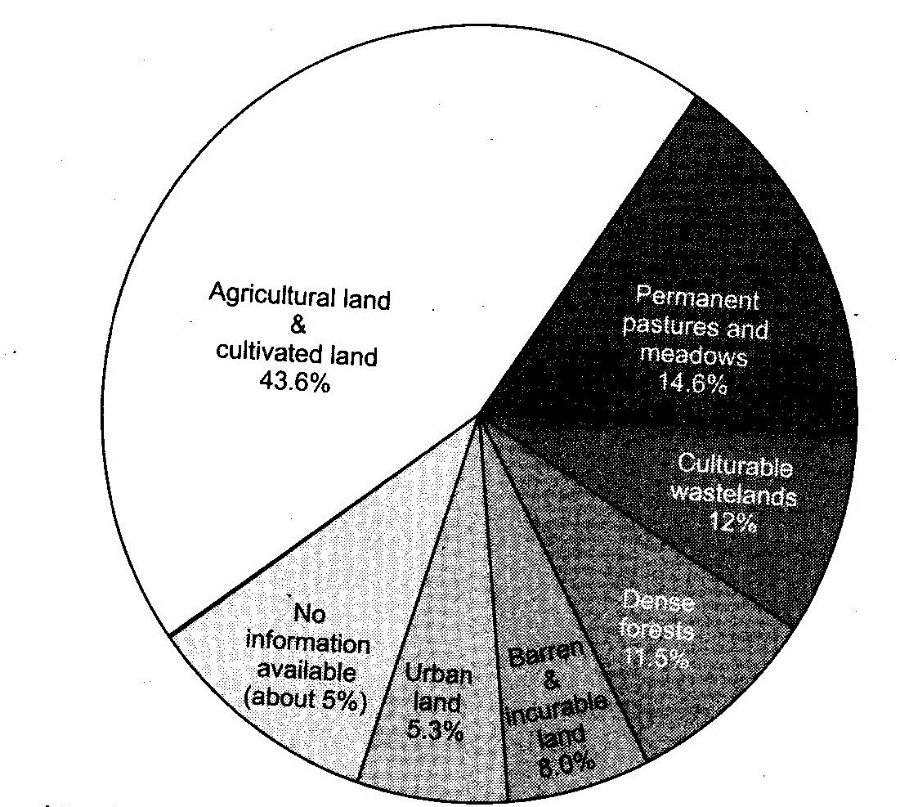
Unit 3: Natural Resources- Renewable and non Renewable Resources
difficult to define but is normally thought of as the lower limit of common rooting depth of native perennial plants, a boundary that is shallow in deserts and tundra and deep in humid tropics.
Soil is a dynamic of earth’s crust. It takes about 200-1000 years to form 2.5 cm of soil, depending upon various factors such as climate, soil type, processes involved in decomposition of parental rocks etc. The soil productivity is determined by many soil factors such as soil texture; availability is determined by many solid factors such as soil textile availability of water; soil water porosity; permeability; soil pH; organic matter and inorganic nutrient contents; cation exchange capacity; microbial population etc. The topography and biotic factors also play an important role in determining the solid conditions. Soil plays a key role in determining the quality and composition of the biosphere. In fact, biosphere develops over the soil and soil provides nutrition to the plants and abodes the microorganisms. The land is vital to our existence due to the following facts:
It preserves terrestrial biodiversity and genetic pool.
It regulates water and carbon cycles.
It acts a store house of basic resources like ground water, minerals and fossil fuels.
It becomes a dump of solid and liquid wastes.
It forms a basis for human settlement and transport activities.
Its top soil horizon, which is only a few cm thick, supports all plant growth and is hence the life support system for all organisms, including man.
Pattern of Land Use:
The pattern of land use varies from country to country. The pattern of land use distribution in the world is 30 per cent forest land, 26 per cent pasture land, 11 per cent cropland and the rest 33 per cent as
land like tundra, desert, bare rock, snow etc. In India, the so called agricultural country, more than two- fifth of the land is agricultural land. The pattern of land distribution in India is 43.6 per cent agricultural land and cultivated land, 14.6 per cent permanent pasture and meadows, 12 per cent cultivable wasteland.
11.5 per cent forest, 8.0 per cent barren and uncultivable land, 5.3 per cent urban land and 5 per cent for which no proper information is available (fig. 8.1.)
Fig. 3.1: Pattern of land distribution in India (approximates)

Slide 40
Unit 3: Natural Resources- Renewable and non Renewable Resources
Land Degradation and Its Causes:
Land degradation refers to deterioration or loss of fertility of productive capacity of the soil. All
modern growth oriented activities are directly or indirectly causing impacts on land. According to UN studies, 23 per cent of all sable land, excluding mountains, deserts, polar regions etc. has been degraded to such an extent that its productivity has been affected. The main cases of this are deforestation, water logging, excessive use of chemicals, agricultural mismanagement, soil salinity, fuel wood consumption, overgrazing, planting unsuitable crops, poor crop rotation, poor soil and water management, frequent use of heavy machinery such as tractors, heavy industrialisation and urbanization.
Rapid rate of increase of human population coupled with man’s increased demand of food and other needs, has brought the land under pressure. The per capita land resource is showing marked
decrease in many thickly populated countries. In India, it may go down from 0.33 hectare to 0.25 hectare in near future. Equally responsible is heavy industrialization, demanding space and raw materials and causing pollution. In Asian tropics, land degradation is a major problem. It is estimated that about our- third of the irrigated agricultural land, about half of rainfed crop land and about three-fourth of the pastoral land are degraded. In India alone about 170 million hectares of productive land is degraded to greater or lesser extent. The cause being decimation of much of the forests in the lowland, forest conversion in uplands for timber to support the industries elsewhere, mining, energy generation through large hydro-electric projects etc. Ecological problems and land degradation have accelerated rapid marginalization of large section of the rural communities and needs to be viewed upon seriously.
In India, had degradation is a key issue, especially in rural environment. Some of the important issues include improving fertility of degraded infertile soils, improving the sub-soil water balance depleted
due to over-exploitation of ground water for agriculture, saline and alkali soil (usar land) formation in areas under green revolution agriculture especially in Haryana, Punjab, Western Uttar Pradesh etc. The changing land use patterns such as utilization of agricultural land for urbanization and growing soil degrading plants for industrial requirements etc. also need to be paid great attention. Soil erosion and contamination of soil with industrial wastes like fly ash, press mud or heavy metals, all causing soil degradation, also need to be looked upon.
Desertification:
Desertification refers to land degradation in arid and semi-arid areas caused by climatic changes
and human activities. It is the combined effect of accelerated erosion by wind and water, woodland destruction, soil waterlogging, salinization and overgrazing in dry land environment etc. Desertification occurs slowly but covers a large area due to merger of different degraded land areas in close vicinity. Desertification is progressing slowly but appearing over the planet like a skin disease wherein patches of degraded land, erupting separately, gradually join together. As a result of desertification, productive potential of the arid and semi-arid lands falls by 10 per cent or more. Moderate desertification brings about 10-15 per cent drop in productivity, severe desertification causes 25-50 per cent drop while severe desertification results in more than 50 percent drop in productivity and usually creates huge gullies and sand dunes. Desertification leads to the conversion of rangelands and irrigated croplands to become deserted, so that the agricultural productivity falls. It results loss of vegetation cover, depletion of ground water; salinisation. Severe soil erosion, degradation of ecosystem etc. The deserts are the places where water is not even in traces for miles together and temperature reaches 134⁰F and is hard to find human life in such an environments. Causes of desertification are many. In most deserts, the amount of evaporation is

Slide 41
Unit 3: Natural Resources- Renewable and non Renewable Resources
greater than the amount of rainfall which in these areas never exceeds 10-15 inches. Water is hardly retained as it is not soaked into the earth and rushes off in torrents, causing gully erosion. That is why water is not seen even in traces for miles together except for short oasis. Many of the deserts do not receive rains for years together. The moisture in these areas is insufficient to support normal life. The low humidity permits up to 90 per cent of solar radiation to penetrate the atmosphere and heat the earth resulting in high temperatures. The nights are very cold due to loss of heat into the atmosphere through radiation. Scarcity of water coupled with extremes of temperature lead to dust storms, that erode the soil which is unprotected by vegetation. Violent dust storms sometimes carry sand dunes to large distances.
Deforestation:
Causes and impacts due to mining, dam building on environment, forests bio-diversity and tribal populations:
Soil Erosion:
It has already been stated that the formation of soil, as it exists today, has taken centuries (see sec. 8.2). The top soil is the most important as all agricultural activities depend on it. The upper most layer of the soil is a vital component since all the nutrients required by plant are present in this layer. At times, if it so happens that the top soil is dissipated or taken to other places by water or wind, then this situation is referred to as ‘soil erosion’. The soil which has been eroded becomes unfit or unsuitable for vegetation or agricultural production. It has been found that on global scale, the fertile land is lost by erosion at the rate of about ten mission hectares per year.
Causes of Soil Erosion:
Soil erosion is a natural process and is caused by the flow of water over the fields and by wind.
Following factors influence the rate of soil erosion.
Deforesation and loss of vegetation cover increase the rate of erosion.
Cultivation on slopes of mountains increase the rate of erosion.
Soils with fine texture and low organic content are more susceptible to erosion.
Effects of Soil Erosion:
Soil erosion depletes the inorganic nutrients like nitrogen, phosphorus, potassium and calcium present in soil. It also uproots the organisms living in the soil – this results in the loss of organic nutrients. The soil erosion also leads to the reduction in soil productivity.
Control of Soil Erosion:
Formation of soil is an extremely slow process and it takes 200-1000 years to form one inch of topsoil. In view of this, it is very necessary to conserve the soil and prevent its erosion. Following are some important methods of controlling soil erosion.
Rotation of Crops: This procedure ensures that some part of the land is continually covered by vegetation.
Tillage at right angle to the slope of land: This is known as contour farming. This procedure creates a series of ridges that slow down the flow of water and thus prevent the soil erosion. This method is useful on gentle slopes.

Slide 42
Unit 3: Natural Resources- Renewable and non Renewable Resources
Strip Farming: This is used on steep slopes. The procedure involves alternating strips of closely sown crops. Alternative bands of wheat and soya beans are commonly sown. The closeness of the strips retards the flow of water and so prevents soil erosion.
Using wind Brakes: It is the practice of planting trees or other plants that protect the bare soil from the full force of winds. Wind brakes decrease the speed of wind and hence reduce the quantity of soil
that the wind can carry away. Thus, soil erosion by wind is reduced.
Deforestation:
According to a global survey conducted in 1970 A.D. about one-fifty of earth’s land was covered by closed forests with a canopy cover of over 20% or more while another 12% was under the open woodland with 5-19% of canopy cover (Reider Parson, 1974). This forest cover is already considered a meagre one and even this too is shrinking at a fast rate.
The area under the Coniferous forests in the North has undergone little change since the beginning of this century. This forest belt lies in Alaska, Canada, Northern Europe and the Russian states. The
pressure of human activity and demands has never been heavy in these woodlands as compared to the tropical and temperate regions of the world. Due to early technological advancement and industrialization the bulk of population has shifted to urban settlements from these areas. The evolution of intensive agriculture has enabled the small rural population left behind to feed the large numbers concentrated in towns and cities. In United States of America barely 2% of the population is involved in agriculture, animal husbandry, forestry etc. It, not only produces enough to feed the entire nation but also exports food grains to needy countries. The reduced pressure of demands and application of better technology in utilization of forest produce, have preserved the Northern belt of Coniferous forests across the globe from wasteful destruction.
Major Causes of Deforestation:
Deforestation is a consequence of over-exploitation of our natural ecosystems for space, energy and materials. The basic reasons for such extensive deforestation are:
Expansion of Agriculture :
Expanding agriculture is one of the most important causes of deforestation. As demands on agricultural products rise more and more land is brought under cultivation for which forests are cleared,
grass-lands ploughed, uneven grounds leveled, marshets drained and even land under water is reclaimed. However this expansion is usually marked with more ecological destruction than rationality. Governments often distribute land under forests to landless people instead of redistributing already established farm lands.
Extension of Cultivation on Hills Slopes:
Outside humid tropical zone, in most of the third world countries, major forests often occur on hill tops and slopes.
Shifting Cultivation:
Shifting cultivation is often blamed for destruction of forests. In fact it is poor fertility of soil which has given the rise to such a pattern of farming. A small patch of tropical forests is cleared, vegetation slashed, destroyed and burned.

Slide 43
Unit 3: Natural Resources- Renewable and non Renewable Resources
Cattle Ranching:
Large areas of tropical forest in Central and South America have been cleared for use as grazing
land to raise castles and cash in on the lucrative beef exports to USA. But in these cases too, the problem of poor productivity of tropical soils makes the venture non-viable. Cattle ranching have done much damage to the tropical forest cover in South and Central America (Fearnside 1980, Parson 1976).
Firewood Collection:
To majority of rural population and a large number of people living in small towns and cities of
developing countries, the only fuel is wood which is burned to cook food and to provide heat in chilly winters. Firewood collection contributes much to the depletion of tree cover, especially in localities which are lightly wooded.
Timber Harvesting:
Timber resource is an important asset for a country’s prosperity. Commercial wood finds ready national as well as international markets.
Commercial logging in tropical countries usually involves felling of trees of only selected species which fetch better prices. When cultivation is fails it is replaced by cattle ranching or by useless tenacious grasses.
Floods:
Generally people think of floods as an outcome of accumulation of large volumes of water flowing through river channels spilling over the banks and causing extensive damage to human lives and property. However, it is a natural phenomena associated with hydrological cycle. The land surface receives more water than it loses.
Major Causes of Recurrent Floods:
Both natural and anthropogenic factors are responsible for causing floods in river basins although the relative importance of these factors may vary from place to place.
High intensity rains in the catchment are of the river :
Heavy rains in the catchment area of the river causes more water to flow through the river channel. Rains downstream may also cause flooding and slow down the discharge of large volumes of water flowing down the channel in upper regions of the basin.
Shallow Channels and extensive flood plains :
Each year more and more silt and sediments are deposited in sections of a river which has a low gradient (or slope) this reduces the depth of the channel.
Sudden Changes in Channel-gradient or blockage of the flow:
Blockage of the flow of a river due to landslides in the upper reaches of drainage basin tends to
flood the region upstream whereas abrupt removal of the debris may result in rapid discharge of large volume of water causing floods downstream.
Curves, bends and meandering course of the river channel:
Sharp curves, turns and meandering of river tend to slow down the flow of water through the channel. With a lowered rate of discharge of water through the channel large quantities of water accumulate upstream and cause extensive floods.

Slide 44
Unit 3: Natural Resources- Renewable and non Renewable Resources
Extensive of deforestation and removal of plant cover :
For agriculture and other uses man has cleared natural vegetation over large areas of most of the
river basins. Trees have disappeared and much of the herbs, shrubs and grasses have dried out. On bared denuded land surface water flows down quickly. Excessive use of chemical fertilizers and pesticides tends to reduce the organic matter content of the soils causing destruction of the soil crumb structure. The loosened soil particles are easily carried by rapidly flowing waters. Little of the rain water percolates underground to recharge the subsurface water table. The flood flow carries more silt and sediments with it which are deposited downstream when the flow slows down raising the river bed and reducing the capacity of the channel to discharge the flood flow.
Impact of urbanization and construction activity blockage of the flow:
Extensive pucca roof tops, land surface and asphalted roads considerably reduce infiltration of water to sub-surface strata. Large voltimes of water accumulate in low lying areas and have to be disposed off as quickly as possible through the drainage system of the city. Impact of road building activities is probably the most important anthropogenic factor in causing floods.
Droughts:
Droughts are more dangerous natural environmental setbacks as there are directly linked o the three basic requirements of life – air, food and water. Water is essential for growing food. No one can live without water. Drought is the cumulative effect of scarcity of water for prolonged periods.
The meaning and definition of drought varies from region and to region. Most of the people are well aware when a drought situation exists but it is very difficult to define what is drought in manner acceptable to all. Drought commonly involves shortage of water but it cannot be defined in terms of only a particular need. The definition of drought should involve not only water needs but also the complex set of factors involved to supply that need through the hydrological cycle.
It will not be out of place to point out here that increased dryness for prolonged periods causing drought conditions is linked to the almost of rainfall, its departure from normal annual value and the local demand of water various purposes.
Impact of the Droughts :
Drought affects all living beings. All plants, animals, and microbes need water. Any shortage of water supply adversely affects them. The impact of prolonged droughts involves ecological, economic,
demographic and political aspects. The biotic component of natural ecosystems under goes a drastic change due to:
Elimination of some species of plants and animals and microbes which cannot survive in dry conditions.
Migration of species to other places due to water scarcity and therefore there is marked decrease in the number of species as well as the number of individuals of a species.
Many organisms die of hunger and starvation because the productivity of the locality is drastically
reduced due to lack of water.
The stiff competition for the resources drastically reduced by drought also results in elimination of weaker animals.

Slide 45
Unit 3: Natural Resources- Renewable and non Renewable Resources
2. Some Droughts of Twentieth Century:
In Australia drought are both frequent in occurrence and cover large tracts of the area of the
continent. It was in Australia that are worst drought of the twentieth century started during the closing years of nineteenth century and continued upto to 1902.
Australia and Sahel area of Africa are rain deficient regions of the world where droughts area common feature.
Water: Use and over-exploitation of surface and ground water, floods, droughts, conflicts over water (international & inter: state).
Conflict over Water:
The surface reservoirs, wider ground deposits and water flowing in streams and rivers provide most of the fresh water for human needs. Some rivers flow through many countries catering to the needs of people belonging to different ethnic groups, religious back grounds, ideologies and nationalities. Over consumption, pollution, wastage and misuse in one locality affect fresh water availability in another. Human manipulation of flood flow of rivers flowing through many states or countries, particularly when the commodity (fresh water) is scarce, is a reason important enough to give rise conflicts and controversies.
Nile, the longest river of the world, brings waters from the drainage basins in Tanzania, Uganda to
the water stress regions of Sudan and is referred to as the White Nile. It is dammed at Jabal Awliya to provide water to the cotton plantations of Sudan. At Khartoum, Sudan, Blue Nile from Ethiopia joins the river. More than two third of the water of Nile is contributed by Blue Nile which is also dammed near Khartoum, in Sudan for irrigation and hydroelectric power generation. Nile is the life line of Egypt the flow of which is largely dictated by drought, floods or human manipulation of flow of Blue Nile and the White Nile in Sudan which may give rise to controversy between the two countries. Similarly the drainage basin of River Niger (Africa) lies in Guinea, Mali, Burkina Faso, Benin, Niger and Nigeria. The twin rivers, Euphrates and Tigris originate in Turkey and flow through Syria and Iraq to drain its water in the Arabian gulf. The drainage basin of Zambezi (Africa) lies in Congo, Angola, Zambia, Zimbabwe, Malawi and Mozambique. River Paranas of South Africa flows through Brazil, Paraguay and Argentina. The Mississippi basin, which is spread over about 3270000 sq. kms. lies in several states of North America. The Multipurpose Irrigation project over Mekong River in South East Asia proposes to construct several dams, some with hydroelectric power generation units and a network of canals. It shall involve four countries namely Cambodia, Thailand, Laos and Vietnam.
As mentioned earlier with freshwater in abundance there shall be no problem. During lean sea- sons the flow of these rivers is limited. With a rapidly growing population, growth of industries and
expansion in agricultural sectors demand for fresh water shall rise. Many of these rivers have been effectively dammed and much of their discharge has now been brought under human control. Under conditions of scarcity it will be difficult to deckle as to who is needier or who has stronger rights over the fresh water resource. Conflict and controversies shall naturally follow. Colorado River which flows through several states of America has been hemmed with several dams and embankments and its flow is entirely under human control. Controversies over the use of its waters have developed many times which could only be resolved by federal intervention or adjuration by the Supreme Court of USA. A well-known example of such a dispute happens to be the waters of River Cauvery in India. The river originates in the

Slide 46
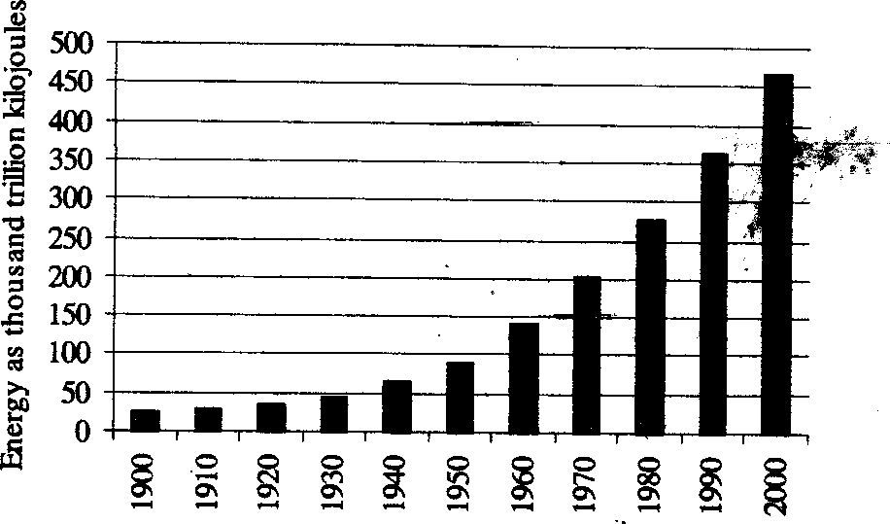
Unit 3: Natural Resources- Renewable and non Renewable Resources
hills of Western Ghats, runs through the rain shadow-region of Karnataka in South India and flows eastward to Thanjavur delta region, the rice bowl of Chennai. It is an important river providing water to crops field both in Karnataka and Chennai. The rapids and the falls of the river are also used to generate hydroelectric power in Karnataka. The Stanley Reservoir and the Metter dam control the flood flow of the river. During lean periods scarcity of water often develops. Karnataka people feel that they have stronger rights over the Cauvery waters. They refuse to release more water under their control and the Chennai farmers suffer.
Surface waters:
To 1,150 cubic kms. of fresh water which appear as surface water may be added about 200 cubic kms. of surface flow which comes from outside India. The surface flow is further enlarged by addition of
about 450 cubic kms. of fresh water from ground water flow while about 50 cubic kms. are added as runoff from irrigated areas. The surface loses almost 50 cubic kms. of its water which percolates down to the ground water deposits. The total surface flow per year is about ,800 cubic kms. which are distributed among a number of river basins.
Ground water:
The major portion of fresh water which goes to earth's crust is retained by its upper layers as soil moisture (about 1,650 cubic kms). Only 500 cubic kms. percolate down to the ground water deposits. A large amount of fresh water applied to agricultural fields (about 120 cubic kms.) moves down to ground water table while about 50 cubic Ions of surface flow also end up as ground water. Therefore, a total of about 670 cubic kms of fresh water enters the ground water annually. It is upto this amount that we can withdraw fresh water from our sub-surface deposits. Any withdrawal above this limit shall be detrimental to the resource base.
Energy Resources Renewable and non-renewable energy sources, use of alternate energy sources growing energy needs,, case studies:
Global Energy Consumption:
Growth of Global Energy Consumption
Minimum per capita energy requirement of man is about 2000 kcals which is the quantity required
to keep him alive and is obtained from food he eats. In a primitive society, apart from cooking, lighting. heating etc. there was little need of more 'al Revolution has, however, brought in an era of concentrated

Slide 47
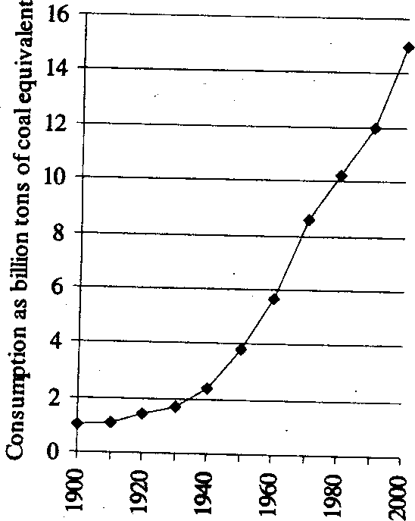
Unit 3: Natural Resources- Renewable and non Renewable Resources
use of large amounts of at energy consumption, which was a little more than 2000 kcals has now shot up to in technologically advanced countries of the world. There has been a rapid and steady rise in global energy consumption ever since the fossil fuels came into wide spread use (Fig. 9.1). We have entered an 'Age' of rapid consumption of fossil fuels, which represents the photosynthesis of millions of years ago. Per capita consumption of energy is not the same all over the world. It is highest in advanced Western countries. Only 20% of the world's people consume about two-third of the total energy produced by man while the rest of the population has to live with only one-third of the energy supply. To millions of people living in developing countries of the world electricity is still a dream, fossil fuels are difficult and costly to obtain and biomass constitutes the only source of energy.
Global Consumption of Fossil Fuels
Conventional Sources of Energy for Mankind
Conventional sources of energy for the human society are those which have been in use since a long time and have become a convention. Since times immemorial man has been using diverse sources of
energy. However, most of energy which mankind has been using or which mankind still uses, is derived directly or indirectly from sun. Important sources of energy for human society can be summarized as follows:
Biomass or dried organic matter: Dried twigs, wood, leaves, cow-dung, burning oils and fats derived from living organisms can be included in this category. These are renewable sources of energy. Ever since man learned to use fire he has been burning dried biomass, oils and fats to obtain energy for lighting, cooking and heating purposes. Of these fuel-wood constitutes the most important source of energy in developing countries of the world. Fuel wood consumption provides almost 43% of the total energy consumed in these countries and amounts to about 14% of the total world's energy production.

Slide 48
Unit 4: Biodiversity and Conservation
Unit 4
Biodiversity and Conservation
Introduction
Biodiversity or Biological diversity is a term that describes the variety of living beings on earth. In short, it is described as degree of variation of life. Biological diversity encompasses microorganism, plants, animals and ecosystems such as coral reefs, forests, rainforests, deserts etc.
Biodiversity also refers to the number, or abundance of different species living within a particular region. It represents the wealth of biological resources available to us. It’s all about the sustaining the natural area made up of community of plants, animals, and other living things that is begin reduced at a steady rate as we plan human activities that is being reduced by habitat destruction.
Biodiversity is the foundation of ecosystem services to which human well-being is intimately
linked. No feature of Earth is more complex, dynamic, and varied than the layer of living organisms that occupy its surfaces and its seas, and no feature is experiencing more dramatic change at the hands of humans than this extraordinary, singularly unique feature of Earth. This layer of living organisms—the biosphere—through the collective metabolic activities of its innumerable plants, animals, and microbes physically and chemically unites the atmosphere, geosphere, and hydrosphere into one environmental system within which millions of species, including humans, have thrived. Breathable air, potable water, fertile soils, productive lands, bountiful seas, the equitable climate of Earth’s recent history, and other ecosystem services are manifestations of the workings of life. It follows that large-scale human influences over this biota have tremendous impacts on human well-being. It also follows that the nature of these impacts, good or bad, is within the power of humans to influence.
Biodiversity is an important value and not always sufficiently considered, given its vital role in the provision of ecosystem goods and services, including fisheries, marine resources, recreation and tourism.
What is Biodiversity
Biological diversity deals with the degree of nature’s variety in the biosphere. This variety can be observed at three levels – the genetic variability within a species; the variety of species within a community;
and the organisation of species in area into distinctive plant and animal communities.
Definitions
Biodiversity is defined as the variation of living forms on earths which includes plants, animals, microorganisms, contains genes and forms the complex ecosystem.
Biologists most often define biodiversity as the "totality of genes, species and ecosystems of a region".
(Tor-Bjorn Larsson (2001) & Davis).
In the Convention on Biological Diversity signed by many member states at the Earth Summit held in Rio de Janeiro (Brazil) in 1992, explains biodiversity as follows:
"Biological diversity" means the variability among living organisms from all sources including terrestrial, marine and other aquatic ecosystems and the ecological complexes of which they are part; this includes diversity within species, between species and of ecosystems.
Levels of Biological Diversity
Biodiversity can be viewed on three levels namely: genetic diversity, species diversity, and ecosystem diversity. All three interact and change over time and from place to place.

Slide 49
Unit 4: Biodiversity and Conservation
Species diversity refers to the variety of different living things.
Genetic diversity refers to the variations between individuals of a species — characteristics passed down from parents to their offspring.
Ecosystem diversity refers to the great variety of environments produced by the interplay of the biotic
(living animals and plants) and the abiotic (non-living world; earth forms, soil, rocks, air and water).
Genetic Diversity
Genetic diversity is the total number of genetic characteristics in the genetic makeup of a species.
It is distinguished from genetic variability, which describes the tendency of genetic characteristics to vary. Each species consists of individuals with their own particular genetic composition. When the individuals interbreed, their offspring have new combinations of the genes, resulting in new mixtures of the characteristics of the species. This diversity of characteristics is essential for the survival of healthy populations in natural communities. When the environment of a community changes, as they do overtime, some individuals will have characteristics that suit the new environment. They are more likely to survive and produce offspring that are also suited to the new environment. As a result, the whole Population may change. This is how the process of adaptation occurs. If a small population of a species becomes isolated from the larger group, the small population is forced to reproduce by breeding within itself — to inbreed. Inbreeding can result in a loss of genetic diversity, making it harder for the species to adapt to changing conditions. This loss of genetic diversity can eventually result in the extinction of the population
Species Diversity
Species diversity refers to the different types of living organisms on Earth. This includes the many
types of birds, insects, plants, bacteria, fungi, mammals, and more. Many differing species often live together in communities depending on each other to provide their needs. A species can be defined as a group or population of similar organisms that reproduce by interbreeding within the group. Members of a species do not normally reproduce with members of any other species. Members of a specific species possess common characteristics that distinguish them from other species and this remains constant regardless of geographic location. Human beings, for example, belong in a single species — Homo sapiens and can successfully breed with different human populations around the world because they all belong to the same species.
Ecosystem Diversity
Ecosystems are the combination of communities of living things with the physical environment in which they live. There are many different kinds of ecosystems, from mountain slopes and savannahs to oceans and coral reefs. The most diverse and ecologically rich systems include rainforests and coral reefs. Each ecosystem provides many different kinds of habitats or living places providing a home for a myriad of species. Different species have differing functional roles to play in ecosystems which help maintain the characteristics unique to that ecosystem. Ecosystems are dynamic in nature and can go through a number of changes in their species composition before they become stable. However, despite their dynamic nature and changes that may occur, some events remain constant such as energy and nutrient cycling. You can begin to appreciate how the elements in each ecosystem are connected to each other and the diversity that exists amongst Earth's ecosystems. Maintaining this ecological diversity is important for the health of the planet.

Slide 50
Unit 4: Biodiversity and Conservation
Biogeographic Zones of India Biogeographic Classification of India
Biogeographic classification of India is the division of India according to biogeographic characteristics. Biogeography is the study of the distribution of species (biology), organisms, and ecosystems in geographic space and through geological time. There are ten biogeographic zones in India. (Chauhan, B. S. 2008).
Trans Himalayan zone.
Himalayan zone
Desert zone.
Semiarid zone.
Western ghat zone.
Deccan plateau zone.
Gangetic plain zone.
North east zone.
Coastal zone.
Islands present near the shore line.
Trans-Himalayan Region
The Himalayan ranges immediately north of the Great Himalayan range are called the Trans- Himalayas. The Trans-Himalayan region with its sparse vegetation has the richest wild sheep and goat community in the world. The snow leopard is found here, as is the migratory black-necked crane.
Himalayas
The Himalayas consist of the youngest and loftiest mountain chains in the world. The Himalayas have attained a unique personality owing to their high altitude, steep gradient and rich temperate flora.
The forests are very dense with extensive growth of grass and evergreen tall trees. Oak, chestnut, conifer,
ash, pine, deodar are abundant in Himalayas. There is no vegetation above the snowline. Several interesting
animals live in the Himalayan ranges. Chief species include wild sheep, mountain goats, ibex, shrew, and tapir. Panda and snow leopard are also found here.
Semi-Arid Areas
Adjoining the desert are the semi-arid areas, a transitional zone between the desert and the denser forests of the Western Ghats. The natural vegetation is thorn forest. This region is characterized by discontinuous vegetation cover with open areas of bare soil and soil-water deficit throughout the year.
Thorny shrubs, grasses and some bamboos are present in some regions. A few species of xerophytic herbs and some ephemeral herbs are found in this semi-arid tract. Birds, jackals, leopards, eagles, snakes, fox,
buffaloes are found in this region.
Western Ghats
The mountains along the west coast of peninsular India are the Western Ghats, which constitute
one of the unique biological regions of the world. The Western Ghats extend from the southern tip of the peninsula (8°N) northwards about 1600 km to the mouth of the river Tapti (21°N).
The mountains rise to average altitudes between 900 and 1500 m above sea level, intercepting monsoon winds from the southwest and creating a rain shadow in the region to their East.

Slide 51
Unit 4: Biodiversity and Conservation
The varied climate and diverse topography create a wide array of habitats that support unique sets of plant and animal species. Apart from biological diversity, the region boasts of high levels of cultural diversity, as many indigenous people inhabit its forests.
The Western Ghats are amongst the 25 biodiversity hot-spots recognized globally. These hills are known for their high levels of endemism expressed at both higher and lower taxonomic levels. Most of the
Western Ghat endemic plants are associated with evergreen forests.
The region also shares several plant species with Sri Lanka. The higher altitude forests were, if at
all, sparsely populated with tribal people. Rice cultivation in the fertile valley proceeded gardens of early commercial crops like areca nut and pepper. The original vegetation of the ill-drained valley bottoms with sluggish streams in elevations below 100m would be often a special formation, the Myristica swamp.
Expansion of traditional agriculture and the spread of particularly rubber, tea, coffee and forest tree plantations would have wiped out large pockets of primary forests in valleys. The Western Ghats are well known for harboring 14 endemic species of caecilians (i.e., legless amphibians) out of 15 recorded from the region so far.
North-West Desert Regions
This region consists of parts of Rajasthan, Kutch, Delhi and parts of Gujarat. The climate is characterised by very hot and dry summer and cold winter. Rainfall is less than 70 cm. The plants are mostly xerophytic. Babul, Kikar, wild palm grows in areas of moderate rainfall. Indian Bustard, a highly endangered bird is found here. Camels, wild asses, foxes, and snakes are found in hot and arid parts of the desert.
Deccan Plateau
Beyond the Ghats is Deccan Plateau, a semi-arid region lying in the rain shadow of the Western Ghats. This is the largest unit of the Peninsular Plateau of India. The highlands of the plateau are covered with different types of forests, which provide a large variety of forest products. The Deccan plateau includes the region lying south of the Satpura range it extends up to the southern tip of peninsular India. Anai mudi is the highest peak of this region. The Deccan plateau is surrounded by the western and the eastern ghats. These ghats meet each other at the Nilgiri hills. The Western Ghats includes the Sahyadri, Nilgiris, Anamalai, and cardamom hills. many rivers such as Mahanadi, Godavari, Krishna, and knavery originates from western ghats and flow toward the east. The eastern ghats are broken into small hill ranges by river coming from the western ghats. Most of these rivers fall into the Bay of Bengal. The Godavari is the longest river in the Deccan plateau .the Narmada and the Tapi flow westwards and fall into the Arabian Sea.
Gangetic Plain
In the North is the Gangetic plain extending up to the Himalayan foothills. This is the largest unit
of the Great Plain of India. Ganga is the main river after whose name this plain is named. The aggradational Great Plains cover about 72.4mha area with the Ganga and the Brahmaputra forming the main drainage axes in the major portion.
The thickness in the alluvial sediments varies considerably with its maximum in the Ganga plains. The physiogeographic scenery varies greatly from arid and semi-arid landscapes of the Rajasthan Plains to the humid and per-humid landscapes of the Delta and Assam valley in the east.
Topographic uniformity, except in the arid Western Rajasthan is a common feature throughout these plains. The plain supports some of the highest population densities depending upon purely agro-based

Slide 52
Unit 4: Biodiversity and Conservation
economy in some of these areas. The trees belonging to these forests are teak, sal, shisham, mahua, khair etc.
North-East India
North-east India is one of the richest flora regions in the country. It has several species of orchids, bamboos, ferns and other plants. Here the wild relatives of cultivated plants such as banana, mango, citrus
and pepper can be grown
Islands
The two groups of islands, i.e., the Arabian Sea islands and Bay Islands differ significantly in origin and physical characteristics. The Arabian Sea Islands (Laccadive, Minicoy, etc.) are the foundered remnants of the old land mass and subsequent coral formations. On the other hand, the Bay Islands lay only about 220 km.
Away from the nearest point on the main land mass and extend about 590 km. With a maximum width of 58 km the island forests of Lakshadweep in the Arabian Sea have some of the best-preserved
evergreen forests of India. Some of the islands are fringed with coral reefs. Many of them are covered with thick forests and some are highly dissected.
Coasts
India has a coastline extending over 5,500 km. The Indian coasts vary in their characteristics and structures. The west coast is narrow except around the Gulf of Cambay and the Gulf of Kutch. In the
extreme south, however, it is somewhat wider along the south Sahyadri.
The backwaters are the characteristic features of this coast. The east coast plains, in contrast are broader due to depositional activities of the east-flowing rivers owing to the change in their base levels.
Extensive deltas of the, Godavari, Krishna and Kaveri are the characteristic features of this coast. Mangrove vegetation is characteristic of estuarine tracts along the coast for instance, at Ratnagiri in Maharashtra.
Biodiversity at Global, National and Local Levels
Global Level:
Conservative estimates of the existing biodiversity is ten million species, but if estimates for insects are correct then it could be around 30 million species, we have till now enlisted about 1.4 million species.
It includes among others about 98% birds, 95% reptiles and amphibians, 90% fish and about 85% higher plants known to exist on this Earth (Table 4.1)

Slide 53
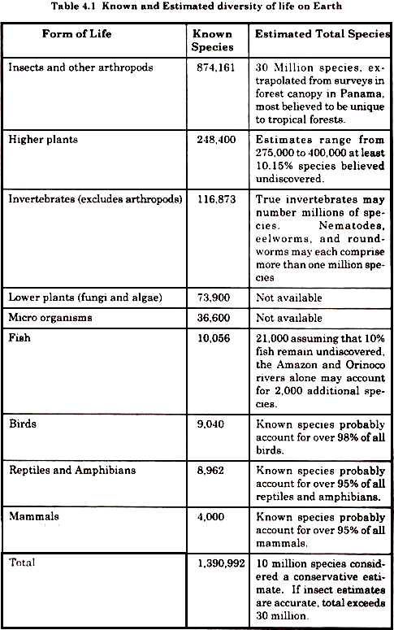
Unit 4: Biodiversity and Conservation
National and Local Level:
India has over 108,276 species of bacteria, fungi, plants and animals already identified and described (Table 4.2). Out of these, 84 percent species constitute fungi (21.2 percent), flowering plants (13.9 percent), and insect (49.3 percent). In terms of the number of species, the insecta alone constitute nearly half of the biodiversity in India (Fig 4.1).
These species occur on land, fresh and marine waters, or occur as symbionts in mutualistic or parasitic state with other organisms. In the world as a whole, 16, 04,000 species of Monera, Protista, Fungi,

Slide 54
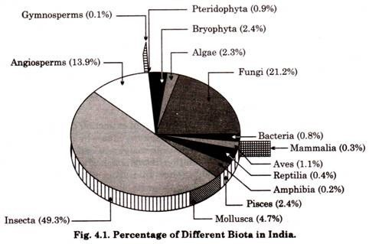
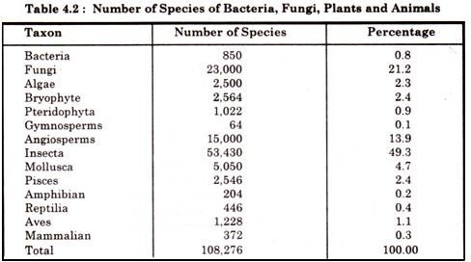
Unit 4: Biodiversity and Conservation
Plantae and Animalia have been described so far. However, it is estimated that at least 179, 80,000 species exist in the world, but as a working figure 122, 50,000 species are considered to be near reality. Percentage of Different Biota in India
India is 10th among the plant rich countries of the world, fourth among the Asian countries, eleventh according to the number of endemic species of higher vertebrates (amphibia, birds and mammals), and tenth in the world as far as richness in mammals is concerned. Out of the 10 ‘Hot spots’ identified in the world, India has four. These are Eastern Himalaya, North East India, Western Ghats and Andaman & Nicobar Islands.
The crops which first grew in India and spread throughout the world include rice, sugarcane,
Asiatic vignas, jute, mango, citrus, and banana, several species of millets, spices, medicinal, aromatics and ornamentals. India ranks sixth among the centres of diversity and origin in terms of agro-biodiversity.
Biodiversity Hot Spots
The earth’s biodiversity is distributed in specific ecological regions. There are over a thousand major eco-regions in the world. Of these, 200 are said to be the richest, rarest and most distinctive natural areas. These areas are referred to as the Global 200.

Slide 55
Unit 4: Biodiversity and Conservation
It has been estimated that 50,000 endemic plants which comprise 20% of global plant life, probably occur in only 18 ‘hot spots’ in the world. Countries which have a relatively large proportion of these hot spots of diversity are referred to as ‘megadiversity nations’.
The rate at which the extinction of species is occurring throughout our country remains obscure. It is likely to be extremely high as our wilderness areas are shrinking rapidly. Our globally accepted national
‘hot spots’ are in the forests of the North-East and the Western Ghats, which are included in the world’s most biorich areas. The Andaman and Nicobar Islands are extremely rich in species and many subspecies of different animals and birds have evolved. Among the endemic species i.e. those species found only in India, large proportions are concentrated in these three areas.
Table 4.3: Global Species Diversity
Group | No. of Described Species
Bacteria and blue-green algae | 4,760
Fungi | 46,983
Algae | 26,900
Bryophytes (Mosses and Liverworts) | 17,000 (WCMC, 1988)
Gymnosperms (Conifers) | 750 (Reven et al., 1986)
Angiosperms (Flowering plants) | 250,000 (Reven et al., 1986)
Protozoans | 30,800
Sponges | 5,000
Corals and Jellyfish | 9,000
Roundworms and earthworms | 24,000
Crustaceans | 38,000
Insects | 751,000
Other arthropods and minor Invertebrates | 132,461
Molluscs | 50,000
Starfish | 6,100
Fishes (Teleosts) | 19,056
Amphibians | 4,184
Reptiles | 6,300
Birds | 9,198 (Clements, 1981)
Mammals | 4,170 (Honacki et al., 1982)
Total: | 1,435,662 Species
Source: ‘Conserving the World’s Biological Diversity WRI, IUCN, CI, WWF-US, the World Bank.’
The Andaman and Nicobar Islands alone have as many as 2200 species of flowering plants and 120 species of ferns. Out of 135 genera of land mammals in India, 85 (63%) are found in the Northeast. The Northeast States have 1,500 endemic plant species. A major proportion of amphibian and reptile species, especially snakes, are concentrated in the Western Ghats, which is also a habitat for 1,500 endemic plant species. Coral reefs in Indian waters surround the Andaman and Nicobar Islands, Lakshadweep Islands, the Gulf areas of Gujarat and Tamil Nadu. They are nearly as rich in species as tropical evergreen forests! (Erach Bharuch, UGC 2013).
India as a Mega-Biodiversity Nation
India is one of the richest countries in the world in terms of biodiversity. This natural variation in life is also reflected in the demography of the land. Although the causes behind biodiversity and

Slide 56
Unit 4: Biodiversity and Conservation
demographic diversity are different, the human population of the land has depended on the biodiversity in many ways for a long time. At the same time, today, the excessive human population of India is leading to a survival pressure on the biodiversity. Thus, it is important to know and appreciate the diversity in both - human population and flora and fauna.
Table 4.4: Comparison between the Number of Species in India and the World
Group | Number of species in India (SI) | Number of species in the world (SW) | SI/SW (%)
Mammals | 350 | 4629 | 7.6
Birds | 1224 | 9702 | 12.6
Reptiles | 408 | 6550 | 6.2
Amphibians | 197 | 4522 | 4.4
Fishes | 2546 | 21730 | 11.7
Flowering Plants | 15000 | 250000 | 6.0
Sources: Indira Gandhi Conservation Monitoring Centre (IGCMC), New Delhi and IISc
A mega-diverse country is one that harbors the majority of the Earth’s species and high numbers of endemic species.
India is one of the 17 mega-diversity countries in the world. The Ministry of Environment and
Forests, Govt. of India (2000) records 47,000 species of plants and 81,000 species of animals which is about 7% and 6.5% respectively of global flora and fauna.
Endemism: Species which are restricted only to a particular area are known as endemic. India shows a
good number of endemic species. About 62% of amphibians and 50% of lizards are endemic to India. Western ghats are the site of maximum endemism.
Center of origin: A large number of species are known to have originated in India. Nearly 5000 species of flowering plants had their origin in India. From agro-diversity point of view also our country is quite rich. India has been the center of origin of 166 species of crop plants and 320 species of wild relatives of cultivated crops, thereby providing a broad spectrum of diversity of traits for our crop plants.
Marine diversity: Along 7500 km long coastline of our country in the mangroves, estuaries, coral reefs, back waters etc. there exists a rich biodiversity. More than 340 species of corals of the world are found
here. The marine diversity is rich in mollusks, crustaceans (crabs etc.), polychaetes and corals. Several species of Mangrove plants and sea grasses (Marine algae) are also found in our country. A large proportion of the Indian Biodiversity is still unexplored. There are about 93 major wet lands, coral reefs and mangroves which need to be studied in detail. Indian forests cover 64.01 million hectares having a rich biodiversity of plants in the Trans-Himalayan, north-west, west, central and eastern Himalayan forests, western ghats, coasts, deserts, Gangetic plains, Deccan plateau and the Andaman, Nicobar and Lakshadweep islands. Due to very diverse climatic conditions there is a complete rainbow spectrum of biodiversity in our country
Critically endangered in India
According to the Red Data List of International Union for Conservation of Nature (IUCN), there are 47 critically endangered species in India (as of 5 September 2011).
The Red List of 2012 was released at the Rio+20 Earth Summit . It contains 132 species of plants
and animals in India listed as critically endangered.

Slide 57
Unit 4: Biodiversity and Conservation
Arthropoda
Rameshwaram parachute spider (Poecilotheria hanumavilasumica)
Peacock tarantula (Poecilotheria metallica)
Birds
White-bellied heron (Ardea insignis)
Great Indian bustard (Ardeotis nigriceps)
Forest owlet (Athene blewitti)
Baer's pochard (Aythya baeri)
Spoon-billed sandpiper (Calidris pygmaea)
Siberian crane (Grus leucogeranus)
White-rumped vulture (Gyps bengalensis)
Indian vulture (Gyps indicus)
Slender-billed vulture (Gyps tenuirostris)
Bengal florican (Houbaropsis bengalensis)
Bugun liocichla (Liocichla bugunorum)
Himalayan quail (Ophrysia superciliosa)
Jerdon's courser (Rhinoptilus bitorquatus)
Pink-headed duck (Rhodonessa caryophyllacea)
Red-headed vulture (Sarcogyps calvus)
Sociable lapwing (Vanellus gregarius)
Fish
Wayanad mahseer (Barbodes wynaadensis)
Pondicherry shark (Carcharhinus hemiodon)
Ganges shark (Glyphis gangeticus)
Glyptothorax kashmirensis (Glyptothorax kashmirensis)
Kudremukh glyptothorax (Glyptothorax kudremukhensis)
Nilgiri Mystus (Hemibagrus punctatus)
Horalabiosa arunachalami (Horalabiosa arunachalami)
Hypselobarbus pulchellus (Hypselobarbus pulchellus)
Red Canarese barb (Hypselobarbus thomassi)
Deccan labeo (Labeo potail)
Mesonoemacheilus herrei (Mesonoemacheilus herrei)
Bovany barb (Neolissochilus bovanicus)
Deolali minnow (Parapsilorhynchus prateri)
Pookode Lake barb (Pethia pookodensis)
Common sawfish (Pristis pristis)
Largetooth sawfish (Pristis microdon)
Longcomb sawfish (Pristis zijsron)
Psilorhynchus tenura (Psilorhynchus tenura)
Deccan barb (Puntius deccanensis)
Schistura papulifera (Schistura papulifera)

Slide 58
Unit 4: Biodiversity and Conservation
Insects
Pygmy Hog Sucking Louse (Haematopinus oliveri)
Reptiles and amphibians
Madras spotted skink (Barkudia insularis)
Northern river terrapin (Batagur baska)
Red-crowned roofed turtle (Batagur kachuga)
Cnemaspis anaikattiensis(Cnemaspis anaikattiensis)
Hawksbill sea turtle (Eretmochelys imbricata)
Gharial (Gavialis gangeticus)
Ghats wart frog (Fejervarya murthii)
Jeypore ground gecko (Geckoella jeyporensis)
Gundia Indian frog (Indirana gundia)
Toad-skinned frog (Indirana phrynoderma)
Charles Darwin's frog (Ingerana charlesdarwini)
Rao's torrent frog (Micrixalus kottigeharensis)
Dattatreya night frog (Nyctibatrachus dattatreyaensis)
Sacred grove bushfrog (Philautus sanctisilvaticus)
Amboli bush frog (Pseudophilautus amboli)
White-spotted bush frog (Raorchestes chalazodes)
Green eyed bushfrog (Raorchestes chlorosomma)
Griet bush frog (Raorchestes griet)
Kaikatti bushfrog (Raorchestes kaikatti)
Mark's bushfrog (Raorchestes marki)
Munnar bush frog (Raorchestes munnarensis)
Ponmudi bush frog (Raorchestes ponmudi)
Resplendent shrubfrog (Raorchestes resplendens)
Shillong bubble-nest frog (Raorchestes shillongensis)
Anaimalai flying frog (Rhacophorus pseudomalabaricus)
Sushil's bushfrog (Raorchestes sushili)
Amboli toad (Xanthophryne tigerina)
Ghats wart frog (Zakerana murthii)
Mammals
Asiatic cheetah} (Acinonyx jubatus venaticus)
Namdapha flying squirrel (Biswamoyopterus biswasi)
Himalayan wolf ("Canis himalayensis")
Elvira rat (Cremnomys elvira)
Andaman shrew (Crocidura andamanensis)
Jenkins' shrew (Crocidura jenkinsi)
Nicobar shrew (Crocidura nicobarica)
Northern Sumatran rhinoceros (Dicerorhinus sumatrensis lasiotis)
Chinese pangolin (Manis pentadactyla)
Kondana soft-furred rat (Millardia kondana)

Slide 59
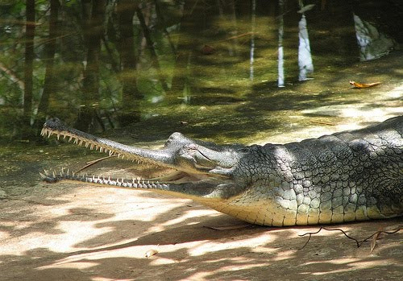
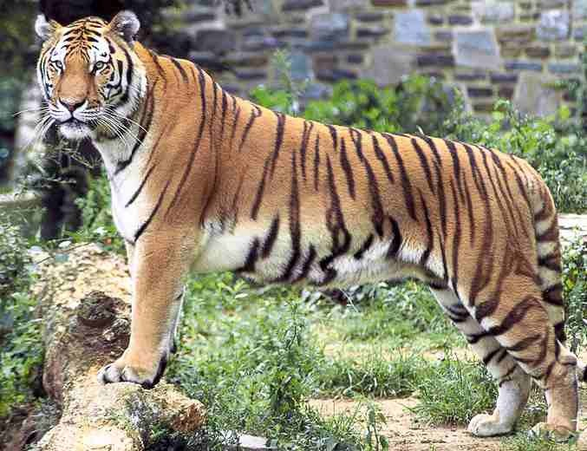
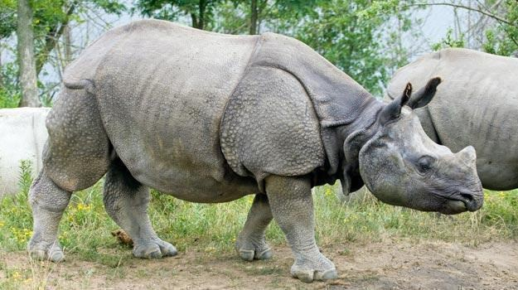
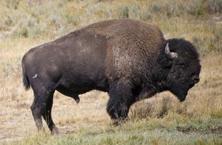

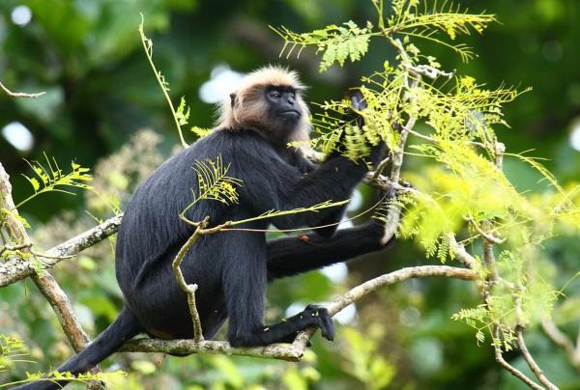
Unit 4: Biodiversity and Conservation
Pygmy hog (Porcula salvania)
Indian Javan rhinoceros (Rhinoceros sondaicus inermis)
Malabar large-spotted civet (Viverra civettina)
Photo: 4.1: Endangered Wild Animal Species of India
Gharial
Indian Tiger
One Horned Rhinoceros
Indian Bison (Gaur)
Snow Leopard
Nilgiri Langur

Slide 60


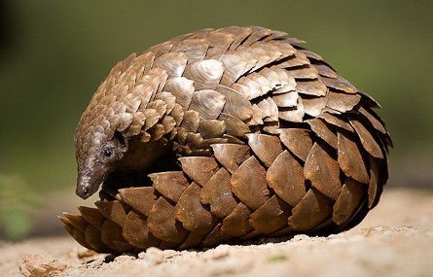
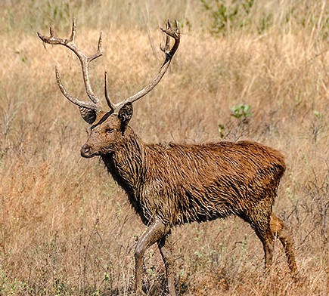

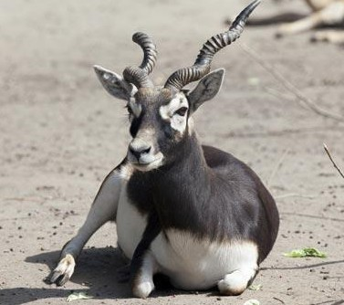
Unit 4: Biodiversity and Conservation
Phayre’s Leaf Monkey
Red Panda
Indian Pangolin
Barasingha
Asiatic Lion
Blackbuck

Slide 61

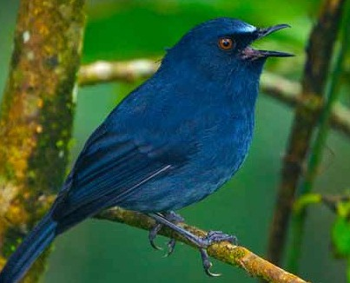

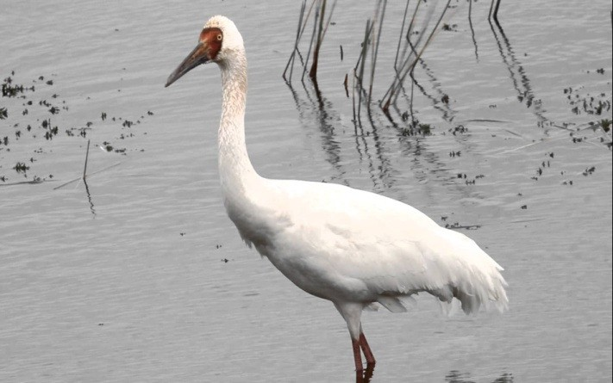
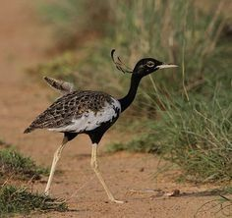
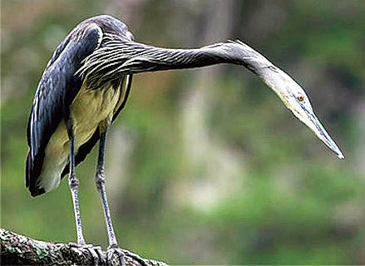
Unit 4: Biodiversity and Conservation
Photo – 4.2: Endangered Birds Species of India
Great Indian Bustard
White-bellied Blue Robin
Forest Owlet
Siberian Crane
Bengal Florican White bellied heron
Threats to Biodiversity: Habitat Loss, Poaching of Wildlife, Man-Wildlife Conflicts
Man has begun to overuse or misuse most of these natural ecosystems. Due to this ‘unsustainable’ resource-use, once productive forests and grasslands have been turned into deserts and wastelands have increased all over the world. Mangroves have been cleared for fuelwood and prawn farming, which has led to a decrease in the habitat essential for breeding of marine fish. Wetlands have been drained to increase

Slide 62
Unit 4: Biodiversity and Conservation
agricultural land. These changes have grave economic implications in the longer term. The current destruction of the remaining large areas of wilderness habitats, especially in the super diverse tropical forests and coral reefs, is the most important threat worldwide to biodiversity. Scientists have estimated that human activities are likely to eliminate approximately 10 million species by the year 2050. There are about 1.8 million species of plants and animals, both large and microscopic, known to science in the world at present. The number of species however is likely to be greater by a factor of at least 10. Plants and insects as well as other forms of life not known to science are continually being identified in the worlds’ ‘hotspots’ of diversity. Unfortunately at the present rate of extinction about 25% of the worlds’ species will undergo extinction fairly rapidly. This may occur at the rate of 10 to 20 thousand species per year, a thousand to ten thousand times faster than the expected natural rate! Human actions could well exterminate 25% of the world’s species within the next twenty or thirty years. Much of this mega extinction spasm is related to human population growth, industrialization and changes in land-use patterns. A major part of these extinctions will occur in ‘biorich’ areas such as tropical forests, wetlands, and coral reefs.
The loss of wild habitats due to rapid human population growth and short term economic
development are major contributors to the rapid global destruction of biodiversity. Island flora and fauna having high endemism in small isolated areas surrounded by sea have so far been most seriously affected by human activity, which has already led to extinction of many island plants and animals (the dodo is a famous example). Habitat loss also results from man’s introduction of species from one area into another, disturbing the balance in existing communities. In the process, the purposely or accidentally introduced organisms (Eupatorium, Lantana, Hyacinth, Congress grass or Parthenium) have led to the extinction of many local species. Loss of species occurs due to the destruction of natural ecosystems, either for conversion to agriculture or industry, or by over-extraction of their resources, or through pollution of air, water and soil. In India, forests and grasslands are continuously being changed to agricultural land. Encroachments have been legalized repeatedly. Similarly natural wetland systems have been drained to establish croplands resulting in loss of aquatic species. Grasslands that were once sustainably used by a relatively smaller number of human beings and their cattle are either changed to other forms of use or degraded by overgrazing (Erach Bharucha (2013).
Our natural forests are being deforested for timber and replanted using teak, sal or other single
species for their timber value. Such plantations do not support the same biological diversity as a multi- storied natural forest, which has a closed canopy and a rich understorey of vegetation. When excessive firewood is collected from the forest by lopping the branches of trees, the forest canopy is opened up and this alters local biodiversity. Foraging cattle retard the regeneration of the forest as seedlings are constantly trampled. Increasing human population on the fringes of our Protected Areas degrade forest ecosystems. This is a major factor to consider in evaluating the quality of the ecosystem. Repeated fires started by local grazers to increase grass growth ultimately reduces regeneration and lowers the diversity of plant species. Without alternate sources of fodder this pressure cannot be decreased. Another factor that disrupts forest biodiversity is the introduction of exotic weeds which are not a part of the natural vegetation. Common examples in India are lantana bushes, Eupatorium shrubs and ‘congress’ grass. These have been imported into the country from abroad and have invaded several large tracts of our natural forests. These weeds spread at the expense of the diverse range of indigenous undergrowth species. The impact on the diversity of insect, bird and other wildlife species, though not adequately studied, is quite obvious. In our country a

Slide 63
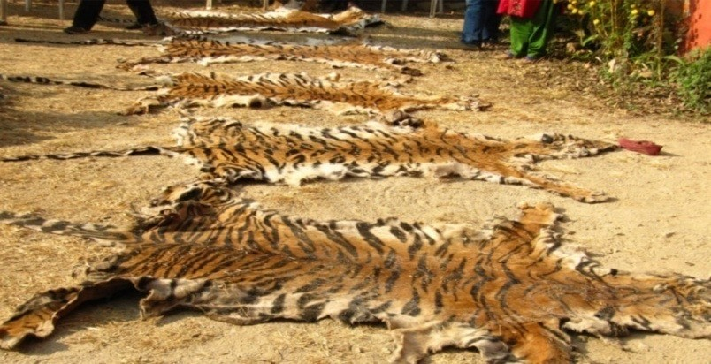



Unit 4: Biodiversity and Conservation
variety of traditional farming techniques have evolved over several centuries. Cultivation by slash and burn in the Himalayas, and ‘rab’ by lopping of tree branches to act as a wood-ash fertilizer in the Western Ghats, are two such systems. When human population in these areas was low, these were sustainable methods of agriculture. Unfortunately these areas now have a large number of people who subsist largely on forest agriculture. These methods are now unsustainable and are leading to a loss of forest biodiversity. Overharvesting of fish, especially by trawling is leading to serious depletion of fish stocks. Turtles are being massacred off the coast of Orissa. The rare whale shark, a highly endangered species, is being killed off the coast of Gujarat.
Poaching: Specific threats to certain animals are related to large economic benefits. Skin and bones from tigers, ivory from elephants, horns from rhinos and the perfume from the must deer are extensively
used abroad. Bears are killed for their gall bladders. Corals and shells are also collected for export or sold on the beaches of Chennai and Kanyakumari. A variety of wild plants with real or at times dubious medicinal value are being over harvested. The commonly collected plants include Rauvolfia, Nuxvomica, Datura, etc. Collection of garden plants includes orchids, ferns and moss. (Erach Bharucha (2013).
Photo- 4.2: Poaching of Wildlife
Conservation of Biodiversity
Human should conserve biodiversity because of its benefit for example services and biological resources which are essential to live our life on earth. However, it also provides spiritual benefits as well as social benefit.

Slide 64
Unit 4: Biodiversity and Conservation
Conservation is the protection, preservation, management, or restoration of wildlife and natural resources such as forests and water. Through the conservation of biodiversity and the survival of many species and habitats which are threatened due to human activities can be ensured. There is an urgent need, not only to manage and conserve the biotic wealth, but also restore the degraded ecosystems.
Humans have been directly or indirectly dependent on biodiversity for sustenance to a
considerable extent. However, increasing population pressure and developmental activities have led to large scale depletion of the natural resources.
Benefits of Biodiversity conservation
Conservation of biological diversity leads to conservation of essential ecological diversity to preserve the continuity of food chains.
The genetic diversity of plants and animals is preserved.
It ensures the sustainable utilization of life support systems on earth.
It provides a vast knowledge of potential use to the community.
A reservoir of wild animals and plants is preserved, thus enabling them to be introduced, if need be, in the surrounding areas.
Biodiversity conservation assures sustainable utilization of potential resources.
Types of Conservation:
Conservation can broadly be divided into two types:
In-situ conservation
Ex-situ conservation
Biodiversity Conservation
IN-Situ
1). Protected Areas
Ex-Situ
Seed Banks, Gene Banks
Long Term Captive Breeding
Animal Translocations
Tissue Culture Banks
Cryopreservation of Gametes and Embryos
Botanical Gardens
Zoological Gardens or Zoos.
National Parks
Sanctuaries
Biosphere Reserves
2). Sacred Forests and Lakes
In Situ Conservation
Faced with the conflict between development and conservation, many nations find it unrealistic and economically not feasible to conserve all their biological wealth.
On a global basis, this problem has been addressed by eminent conservationists. They identified for
maximum protection certain ‘biodiversity hotspots’ regions with very high levels of species richness and high degree of endemism (that is, species confined to that region and not found anywhere else).
Initially 25 biodiversity hotspots were identified but subsequently nine more have been added to the list, bringing the total number of biodiversity hotspots in the world to 34.

Slide 65
Unit 4: Biodiversity and Conservation
These hotspots are also regions of accelerated habitat loss. Three of these hotspots – Western Ghats and Sri Lanka, Indo-Burma and Eastern Himalayas cover our country’s exceptionally high biodiversity regions.
Although all the biodiversity hotspots put together cover less than 2 percent of the earth’s land area, the number of species they collectively harbour is extremely high and strict protection of these
hotspots could reduce the ongoing mass extinctions by almost 30 per cent.
In India, ecologically unique and biodiversity-rich regions are legally protected as biosphere reserves, national parks, sanctuaries, reserved forests, protected forests and nature reserves.
India now has 14 biosphere reserves, 90 national parks and 448 wildlife sanctuaries.
Plantation, cultivation, grazing, felling trees, hunting and poaching are prohibited in biosphere reserves, national parks and sanctuaries.
Protected Area Network in India
National Board for Wildlife (NBWL), chaired by the Prime Minister of India provides for policy framework for wildlife conservation in the country.
The National Wildlife Action Plan (2002-2016) was adopted in 2002, emphasizing the people’s
participation and their support for wildlife conservation.
Reserved & Protected Forests
As of present, reserved forests and protected forests differ in one important way:
Rights to all activities like hunting, grazing, etc. in reserved forests are banned unless specific orders are issued otherwise.
In protected areas, rights to activities like hunting and grazing are sometimes given to communities
living on the fringes of the forest, who sustain their livelihood partially or wholly from forest resources or products.
The first reserve forest in India was Satpura National Park in Madhya Pradesh.
Typically, reserved forests are often upgraded to the status of wildlife sanctuaries, which in turn may be upgraded to the status of national parks, with each category receiving a higher degree of protection
and government funding.
Wildlife Sanctuaries or wildlife refuges
Wildlife Sanctuaries or wildlife refuges are home to various endangered species.
They are safe from hunting, predation or competition.
They are safeguarded from extinction in their natural habitat.
Certain rights of people living inside the Sanctuary could be permitted.
Grazing, firewood collection by tribals is allowed but strictly regulated.
Settlements not allowed (few exceptions: tribal settlements do exist constant; efforts are made to relocate them).
A Sanctuary can be promoted to a National Park.
There are more than 500 wildlife sanctuaries in India.
National Park
National parks are areas reserved for wild life where they can freely use the habitats and natural resources.
The difference between a Sanctuary and a National Park mainly lies in the vesting of rights of people
living inside.

Slide 66

Unit 4: Biodiversity and Conservation
Unlike a Sanctuary, where certain rights can be allowed, in a National Park, no rights are allowed.
No grazing of any livestock shall also be permitted inside a National Park while in a Sanctuary, the Chief Wildlife Warden may regulate, control or prohibit it.
Eco-Sensitive Zones
The National Wildlife Action Plan (2002–2016) of MoEFCC stipulated that state governments
should declare land falling within 10 km of the boundaries of national parks and wildlife sanctuaries as eco fragile zones or ESZs under the Environmental (Protection) Act, 1986.
The purpose of the ESZ was to provide more protection to the parks by acting as a shock absorber or transition zone.
Eco-Sensitive Zones would minimise forest depletion and man-animal conflict.
The protected areas are based on the core and buffer model of management.
The core area has the legal status of being a national park.
The buffer area, however, does not have legal status of being a national park and could be a reserved forest, wildlife sanctuary or tiger reserve.
Biosphere Reserve
Large areas of protected land for conservation of wild life, plant and animal resources and traditional life of the tribal are living in the area.
May have one more national parks or wildlife sanctuaries in it.
Core area
Comprises a strictly protected ecosystem for conserving ecosystems, species and genetic variation.
In core or natural zone human activity is not allowed. Buffer zone
Used for scientific research, monitoring, training and education.
Transition area
Ecologically sustainable human settlements and economic activities (tourism) are permitted.
With the cooperation of reserve management and local people several human activities settlements, cropping, recreation, and forestry are carried out without disturbing the environment.
like
Source: http://cdn.intechopen.com/
Man and Biosphere Programme (MAB programme)
It was first started by UNESCO in 1971.
Later introduced in India in 1986

Slide 67
Unit 4: Biodiversity and Conservation
Aim
Studying the effects of human interference and pollution on the biotic and abiotic components of ecosystems.
Conservation the ecosystems for the present as well as future.
The main objects of MAB programme are to:
Conserve representative samples of ecosystem.
Provide long term in situ conservation of genetic diversity.
Provide opportunities for education and training.
Provide appropriate sustainable managements of the living resources.
Promote infer national co-operation.
Tiger Reserves
Same as sanctuaries. But they are monitored by NTCA under Project tiger.
The various tiger reserves were created in the country based on ‘core-buffer’ strategy.
Core area
The core areas are freed of all human activities.
It has the legal status of a national park or wildlife sanctuary.
Collection of minor forest produce, grazing, and other human disturbances are not allowed.
Buffer areas
Twin objectives:
Providing habitat supplement to spillover population of wild animals from core area.
Provide site specific co-developmental inputs to surrounding villages for relieving their impact on core area.
Collection of minor forest produce and grazing by tribal’s is allowed on a sustainable basis.
The Forest Rights Act passed by the Indian government in 2006 recognizes the rights of some forest dwelling communities in forest areas.
Conservation Reserves
Conservation Reserves can be declared by the State Governments in any area owned by the Government, particularly the areas adjacent to National Parks and Sanctuaries and those areas which link one Protected Area with another.
Such declaration should be made after having consultations with the local communities.
The rights of people living inside a Conservation Reserve are not affected.
Community Reserves
Community Reserves can be declared by the State Government in any private or community land not comprised within a National Park, Sanctuary or a Conservation Reserve, where an individual or a
community has volunteered to conserve wildlife and its habitat.
As in the case of a Conservation Reserve, the rights of people living inside a Community Reserve are not affected.
Sacred Groves
India has a history of religious/cultural traditions that emphasised protection of nature.
In many cultures, tracts of forest were set aside, and all the trees and wildlife within were venerated and given total protection.

Slide 68
Unit 4: Biodiversity and Conservation
Such sacred groves are found in Khasi and Jaintia Hills in Meghalaya, Aravalli Hills of Rajasthan, Western Ghat regions of Karnataka and Maharashtra and the Sarguja, Chanda and Bastar areas of Madhya Pradesh.
In Meghalaya, the sacred groves are the last refuges for a large number of rare and threatened plants.
Ex situ Conservation
In this approach, threatened animals and plants are taken out from their natural habitat and placed in special setting where they can be protected and given special care.
Zoological parks, botanical gardens, wildlife safari parks and seed banks serve this purpose.
There are many animals that have become extinct in the wild but continue to be maintained in zoological parks.
In recent years ex situ conservation has advanced beyond keeping threatened species. Now gametes of threatened species can be preserved in viable and fertile condition for long periods using cryopreservation techniques, eggs can be fertilized in vitro, and plants can be propagated using tissue culture methods.
Seeds of different genetic strains of commercially important plants can be kept for long periods in seed banks.
The national gene bank at National Bureau of Plant Genetic Resources (NBPGR), Delhi is primarily
responsible for conservation of unique accessions on long-term basis, as base collections for posterity, predominantly in the form of seeds.
Botanical garden
Botanical garden refers to the scientifically planned collection of living trees, shrubs, herbs, climbers and other plants from various parts of the globe.
Purpose of botanical gardens
To study the taxonomy as well as growth of plants.
To study the introduction and acclimatization process of exotic plants.
It acts as a germplasm collection.
It helps development of new hybrids.
It augments conserving rare and threatened species.
It facilitates training of staff.
It acts as a source of recreation.
Zoo
Zoo is an establishment, whether stationary or mobile, where captive animals are kept for exhibition to the public and includes a circus and rescue centers but does not include an establishment of a licensed dealer in captive animals.
The initial purpose of zoos was entertainment, over the decades, zoos have got transformed into centers for wildlife conservation and environmental education.
Apart from saving individual animals, zoos have a role to play in species conservation too (through captive breeding).
Zoos provide an opportunity to open up a whole new world, and this could be used in sensitizing
visitors regarding the value and need for conservation of wildlife.
Constraints in biodiversity conservation
Low priority for conservation of living natural resources.

Slide 69
Unit 4: Biodiversity and Conservation
Exploitation of living natural resources for monetary gain.
Values and knowledge about the species and ecosystem inadequately known.
Unplanned urbanization and uncontrolled industrialization. Historic Citizen Movements to Conserve Biodiversity Chipko Movement
It is a social-ecological movement that practiced the Gandhian methods of satyagraha and nonviolent resistance, through the act of hugging trees to protect them from falling.
The modern Chipko movement started in the early 1970s in the Garhwal Himalayas of Uttarakhand, with growing awareness towards rapid deforestation.
The landmark event in this struggle took place on March 26, 1974, when a group of peasant women in
Reni village, Hemwalghati, in Chamoli district, Uttarakhand, India, acted to prevent the cutting of trees and reclaim their traditional forest rights that were threatened by the contractor system of the state Forest Department.
Their actions inspired hundreds of such actions at the grassroots level throughout the region.
By the 1980s the movement had spread throughout India and led to formulation of people-sensitive
forest policies, which put a stop to the open felling of trees in regions as far reaching as Vindhyas and the Western Ghats.
The first recorded event of Chipko however, took place in village Khejarli, Jodhpur district, in 1730
AD, when 363 Bishnois, led by Amrita Devi sacrificed their lives while protecting green Khejri trees, considered sacred by the community, by hugging them, and braved the axes of loggers sent by the local ruler, today it is seen an inspiration and a precursor for Chipko movement of Garhwal.
Appiko Movement
Appiko movement was a revolutionary movement based on environmental conservation in India.
The Chipko movement in Uttarakhand in the Himalayas inspired the villagers of the district of Karnataka province in southern India to launch a similar movement to save their forests.
In September 1983, men, women and children of Salkani ‘hugged the trees’ in Kalase forest. (The local term for ‘hugging’ in Kannada is appiko.)
Appiko movement gave birth to a new awareness all over southern India.
Ecosystem and Biodiversity Services:
Ecosystems and the biological diversity contained within them provide a stream of goods and
services, the continued delivery of which remains essential to our economic prosperity and other aspects of our welfare. In a broad sense, ecosystem services refer to the range of conditions and processes through which natural ecosystems, and the species that they contain, help sustain and fulfil human life (Daily, 1997). These services regulate the production of ecosystem goods, the natural products harvested or used by humans such as wild fruit and nuts, forage, timber, game, natural fibres, medicines and so on. More importantly, particularly for those in less developed economies, ecosystem servicessupport life by regulating essential processes, such as purification of air and water, pollination of crops, nutrient cycling, decomposition of wastes, and generation and renewal of soils, as well as by moderating environmental conditions by stabilising climate, reducing the risk of extreme weather events, mitigating droughts and floods, and protecting soils from erosion. (Dr. Jaboury Ghazou 2005).

Slide 70
Unit 4: Biodiversity and Conservation
Ecological Value:
From an ecological perspective, the diversity increases the ecosystem's stability (capacity to maintain
itself into healthy margins of variation adapting recurrently to changes) and resilience (ability to respond and recover to great stress events), which is an extraordinary quality, because it means that biodiversity is able to maintain itself in the time, owing to the called biogeochemical cycles
Economic Value:
From the perspective of an economist, biological diversity or ‘biodiversity’ is of interest for two fundamental reasons. First, biodiversity is valuable to society. That is, the greater the biodiversity we have, the better off we are and if we lose some biodiversity, we consider ourselves to be worse off. Second, choices made by society have made and are continuing to have effects on biodiversity. That is, some of the resource use decisions made by society – albeit inadvertently – have left us with less biodiversity. Clearing land for agriculture, harvesting timber from forests, draining wetlands for housing estates for example, have caused depletions in biodiversity. Putting these two reasons together lead the economist to conclude that biodiversity is a scarce and valuable resource. And for an economist, that means their discipline has something to contribute to the biodiversity debate, simply because the focus of economics is on the analysis of the ways societies make choices about their scarce and valuable resources.
Biological diversity contributes to billions of dollars to national economy for all countries around
the world. This is real, and not potential. According to the Secretariat of Convention on Biological Diversity (SCBD), the estimated economic potential of biodiversity in the pharmaceutical sector is about
$640 billion of which 25-50 per cent is derived directly from biological resources, globally.
Social Value:
While traditional societies which had a small population and required less resources had preserved their biodiversity as a life supporting resource, modern man has rapidly depleted it even to the extent of leading to the irrecoverable loss due to extinction of several species. Thus apart from the local use or sale of products of biodiversity there is the social aspect in which more and more resources are used by affluent societies. The biodiversity has to a great extent been preserved by traditional societies that valued it as a resource and appreciated that its depletion would be a great loss to their society.
The consumptive and productive value of biodiversity is closely linked to social concerns in traditional communities. ‘Ecosystem people’ value biodiversity as a part of their livelihood as well as through cultural and religious sentiments. A great variety of crops have been cultivated in traditional agricultural systems and this permitted a wide range of produce to be grown and marketed throughout the year and acted as an insurance against the failure of one crop. In recent years farmers have begun to receive economic incentives to grow cash crops for national or international markets, rather than to supply local needs. This has resulted in local food shortages, unemployment (cash crops are usually mechanised), landlessness and increased vulnerability to drought and floods.
Ethical and Moral Values
Every form of life on earth is unique and warrants respect regardless of its worth to human beings; this is the ecosystems right of an organism. Note that every organism has an inherent right to exist regardless of whether it’s valuable to human beings or not. Humankind is part of nature and the natural

Slide 71
Unit 4: Biodiversity and Conservation
world has a value for human heritage. The well being of all future generations is a social responsibility of the present generations, hence the existence of an organism warrants conservation of the organism. (Thecla M. Mutia, 2009)
Aesthetic Value:
Human beings derive great enjoyment from natural environment. The shapes, structure and colour stimulate our senses and enrich our culture. This is illustrated majorly in the popularity of biodiversity conservation measures and the myriad of the many organizations which fight for the protection of different organisms. A lot of money is paid to conserve wildlife for their value in nature through so many organizations. Wild species enhance our appreciation and enjoyment of the environment through:
Leisure activities e.g. bird watching and nature trailing;
Spotting activities e.g. spot hunting, spot fishing, diving and mushroom picking;
Hearing, touching or just seeing wildlife;
Enjoyment as seen in art and culture e.g. dolls and teddy bears.
Informational Value:
Biodiversity holds the potential for applied knowledge through the discovery of how different species have adapted to their varied environments (Wilson 1992). That is, biodiversity holds potential insights for solutions to biological problems, both current and future. We might discover bacteria that inhabit hot springs and have evolved enzymes that function at unusually high temperatures, as in the case of PCR described earlier. We might discover novel predator defense mechanisms of plants and develop previously unimagined alternatives to pesticides for our foods. Or from indigenous peoples we learn about poison-dart frogs; study of the toxins of poison dart frogs is providing insight into fundamental neural mechanisms. Such new insights and tools came not from our imaginations but from observations of other peoples and other species. Even with the dazzling power of modern molecular biology, is it reasonable to expect that we can imagine all the new solutions that can be devised? The diversity of life supplies us not only with new tools and techniques, but also with the inspiration to imagine innovations.
Wildlife studies have shown evidence of effects of various chlorinated organic compounds on the immune systems of animals (reviewed in Repetto and Baliga 1995) and on their reproductive physiology (Colborn and others 1993). The evidence is much less conclusive that these compounds have an effect on human physiology, but the accumulation of evidence from wildlife studies points to the need for more- detailed research on possible effects on humans.

Slide 72

Unit 5: Pollution
Unit 5
Pollution
Introduction
Pollution of the environment is one of most horrible ecological crisis to which we are subjected now-a-days. The three basic amenities for living organisms are water, land and air. In the past, these were pure, uncontaminated and basically most hospitable for living organisms. But the situation is just revere today, because progress in science and technology is also leading to pollution of environment and serious ecological imbalance which in the long run may prove disastrous to mankind.
The environmental pollution is the result of industrial and technological revolution coupled with speedy exploitation of every bit of natural resources. The race among nations for development has complicated the existence of man on earth. The craze of more yields in agriculture, industry and refinement in technology is taken as the general criterion of development of any nation. Such activities of man have created adverse impacts on all the living organisms.
The rapid industrialization has left us with polluted rivers, contaminated soil, depleted wildlife and exhausted natural resources. Today, the environment has become foul, contaminated and therefore, harmful for man’s survival. The overall exploitation of nature by man has disturbed the delicate ecological balance between living and non-living components on earth. This undesirable situation created by man has threatened the very survival of man on this planet.
The evil of environmental pollution (air, water, soil) is thus the outcome of man’s fiddling with nature in the guise of progress. It is not only the industrialized nations which are threatened with pollution, but also developing countries of the world over too.
Air Pollution Introduction
The earth is the only planet in the entire universe, which is known to be capable of supporting life. The unique atmosphere of our planet is responsible for life on it. Today’s there is overwhelming evidence that various pollutants affect the life on planet. The harmful effects of various pollutants in human beings, animals and plants have been well recognized.
It has become evident that air pollution is affecting the vegetation to some extent as it is affecting human and animal life. So “fight against pollution” has become the need of the day.

Slide 73

Unit 5: Pollution
For our better living, we need clean air and water which is likely to deteriorate further because of the rapid industrialization, urbanization and population explosion.
What is Air Pollution?
Air pollution may be defined as the imbalance in quality of air, so as to cause adverse effect on the living organisms existing on earth.
Air pollution is generally disequilibrium condition of air caused due to the introduction of foreign elements from natural & man-made sources to the air so that it become injurious to the biological communities.
According to the latest view, air pollution is defined as “the substances introduced into the air, by the activity of mankind in such a concentration which is sufficient to cause serious effects on his health,
vegetables or interference with the enjoyment of his property”.
Major Sources of Air Pollution
Natural Sources - The natural sources of air pollution are volcanic eruption releasing poisonous gases such as SO₂, H₂S, and CO, vegetation decay and forest fires. All these are produced naturally and released in the
air making it dirty and injurious to the health. Green plants through respiration release huge amount of CO₂, forest fires and reactions between natural gas emissions also constitute a source of air pollution.
Artificial or Man-Made Sources- Man made sources such as increase in population, emission from vehicles,
agriculture activities, deforestation, rapid industrialization, burning of fossil fuels and wars are the major sources of air pollution.
Emission from the vehicles-The automobile exhaust are responsible for more than 75% of air pollution. Automobile such as cars, scooters, motors-bikes, helicopters, aeroplanes etc. taxis, release huge amounts of poisonous gases such as carbon monoxide(77%), hydrocarbons (14%) and nitrogen oxide (above 8%).
In America, more than 60% of air pollution is produce by its 83 million cars. It is estimated that the highest intensity of carbon monoxide in atmosphere during peak traffic hours at selected point in Kolkata
is 35 ppm due to auto-exhaust.
Deforestation- Plants maintain the balance of CO₂ and O₂ in the nature. Plants purify the air by taking in CO₂ for their use in photosynthesis and giving oxygen to be used by the animal during respiration.

Slide 74
Unit 5: Pollution
Indiscriminate cutting of trees and clearing of the forest i.e. , deforestation by man for his own immediate needs disturb balance of CO₂ and O₂ in nature. This causes increase in CO₂ and decrease in O₂ concentration in atmosphere.
Fast increasing population is also responsible for deforestation because forest land have to be converted for agricultural and habitation purpose.
Rapid Industrialization- A large number of industries such as chemical industries, paper and pulp, metallurgical plants, petroleum refineries, mining and synthetic rubber industries are responsible for about 20% of air pollution. The most common pollutants emitted are SO₂, H₂S, NO, NO₂, CO₂, CO etc. In addition, the smoke coming out from their chimneys also contain small particles of dust, carbon, metals, other solids, liquids and even radioactive material which gets mixed in smoke and pollute the air. All such gases and suspended particles in air are injurious to the health of human beings.
In textiles industry, workers constantly inhale cotton dust. The cotton dust release from industries located at Ahmedabad and Surat in Gujarat is one of the most air pollutants in cities.
Similarly in flour mills, workers constantly inhale flour dust, making bangles and other glassware. Food processing factories and tanneries produces the problem of dirty odours.
At the petrol filling stations, the workers inhale large quantities of benzene constituent of petrol which cause headache, sleeplessness, giddiness etc. to some of them.
Agricultural Activities- Different type of pesticides, insecticides etc. which are used in agricultural practices, also cause air pollution because some amount of these poisonous substances are carried away by the wind to different places, during their spray over the crops and thus makes surrounding air unfit for human health.
Burning of Fossil Fuels and Fires- The conventional sources of energy are wood, coal and natural gas. About 92 % of the energy we use in our homes and factories is generated by coal, oil, and natural gas which are called fossil fuels.
Oil and gas are the most important fuels than coal because they are easier to extract and give more heat. Burning of these sources is responsible for the air pollution. The by-products of wood, coal and fossils fuel emit poisonous gases such as CH₄, CO, SO₂, NO₂ etc. The kind, quality and concentration of these pollutants depend on the type of fuel being used, e.g. the smoke coming out from the chimneys of a large number of factories contain SO₂. These gases sometimes mix with small particles of metal near factories and get oxidized to SO₃. SO₂ and SO₃ are harmful and also react with water to form sulphuric acid. These acids come down on down on earth in the form of acid rain.
Wars - The air pollution is also caused by various types of explosives used in wars. Radioactive rays coming out from nuclear explosions pollute the air. Therefore, mankind is suffering to a very large extent. The impact of atom bomb explosion in Hiroshima and Nagasaki during second world war and recent gulf war well known examples.
Air Pollutants
There are five primary gaseous pollutant which together contribute more than 90 % global air pollution. These are:
Oxides of Nitrogen (NOx)
Oxides of Sulphur (SOx)
Oxides of Carbon (CO₂ & CO)

Slide 75
Unit 5: Pollution
Hydrocarbon
Particulate Matter
Oxides of Nitrogen (NOx)- Oxides of nitrogen involve in air pollution, denoted by NOx are N₂O, NO, NO₂, N₂O₃ and N₂O₅. Of these Nitric Oxide (NO) is the principal component. It is formed by combustion of nitrogen and oxygen. About 95% of nitrogen oxide is emitted as nitric oxide & remaining 5
% or NO_{2,} These oxides are largely emitted by automobile and electric power industry of developed
countries in metropolitan cities. Vehicular exhaust is most important sources of nitrogen oxide. These oxides occur in atmosphere in following form.
Nitric Oxide: It is main product of combustion from automobile exhaust produced by combustion of gasoline.
Nitrous Oxide (N₂O): It is present in air at a concentration of 0.25 ppm. Maximum level is 0.5 ppm. It is
not a product of combustion.
Nitrogen dioxide (NO₂): In atmosphere, NO₂ level is about 0.001 ppm. It is a strong absorber of ultraviolet light and chief constituent of photochemical smog. It initiates photochemical reaction in troposphere.
Nitrogen Trioxide (N₂O₃): It reacts with water vapor to form nitric acid which combines with ammonia to form ammonium nitrate.
Nitrogen Pentaoxide (N₂O₅): It forms nitric acid water and thus it reduces pH of rain water.
Sources of NOx Pollution- Man made sources of NOx varies depending upon area to area. NOx are 10 to 100 times greater in urban atmosphere as compared to rural areas. Major man made activities
include combustion of coal, oil, natural gas and gasoline which produced upto 50 ppm of nitrogen. NOx are also produced as a byproduct of some chemical industries like sulphuric acid and nitric acid industry.
Effect of NO2 on Plants
Higher concentration of NO₂ damages the leaves of plants, retard photosynthetic activity and cause chlorosis.
Plants exposed to 100 ppm of NO₂ cause leaf spotting and breakdown of plant tissues.
Its damage to the vegetation, probably results from production of secondary pollutant such as ozone and smog.
NO₂ is highly injurious to plants. Sensitive plant show visible leaf injury when exposed to 5 to 8 ppm
of NO₂ for 1 to 3 hours.
Effect of NO2 on Human Health
Adverse effect of NO₂ on health may vary with degree of exposure. An exposure of 50 to 100 ppm of NO₂ causes inflammation of lung tissue for 30 to 50 min. for a period of 5 to 8 weeks.
NO₂ has irritating effect on mucus membrane.
Higher doses of NO₂ cause bronchitis and respiratory problems.
500 to 600 ppm of NO₂ for 2 to 10 days results in death of victim.
Cigarette smoker readily develop lung diseases develop as cigarette contain 330 to 1500 ppm of NOx.
NO₂ causes irritation of eyes.
Nitrous acid cause adverse effect on respiratory, digestive and nervous system.

Slide 76
Unit 5: Pollution
Nitric oxide gets attached to haemoglobin and reduces oxygen transport efficiency of blood.
Higher level of NO₂ causes internal bleeding, pneumonia, oxygen deficiency and lung cancer.
Both NO and NO₂ are fairly toxic at low concentration. NO₂ being about five times as toxic as NO is responsible for destructive metabolism of body.
Oxides of N₂ are second most abundant atmospheric pollutant. These are extremely dangerous to human health. Their acute effects are more severe than CO.
2. Oxides of Sulphur (SO₂)
SO₂ is the second most important contributor air pollutant, as it accounts for about 29% of the total weight of pollutant. Sulphur in low concentration is essential for plant and animal both, but it
becomes injurious when its concentration increases. There are two sources of SO₂:
(i) Natural (ii) Man- Made
Natural Sources i.e. volcanoes provide about 67% of the SO₂ pollution all over the globe while
man-made source i.e., fossil fuel combustion accounts for 74%, industries 22% and transportation 2% of the total SO₂ emission. This clearly indicates that coal fired power station is mainly responsible for SO₂ pollution followed by industrial plant.
Burning of fossils fuel in thermal power plant, manufacture of sulphuric acid, fertilizers, smelting and other and other process accounts for 76% of total SO₂ emission while automobile and refineries
contribute to the rest of 25%.
In USA, 37 million tons of SO₂ was emitted in 1970 and 95 million tons in 1980. It is expected that about 109 million tons of SO₂ are added year into the entire world. According to a recent report of
NEERI, level of SO₂ in air Delhi is 41.4 mgm/m³, in Mumbai 57.1 mgm/m³, in Kolkata 32.9 mgm/m³, in Chennai 8.3 mgm/m³. Specify the accepted levels of SO₂.
Effect of SO2 on Human Beings
It causes intense irritation at 2.5 ppm level to the eyes and respiratory tract.
SO₂ is absorbed by nasal system leading to swelling. It particularly hits the aged and ill persons.
People may suffer from lung cancer due to raised level of SO₂ in the atmosphere.
SO₂ inhalation causes bronchitis & other lung diseases. These symptoms increase with increase in atmospheric concentration of SO₂.
Oxide of sulphur are the major contributor to lung diseases. Their increased concentration causes
acute and chronic asthma.
Effect of SO2 on Plants
SO₂ damages vegetables, crops and affect the plant growth and nutrient quality of plant product.
Acute exposure to high level of SO₂ kills leaf tissues causing leaf necrosis.
The edges and area between leaf veins are severely damaged.
Its chronic exposure to plant reduces plant productivity.
SO₂ is absorbed through stomata into mesophyll of leaves. When its absorption exceeds a particular level, the cells become inactive and are killed causing tissue collapse and drying of leaves.

Slide 77
Unit 5: Pollution
Effect of SO2 on Material
SO₂ is injurious not only to man but it also attacks marble, slate, paper, limestonnes, textile, roofing and building.
Paper also absorb SO₂ which is oxidiesed to supluric acid causing it to become brittle. SO₂ is also involved in erosion of building material such as marble.
3. Hydrogen Sulphide (H₂S)
Effect of H2S
It causes odur nuisance when present even in minute concentration.
H₂S causes headache, nausea, coma and finally death even at 1-3 ppm.
H₂S at 5 ppm affect digestive system destroying appetite.
An exposure of 150 ppm of H₂S creates conjunctivitis and irritation.
H₂S gas rapidly passes through alveolor membrane of lung and penetrates in blood. It causes death due to respiratory failures.
Short exposure even for 10-30 min. at 500 ppm of H₂S cause pneumonia.
Sources of H₂S: Major industrial source of H₂S are the users of sulphur containing specify the acceptable levels of H₂S fuels. About 28-31 million tonnes of H₂S are released by H₂S are by oceans and 60-80 million tonnes by land per year. Other sources of H₂S are decaying vegetation and animal matter, volcanic eruption, coal mines and sewer lines etc.
4. Carbon-Monoxide (CO) Sources
The natural source of CO are forest fire, the natural gas emission and the volcanic activities. Human activities, mainly automobile exhaust, contribute about 80% of CO emission. Its concentrations
vary depending upon the density of vehicular traffic.
In Mumbai, nearly 300 tonnes of CO is released from vehicular exhaust every day. It has been
observed that the ambient air concentration vary between 20 to 70 ppm at traffic junctions like Worli, Bycilla, Dadar and Fort during peak hours.
Effects: CO is very dangerous pollutant. It causes slow poisoning. It reacts with hemoglobin in the blood & effect its O₂ supply function. It is a strong agent to bind the haemoglobin, and has 300 times greater affinity for haemoglobin.
HbO₂ + CO
---> COHb + O₂
<---
Carboxy haemoglobin
The Brain has a high metabolic rate and consequently a high demand for O₂ which can be impaired by high carboxy-haemoglobin level. Cerebral oxygenation may suffer due to cardiac damage induced by CO. Immediate effects are headache, dizziness and loss of mental alertness and it becomes poisonous after, it increases the limit of 50 ppm.

Slide 78
Unit 5: Pollution
Particulate Pollutant
Air borne small solid particles and liquid droplets are collectively known as particulates. These are present in atmosphere in large number and sometime cause serious air pollution problem.
Types of Particulate:
Smoke: Smoke consists of solid and liquid particle ranging from 0.05 to 1 m which are formed during incomplete combustion process. It include smoke of gaseous pollutants like oxides of sulphur and nitrogen, CO, hydrocarbon etc.
Dust: Dust is composed of fine solid particles and their size range from 1 to 100 m. Dust particles are formed by (i) free materials used in mechanical processes i.e. , sand from sand blasting. (ii) particles
obtained directly from material upon it undergoes mechanical operation i.e. , saw dust, wood work.
Mist: Mist or liquid particles are formed by the condensation of vapour having size 10 m.
Fumes: Fumes are generally obtained by the condensation of vapours by the process of distillation,
sublimation, boiling and several other chemical reactions. Generally organic solvent like metal, metallic oxide from the fume particles having a size less than 1 m.
Carbon particles, ash, asbestos, oil and grease from particulates which are widely distributed in air. Sources of particulates- Natural processes injects 2000 million tonnes of particulate matter every year into the atmosphere. These processes include volcanic erruption, blowing of dust, soil by the wind.
Man-made activities- Emit 450 tonnes of particulates every year. e.g. particulate in the form of dust, asbestos formed during construction work fly ash from thermal power plant, mining process, smoke from incomplete combustion process etc.
Miscellaneous sources i.e., coal burning, agricultural burning, forest fires and other fires contribute 1/3 of total particulate emission by man-made activities.
Effects of Particulate Pollution
Effect on Human Beings:
Effect of particulate pollutant are largely dependent on the particle size. Air borne particles i.e. dust, soot, fumes are dangerous to the human health.
Particulate pollutant with size of about 1 m enters into lung rapidly and thus damages lung tissues.
Workers exposed to the asbestos particulates mostly develop lung cancer.
Lead is the most serious pollutant released from automobile exhaust and is reported to have harmful effect on children’s brain.
Lead also interferes with the development and maturation of RBCs.
It has been reported that smokes can easily develop symptoms of asthma which is also due to excess concentration of Pb.
Silicosis, a chronic disease of lung is caused by inhalation of dust containing silica.
Acid particulate cause eye, nose and throat irritation.
Lead and asbestos act as a cumulative poison and are dangerous to the children causing brain damage and cancer.
Black lung disease is common in coal miners while lung disease occurs frequently in textile workers.

Slide 79
Unit 5: Pollution
11) Fine particulate less than 2 m are the worst sources of lung damages while larger particles of 3 m are trapped in nose and throat. These particles create various breathing troubles by nose blockage and irritation of lungs.
Effects of Hydrocarbon
Effects on human Being
Hydrocarbons at high concentration (500-1000 ppm) have carcinogenic effects on lungs. Mainly, they cause swelling when they enter the lungs.
Aromatic hydrocarbons like benzene, toluene etc. are more dangerous than acyclic and alicylic
hydrocarbons. The inhalation of their vapours causes much irritation to the mucus membrane. However, their different levels create various acute symptoms in the body.
Secondary pollutant (PAN) produce by hydrocarbon and NOx results in the formation of
photochemical smog which causes irritation of eyes, nose, throat and respiratory distress.
Excess of hydrocarbon increase mucus secretion as a result of which respiratory tracts are blocked and man coughs regularly. Because of continuous cough much pressure is caused on the trachea of lungs due to which the lining membrane of alveoli bursts. So, very less area is left for exchange of oxygen and carbon dioxide.
Benzpyrene, which is present as trace amounts in tobacco, charcoal, boiled stacks and gasoline exhaust etc., is a dangerous cancer inducing hydrocarbon pollutant.
Methane (marsh gas) is a severe gas pollutant and occurs in air by volume of 0-0.002%. Its higher
levels in absence of oxygen, create narcotic effects on human beings.
Table 5.1: Effect of Toxic Hydrocarbons
Hydrocarbons | Content (ppm) | Adverse Effect
Benzene | 100 | Mucus membrane irritation
 | 3000 | Injure sensitive parts of body respiratory irritant
 | 7500 | Lung cancer, dangerous for health
 | 20,000 | Most fatal, causes death
Benzpyrene | 100 | Induces cancer
Toluene | 200 600 | Headache, weakness, fatigue Affect nervous system
Ozone, upto 0-2 ppm causes nose and throat irritation. Its exposure for two hours at 1 to 3 ppm. produces extreme fatigue and lack of co-ordination, while its high concentration (9 ppm) causes severe edema.
A group of hydrocarbons, especially the carcinogenic hydrocarbons cause cancer in man and animal affecting DNA and cell growth.

Slide 80
Unit 5: Pollution
Table 5.2: Hazards of Carcinogenic Hydrocarbons
Compound | Hazards | Compound | Hazards
Benzidine ß-Naphthylamine 3.Bis-chloromethyl ether | Causes bladder cancer Causes cancer in urinary bladder Creates lung cancer | 6.Ethyleneimine 7.b-piolactone 8. α- Naphthylamine | Causes cancer Potential carcinogen Causes bladder cancer
4. Ethylene dichloride |  | 9. Nitrophenol | Causes bladder cancer
5. Vinyl chloride | Causes stomach, spleen and lung cancer Causes liver cancer | 10.3-3’ dichlorobenzi- dine | Causes cancer
Effects on Plants
Hydrocarbons and photochemical oxidants are injurious to plants. Exposure to high levels of ozone to plants causes chlorosis i.e. , yellowing of green portion of leaves.
Ozone enhances plant injury creating light flecks of stipples (clusters of dead cells) on the upper leaf surface inhibiting photo synthetic activity of leaves.
Ethylene even at 1 ppm. concentration shows adverse effects on vegetation.
Acetylene and propylene at 50-500 ppm shows extreme toxicity towards plants damaging growth of vegetation.
Ethylene hydrocarbons inhibit plant growth and damage leaf tissues and death of flowering plants.
Effects on Material
Even low levels of ozone induces chemical alteration in natural synthetic textiles, paper, rubber, and polymers. Higher the number of carbon-to-carbon double bonds in the material, greater is the susceptibility of their attack.
Hydrocarbon pollutant damages long chains of carbon atoms losing tensile strength of polymers.
Ozone forms new carbon chain links between parallel carbon chains so that the material becomes less elastic and more brittle.
Water Pollution Introduction
Water is prime necessity of life. Man uses water for different purpose like drinking, disposal of waste, irrigation, generating electricity, cooling and manufacturing different product and disposal of
sewage.
During all these process, undesirable substance get entry to the water sources and therefore 20%
of river, lake, stream and surface water in India are polluted. Today, many of the rivers of world receive millions of liters of sewage, domestic, industrial and agricultural waste varying from simple nutrient to the highly toxic substance i.e. , Cd, Hg, nitrate and hydrocarbons etc.

Slide 81
Unit 5: Pollution
In USA, every major river has become seriously polluted. In India, all fourteen major rivers including Ganga, Gomti, Kaveri, Damodar have been polluted. Damodar is perhaps the most heavily polluted river. One litre of Damodar water contains as much as 900 milligram of iron and 27 mg of lead, 32 mg of Zn and 1313 mg of Ni. Beside these heavy metals, very high levels of sulphate, phosphate and nitrate were also found in water. Sulphate level ranging from 100 to 400 mg/1 was the highest recorded among the Indian river.
Pollution means the process of making soil, water and air dirty. According to Odum, water is said
to be polluted when it is changed in its quality or composition directly or indirectly as a result of waste disposal and other human activities so that it becomes harmful for domestic, industrial, agricultural, recreational and other purposes.
Normally, water is never pure in a chemical sense. It contains impurities of various kinds both dissolve and suspended. These comprises dissolved gases (CO₂, NH₃, and N₂), dissolve minerals (salts of Ca, Mg, Na), suspended impurities (clay, silt, sand and mud) and microscopic organisms. These are natural impurities derived from atmosphere and nearby area. But they are found in such a low concentration that they do not pollute water normally rather their presence is sometimes essential for maintaining potable water and other useful properties of water.
Polluted waters are turbid, sometimes smell bad and are not suitable for the domestic activities. They are generally harmful and disease like typhoid, paratyphoid, dysentery and cholera spread through
polluted water.
Causes of Water Pollution
Water pollution is mainly caused by:
(i) Natural process; (ii) Anthropogenic activities
Natural process in which decomposed vegetables, animals etc. are brought into main water bodies. All
these processes are interdependent on each other and lead to the natural environment. e.g. If organic waste or industrial effluent is added to the water it will not only influence chemical characteristics but will also affect color, odour and biological properties of water.
Artificial process such as industrial, agricultural, domestic, radioactive, mining, thermal power plants and use of fertilizers and pesticides by man.
These pollutants are constantly getting added to water deteriorating it to such an extent that it becomes unfit for the living communities.
Types of Water Pollution
Water pollution can be classified mainly into four categories. These are
Physical
Chemical
Bacteriological
Biological
Sources of Water Pollution
The major sources of water pollution are:
1) Domestic waste

Slide 82
Unit 5: Pollution
Industrial waste
Agricultural waste
Heat i.e., thermal pollution
Domestic Waste
It includes water, food waste, modern synthetic detergents which are used for cleaning and washing purpose. It also includes human waste (excreta) and other waste which are released and find their way into nearby water bodies.
Industrial Waste
Establishment of large number of industries like paper and pulp, textile, rubber, medicine and oil has caused water pollution problems. These industries produce a large number of effluent and are discharged into nearby rivers, ponds and streams without giving adequate treatment. Waste from chemical industries contain heavy metals like Cd, Cr, Hg, Pb which are carcinogenic in nature and toxic compounds like phenol, cyanide and ammonia. Most of these pollutants are non-degradable. Therefore they accumulate in food chain as Fe and cause many harmful effects. e.g. Mercury comes in water, in the effluent of paper and pulpindustry, which is harmful for aquatic life.
The waste from the textile industry are heavily loaded with organic and inorganic compounds which cause depletion of O₂ level in water bodies.
Table 5.3: Selected Indian Rivers and their Major source of Pollution
Sr. No. | Name of River | Sources of Water Pollution
1. | Yamuna in Delhi | Indraprastha Thermal Power Station (Delhi) DDT factories, sewage Chemical and tannery industries
2. | Ganga at Kanpur | Paper and pulp industry
3. | Gomati at Lucknow | Textile, chemical, paints, steel, rayon and oil industries
4. | Hooghly at Calcutta | Paper and pulp textile, tannaries and sewage
5. | Kaveri at Tamilnadu | Fly ash from thermal power station, steel industries
6. 7. | Damodar Godavari | Fertilizer industries and sewage
Agricultural Waste
In order to increase yield of crops, a number of fertilizers which are extremely essential for the plants and crop are applied but they have a harmful effect on human beings and animal life.
When excess of fertilizers are used they seep into ground through the surface water and find their way in
to nearby water bodies causing severe health hazards. These fertilizers, pesticides, insecticides etc., when reach bodies causes pollution problem. Most common insecticides are DDT, BHC etc.
Heat i.e. Thermal Pollution
Industries like nuclear power plant and thermal power station use a large quantity of water for cooling purposes. Thus water becomes heated. If such water is released into a nearby river or lake it causes thermal pollution. This pollution has profound effect on aquatic ecosystem.
The warm water has less amount of oxygen but animals need more of it, as their metabolic rate is higher. This lack of oxygen results in suffocation of many animals.

Slide 83
Unit 5: Pollution
This pollution can be controlled if thermal power stations have their own cooling ponds. This stored water can be used repeatedly and thus pollution can be minimized.
Effects of Water Pollution
Harmful Effects of Domestics Waste and Sewage
Sewage is commonly dilute aqueous containing minerals and inorganic matter. About 75% of the water pollution is caused by sewage, domestic waste and food processing plants. It also includes human excreta, soap detergents, glass, garden waste and sewage sludge.
Municipal waste is the principal contributor of water pollution. A recent report from the water pollution research lab indicates that domestic sewage contain trace quantities of Cu, Cr, Zn, Mn, Pb and
Ni. Sewage contain decomposible organic matter which generally include fatty acids, esters and amino acids and amides.
Harmful Effects of Domestic Waste
Sewage is an excellent medium for the growth of pathogenic bacteria, viruses, protozoa. Vibrio cholerae found in sewage causes cholera. Salmonealla typhosa cause typhoid while Shigella cause bacillary dysenteries.
The ova and the larvae of many worms are parasitic to man. They may pass out in urine and faeces, thereby contaminating water bodies.
Several pathogenic micro-organisms introduces into the water can cause harmful and chronic disease
in man and animal.
Sewage containing oxidizable organic matter causes depletion of dissolve oxygen in receiving water bodies thus affecting the aquatic flora.
Oxygen deficiency leads to the production of objectionable odour in water bodies.
Presence of solid matter floating in suspension and colloidal matter in sewage create serious water pollution problems.
Suspended matter present in sewage has a tendency to blanket water bodies. Thereby sunlight will not penetrate. Thus there will be reduction of aqueous organism.
Accumulation of sewage and domestic waste in water bodies stop self regulatory capacity of aquatic organism. Thus self purifying ability of water is lost and it becomes unfit for domestic purpose.
Discharge of nutrient rich effluent, sewage and domestic waste causes serious health problem in man.
Harmful Effects of Industrial Waste
Industrial effluent causes harmful effect on living organism and may bring about harm to kidney, liver, lung, brain and other reproductive system.
Biofectants such as chlorine gas, ozone, Al₂O₃, some iron compounds which are added in water to control the algal growth and bacteria present in water body may cause heavy mortality of fishes and plankton.
Industrial effluents containing acid and alkalies makes water corrosive.
Mineral constituent are responsible for excessive hardness of water which become unsuitable for domestic consumption.
Industrial effluent may impart color, odours, turbidity to receiving water bodies.

Slide 84
Unit 5: Pollution
(vi) In river Ganga alone, about 315 industrial plants are dumping their effluents. These are responsible for the ill health of 300 million people of north India.
Effects of Agriculture Waste
Effect of Fertilizers in Man and Animal
Excessive use of fertilizer leads to accumulation of nitrate in water. When such water is used by man, these nitrates are reduced to the toxic nitrite. Nitrite causes serious diseases in children called “Blue baby syndrome” where nitrite interferes with oxygen carrying capacity of blood and it damages the respiratory system of a normal person.
Normally, 0.8% of methanoglobin is present healthy person. But in “methanoglabimea” the content
increase in blood is 10%. Above 40%, it causes headache and giddiness. Above 60% it causes unconsciousness (coma). Death occurs at 80% of methanoglobin.
Recently, World Health Organization (WHO) reported that nitrate level in Rajasthan is 900 mg/lit
which is higher than the permissible limits of 45 mg/L. Nitrate poisoning in grazing animals like cow have been reported in Nagpur which is due to consumption to vegetables grown in nitrite rich soil.
Effects of Thermal Pollution
Rise in the temperature in aquatic system has profound effect on organism as well as on water quality. These effects are:
Reduction in dissolved oxygen.
Increase in B.O.D.
Direct fish mortality.
Early hatching of fish eggs.
Rapid multiplication of bacteria.
Undesirable changes in algal population.
Migration of aquatic organisms.
Changes in physical and chemical properties of water.
5. Heavy Metal Pollution
Heavy metal are usually present in trace amount in natural water, but many of them are toxic even at very low concentration. Their concentration increase in water due to addition of industrial waste. Some of them gets biomagnified in water and get accumulated in higher tropic level e.g. fish, crabs and other aquatic organisms.
Some of the heavy metals are extremely essential to human being e.g., Co, Cu, Mb, but large quantities of them may cause physiological disorders. Many of them are highly toxic even in micron
quantity.
Most of the rocks having these metals are sparingly soluble, hence limiting their concentration in
natural water bodies. Increasing quantity of heavy metal in our water bodies is currently of greater concern especially large number of industries discharges their metals containing effluent to the fresh water bodies without giving any adequate treatment. Significant quantities of heavy metal get transported through the agricultural runoff containing residues of organometallic compounds such as pesticides.

Slide 85
Unit 5: Pollution
Arsenic (Ar)- Arsenic is present in waste water of many industries such as tanneries, chemicals, metal and pesticide. It has a tendency to get accumulated in body tissues which cause a deadly disease known as arsenosis. It affects liver and heart and is also reported to be carcinogenic in nature.
Cadmium (Cd)- Cd is present in waste water from electroplating industries, chemical industries and mining waste. It accumulates in various part of the body i.e. , liver, kidney, pancreas and is known to
cause painful bone disease called Itai-Itai. This disease is common in foreign countries like Japan.
Chromium (Cr)- Chromium occur in higher concentration in the waste from electroplating industries,
paints, dyes, ceramic, paper etc. It is also added to cooling water to check corrosion. There are certain reports of accumulation of chromium at higher concentration irrespective of their valencies.
Copper (Cu)- Copper is naturally present in water and results in higher concentration due to pollution. It
is used with sulphate as pesticide and also separately as insecticide. Although it passes as such through the body but there is evidence of accumulation of large quantities in liver.
Lead (Pb)- Lead is also a toxic element and is introduced in water due to the industrial water such as
from printing, dying petrochemical and oil refineries. It accumulates in body mainly in bone. It is also found in kidney, brain and muscles. Lead poisoning is due to permanent cumulative effect and not due to occasional exposure in smaller doses. However, in extreme dose of Pb death may occur.
Mercury (Hg)- Mercury is highly poisonous element and is introduced in natural water by effluent from chemical industries. It is used in preparation of caustic soda, pesticides, batteries, pharmaceutical,
cosmetics and in dental preparation. It accumulate mainly in the forms of methyl mercury. It affects central nervous system and at higher doses resulted into death. Mercury was, main culprit in Minamata accident in Japan.
Zinc (Zn)- Zinc is present in higher concentration in the waste from pharmaceutical industries, paints, dyes, cosmetics and several insecticides and pesticides. Their discharges increase concentration and may cause various toxic effect. It also causes water to appear milky and on boiling a greasy surface i.e. , scum may also form in water.
Approaches to Prevent and Control Water Pollution
To achieve this goal, some of the suggested approaches are:
Establishing the Standard for Water Pollution Control: Standards have to be set for the receiving water itself
as well as for all effluent discharges into water bodies. Streams standards are the most suitable and economical way of getting desired water quality goals in large river where pollution occurs periodically. The waste water treatment required is based on pollution level. What does ‘regular interval’ imply? Does it mean that water pollution occurs periodically or at different places? Then ‘optional way’ has also not been elaborate upon. However, it has been found that stream and river standard involves lot of administrative and political difficulty.
Monitoring Network of Water Quality: Monitoring has to be undertaken in receiving water system and it waste water discharges which requires an extensive supervision. It is not difficult to monitor domestic
waste and sewage but problem arises with various industrial waste.
Different manufacturing procedure, internal operation, formation of new and varied product causes
high level of heterogeneous mix of effluent which makes monitoring very difficult in supervision scheme.

Slide 86
Unit 5: Pollution
Water Pollution Control Boards: Water prevention and control of pollution act, 1974 was adopted by 16 states and also constituted water pollution control board on New Delhi. Central Water Pollution Control Board (CPCB) has also been set up to coordinate with the various works of state boards.
Punishment for Violating the Act: In Industry, owner found violating the norms will be sent for six months of imprisonment.
Environmental Audits: To check industrial pollution, the government has decided that environmental audit statement will be compulsory in almost all countries or states. Accordingly a total of 1500 industries in India have been asked to adopt the anti-pollution measure of which 900 industries have so far completed the procedures till 2006.
Soil Pollution
“The soil may be defined as the uppermost, weathered layer of earth’s crust which contains dead and decaying matter and anchors plants”. The soil is formed due to weathering of rocks and the process is
called as Pedogenesis. The weatherings of soil occurs due to chemical method, physical method as well as the biological methods in which various factors operate to produce the soil. Formation of soil is affected by rainfall, temperature and nature of parent material.
The soil is made up of six components viz. inorganic matter, organic matter, soil moisture, soil air, soil solution and lastly the soil organisms. The organic matter is present in the soil in the form of parts of
dead and decaying plants and animals. The inorganic component is present in the form of gravel, silt, sand and clay. Soil organisms consist of micro-flora and macro-fauna consists of protozoan and bacteria. Fungi and algae are plants. The pollution of soil occurs due to addition of various harmful materials to the top soil cover.
Sources of Soil Pollution
Agricultural Activities
The agricultural practices add pollution load to the soil to a large extent. The agricultural aids wastes include different kinds of fertilizers, pesticides, herbicides etc. Due to inorganic impurities in fertilizers they cause soil pollution. The excreta of animals also contain pathogens and the pesticides include – DDT, Dieldrin, endrin, monocrotophos, phosphomidon etc. The spraying of pesticides adds a layer over the soil, subsequently polluting it.
Industrial Wastes
Various industries manufacturing chemicals, fertilizers, tanneries, pharmaceuticals, sugars, electroplating steel etc. dump their solid as well as liquids wastes on soil subsequently polluting it. Thermal power plants utilize coal from which fly ash is generated which covers the soil on large areas causing the soil quality to deteriorate. The cement and steel industries disturb the salt balance of soil and destroy its fertility. The alkalinity of soil is increased and the heavy metals and certain chemical compounds may ‘leach’ means out/away (of chemicals, minerals etc.) to be removed from soil etc. by passing water through it and enter plants causing bioaccumulation which are health hazards. Toxic effects can be seen in the plants and animals of the area.
Soil Pollution by Urban Wastes
Urban wastes comprises of both commercial and domestic wastes consisting of dried sludge. The solid wastes and refuse, particularly in urban areas contribute to soil pollution. This refuse contains

Slide 87
Unit 5: Pollution
garbage and rubbish materials like plastics, glasses, metallic cans, fibers, paper, rubbles, leaves, etc. Soil gets enormous quantities of waste product each year which causes the problems.
Radioactive Pollutants
They result from explosions of nuclear tests conducted on land and as atmospheric fallout from nuclear dust and radioactive wastes produced by nuclear testing labs. They penetrate the soil and cause the pollution.
Chemical and Metallic Pollutants
A number of industries like dyes, soap, detergents, tanneries, electroplating and metal industries pour their hazardous effluents in soil and create soil pollution. Today, soil contamination by toxic chemicals is an acute problem.
Soil Pollution by Biological Agents
Soil gets large quantities of animal, human and birds excreta which constitute major source of soil pollution by biological agents. In western developing countries intestinal parasite are the most serious problems of soil organisms. These biological agents are highly responsible for heavy contamination of soil and crops by pathogens.
Effects of Soil Pollutants
The industrial wastes are extremely toxic in nature for the living beings. The industrial wastes released various toxicants in the soil and consequently the toxicants are transferred to different organisms via food chain, thus, causing a number of undesirable effects.
Soluble metallic salts cause crop loss, soil loss and precipitate in food chain.
Severe agricultural crop damages are caused due to acidic and alkaline soils produced by discharged of industrial effluents.
The accumulation of sewage and domestics wastes in water bodies retards the self regulating capacity
of aquatic ecosystems.
Several pathogenic microorganisms introducd into water courses cause deleterious effects and cause chronic diseases in man. The protozoa, bacteria and viruses begin to grow on sewage under the
anaerobic conditions and spread water borne diseases like viral hepatitis, cholera, typhoid, dysentery etc.
Continued exposure of lead through ingestion result in gradual accumulation in the body. Symptoms of poisoning include loss of appetite, weakness, anaemia, vomiting, irritability etc.
Some heavy metals like cadmium are carcinogenic.
Radioactive pollutants of soil can produce harm to human beings on ingestion, after entering the body through food.
Several heavy metals presents in the effluents destroy useful microorganisms in the soil.
The pesticides presents in soil, particularly the Polychlorinated Biphenyls (PCB’s) cause diseases of lungs, cancers and nervous disorders in many people around the globe.
Control of Soil Pollution
The soil pollution cannot be controlled but can be minimized by adopting various methods. Sewage pollution of soil can be reduced by applying microbial treatment. From the solid waste of cattle,

Slide 88
Unit 5: Pollution
‘gobar gas’ can be generated and the sludge can be utilized as a manure for farms. Instead of normal chlorinated pesticides, biodegradable pesticides can be utilized which cause very less harm to soil.
Marine Pollution
Marine pollution can be defined as “The direct or indirect introduction of substances, by humans,
into the marine environment resulting in harm to marine organisms, hazards to human health, hindrances to activities including fishing and the deterioration and impairment of marine water quality”. Presently, the global marine waters are polluted due to human induced activities on land or in seas.
The vast stretches of ocean constitute the marine environment. The oceans are today, the ultimate sinkers for most of the waste we produce and dump. In addition to natural run-off, the oceans receive
agricultural runoffs, garbage, sewage and many such things. Many of these material which sink into sea are always contaminated with disease causing micro-organisms and toxic substances in traces including heavy metals, pesticides, herbicides and various organic compounds. Besides these, washing of cargo oil tankers, offshore oil drilling operations also cause marine pollution. The most notorious marine pollutant today is ‘crude oil’ from tankers.
Sources of Marine Pollution
Sewage run-off’s into oceans
Erosion of sediments due to mining, coastal dredging
Industrial waste discharges into coast
Seepages from landfill areas
Accidents of crude oil tankers in high seas
Offshore oil drilling operations
Oil well blow off’s in sea water
Plastics wastes floating due to dumping in open sea
Radioactive substance release from discarded nuclear submarines
Hot water release from power plants
Filling and releasing of water from oil carrying tankers
Effects of Oil on Marine Life
Due to human activity, oil spills at sea can originated from tankers, drillings, well below outs, intentional oil discharges in to sea, fractures in geological formations etc.
Oil tanker accidents are one of the major sources of oil spills in seas which result in widespread marine pollution. In the marine environment, oil is transported by wind, waves, tides and currents. It
spreads out in a slick. At sea, slicks move at about 3-4% of the wind speed. Depending on the oil spilled in sea, slicks are larger or smaller, may break up quickly or slowly and may mix with water contaminating it.
The effect of oil on ocean ecosystems depends mainly upon the following factors such as:-
Type of oil released whether refined or crude
Amount of oil released
Weather conditions prevailing in the area
Water temperature

Slide 89
Unit 5: Pollution
Distance of release from the shore
Ocean currents.
The effects of oil on marine organisms and their ecosystems depend upon physicochemical factors such as density, volatility, solubility, aromatic content and viscosity of the oil. The environmental factors like water temperature, season and size of area play an important role along with coastline characteristics. The toxicological characteristics of the spill relates to the vulnerability, sensitivity and developmental stage of marine organisms.
The maximum impact is on shore communities including crabs, lobsters, starfishes, molluscs, barnacles and sea weeds. The most common victims are the shoreline birds or sea birds. The oil directly impregnates the feathers of birds especially diving birds and the fur of marine mammals such as seals and otters. The oily coating destroys the animals’ natural insulation and buoyancy and most organisms get drowned or die of exposure from loss of body heat.
Heavy oil components that sink to ocean bottom can kill bottom dwelling organisms such as crabs, mussels and oysters and make them unfit for human consumption because of their oily taste and smell. Oil spills also cause most beaches oily with floating tar balls. Oil slicks that wash onto the beaches can have serious economic effects on coastal residents, who lose income due to lack of fishing and tourist activities. Oil polluted beaches are cleaned up after a year but contamination persists for a long. The volatile organic hydrocarbons in oil immediately kill a number of aquatic organisms directly.
A large number of fish mortality occurs due to choking of gills. A large number of corals are destroyed due to oil spills. The coral deaths result from smothering when submerged oil directly adheres to coral surfaces. Also tar accumulation on beaches reduces tourism potential of coastal areas.
The offshore oil and gas exploration can become a source of pollution, either in the form of accidental oil spills or release of water from oil bearing strata with oil and gas at the time of production. The produced
water is discharged with waste drilling chemicals, mud and contain toxic Poly-Aromatic Hydrocarbons (PAH), benzene, xylene and heavy metals like lead, mercury copper and nickel in varying amounts. It directly kills the phyto and zooplanktons as well as bioaccumulate the products in food chains thus magnifying it to a large extent affecting man ultimately.
Control Measure of Oil Spillage
The oil spillage control management includes:
Identifying likely spills sites and oil product carries
Listing of various experts, agencies and personnel dealing with oil spill management
Weather and oceanographic information
Toxicity and persistence testing using local marine organisms
Models for anticipated spills.
Oil Spills are Controlled by 3 Methods at Present
Physical control
Chemical control
Biological control

Slide 90

Unit 5: Pollution
Physical control is the first response and it is carried out mainly by specially designed floating booms. The oil is collected by specialized surface pumps, floating absorbents such as saw dust and straw and manual mapping. This practice id useful only when weather is cool and calm and to protect labors and in shores but ineffective in open seas.
In chemical control various sinking agents such as chalk, dispersants, gelling and surface wetting agents are used. The chemical dispersants break surface oil films into droplets. The droplets are then dispersed by tides. Their major drawback is they require specialized aircraft or ships for spraying and their subsequent toxicity.
Biological control of oil slicks is called as ‘Bioremediation’ in which degradation of organics occurs by biochemical activities of microorganisms which degrade the slicks into simpler forms. For this, addition of microbes is done in the oil films.
Table 5.4: Some Major Oil Spills in the World Marine Waters from Tankers
Year | Location and Tankers which met with Accidents | Spill Size (Tonnes)
1968 | England (Torrey Canyon) | 1,17,000
1968 | South Africa (World Glory) | 45,500
1970 | Baltic Sea (Othello) | 1,000,00
1972 | Gulf of Oman (Sea Star) | 1,15,000
1975 | Portugal (Jakob Macrsk) | 84,000
1977 | Pacific Ocean (Hawaian Patriot) | 99,000
1978 | France (Amoca Cadiz) | 2,33,500
1979 | Tobago (Atlantic Empress) | 1,20,000
1983 | Gulf of Oman (Assimi) | 54,000
1988 | North West Atlantic (Odyssey) | 65,000
1991 | Angola (ABT Summer) | 51,000
Noise Pollution
Noise may be defined as, “The undesirable sound that interferes significantly with the comfort,
health or welfare of persons, or with the full use or enjoyment of property”. It can be intermittent, continuous or instantaneous.
Sound is produced by the vibrations of an object and transmitted in the form of waves-alternating
with increase and decrease in pressures. It radiates outwards through a material medium of molecules, more or less like the ripples spreading out on water surface when some heavy object like stone has been thrown into it. The speed of sound varies according to the nature of the carrier media. In water, sound travels about 5 times faster than in air. In iron and steel it is even faster, about 3 times faster than the speed in water.

Slide 91
Unit 5: Pollution
Unlike all other pollution causing components of environment, sound is not a substance which can accumulate and harm future generations. It is a special kind of wave-action usually transmitted by air, in the form of pressure waves and received by the ear in the body of human beings and animals.
Decibel (dB) is used in environmental noise pollution as a measure of sound intensity.
Table 5.5: Sources of Noise and their Levels
Decibe (dB) | Sources of Noise
0 | Threshold of hearing
20 | Audible
30 | Bedroom at night
40 | Living room
50 | Office
60 | Normal conversation
70 | City street corner
80 | Inside an automobile
90 | Heavy machinery workshop
100 | Voice shouting, bottling plant
110 | Auto on Highway
120 | Boiler shop (threshold of pain)
130 | 75-piece orchestra
200 | Rocket take-off
Sources of Noise
The sources of noise are more in urban and industrial areas, as compared to rural areas. The sources, may be stationary or mobile.
Stationary Sources include industries; use of loudspeakers on various occasions like festivals, elections,
worshops in temples, mosques etc., and during advertisements; mining operations; use of bulldozers, drillers and dynamites to break rocks; household gadgets like vacuum cleaner, TV, radio, and fish markets; etc.
Mobile sources include road traffic, railway traffic, air traffic, navigation etc.
Traffic Noise
It is divided into three categories, viz. Road traffic, Aircraft, and Rail traffic noise.
Road Traffic or Highway Noise – The noise generated from highway traffic is one of the major sources of
noise pollution. Highway noises are of two types, viz. noises generated by individual vehicles, and noises generated by a continuous flow of vehicles of all types. The noise from individual vehicles includes noise from engine; exhaust noise, and use of horn. The noise volume increases with increase in traffic speed. The other factors on which traffic noise depends are traffic density and a number of other factors. In urban areas there are distinct traffic peaks in the morning and evening; and heavy diesel engine vehicles are the noisiest vehicles in roads.

Slide 92


Unit 5: Pollution
Table: Vehicle types and their Noise
Vehicle type | Noise (dB)
Luxury Limousine | 77
Small passenger car | 79
Miniature passenger car | 84
Sports car | 91
Motor cycle | 94
Scooter | 80
It can be observed from the table that sports and motor cycles (with their exposed engines and inadequate silencing arrangements) are notorious noise producers which produce more than 30 times more intense sound than the small passenger car and scooter.
Aircraft Noise- This source of noise pollution has been increasing steadily during recent years, especially in nearby areas close to international airports, and has now become a very serious problems. Noise made by jet planes is more disturbing. Noise is at a maximum during take-off landing. Aircrafts fly close to the ground for quite some distance during the landing, and this noise often constitutes a more sustained environmental nuisance than the intense noise of shorter duration produced during take-off. Major cities around the world have banned or reduced flights at night; and also prescribed noise limits.
Rail Traffic Noise- Noise from rail traffic is not a serious nuisance as compared to the road traffic and
airport noise. The noise produced is, generally of lower frequency than that of road vehicles; and further, most railway tracks run through rural areas. The impact of noise pollution by trains is felt maximum in

Slide 93
Unit 5: Pollution
buildings located besides railway tracks. The introduction of electric locomotives has helped greatly in the reduction of rail traffic noise.
Industrial Noise
The major sources of noise in an industrial plant are electromechanical machines (like motors, generators), impact machines (like punching, stamping, hammers), combustion process (furnaces), fluid motion (compressors, fans) and mechanical parts (like shafts, gears). For most of the industrial plants, the noise problem is limited to indoors. Textiles mills, foundries, machine tool and automobile industries, fertilizers plants and many other industries where heavy machines are working at high speed have high noise pollution, which requires urgent attention.
Noise from Construction Works
Noise from construction sites is generally far worse than the noise originating from factories.
There are two reasons for this-one is that construction (of roads bridges, buildings, dams, etc.) may become necessary anywhere; and the other reason is that construction equipments are inherently noisy.
(See table no 5.6)
Table 5.6: Sound Levels of Different Construction Equipment
Construction Equipment | Typical Sound Level [dB(A) at 15 m]
Rock drill | 98
Paver | 89
Scrapper | 88
Jack hammer | 88
Dump truck | 88
Dozer | 87
Concrete mixer | 85
Pneumatic tools | 85
Concrete breaker | 85
Hand held free saw | 82
Air compressor | 81
Generator | 76
Pump | 76
(iv) Neighborhood Noise
It includes a variety of noise sources which disturb and annoy general public. The most prominent is the indiscriminate use of loudspeakers in public functions, entertainments, festivals, elections, etc.
The other sources include vacuum cleaners, TV and radio sets, washing machines, etc.
Harmful Effects of Noise
Noise affects human body in a number of ways, ranging from psychological to physiological effects. Some of the important effects are:
(i) Auditory Effects- The exposure to intense sound can cause temporary or permanent shifting of the threshold of hearing, in those who are exposed to high noise levels over a long span, e.g. factory workers. Continuous exposure to noise levels above 100 dB has adverse effect on the hearing ability within a fairly

Slide 94
Unit 5: Pollution
short time. Besides progressive hearing loss, there may be instantaneous damage or acoustic trauma usually caused by a very high intensity noise of about 150 dB from explosion very near to the ear.
Speech Interface- A person may face the problem of trying to “understand another person talking to him in an environment with a high background noise level. Background noise level can thus affect the efficiency of offices, schools and other places where communication is of vital importance. External sounds can also interfere with conversation and use of the telephone, as well as the enjoyment of radio and TV. The maximum acceptable level of noise under such conditions is 55 dB. Background noise level 70 dB is considered very noisy and serious interference with verbal communication occurs.
Sleep Interference- The arousal from sleep depends upon the intensity of noise, depth of sleep, age, effect of alcohol or drugs, etc. Frequent sleep interface is a health hazard, since it deprives a person of the restorative process for his organs to renew their supply of energy and nutritive elements provided by a good night’s sleep. The loss of sleep from noise affects personal well-being and job performance. The preferable level is below 40 dB.
Task Interface-Many people complain that noise makes them mentally ill and reduces their working efficiency. Irregular bursts of noise are more disruptive than steady noises; and sound levels of 90 dB may interfere with the performance of task. In fact, noise is more likely to reduce the accuracy tasks are more likely to be adversely influences by noise.
Behavioral Effects- Noise pollution lowers down the hearing capabilities of an individual, which, in turn, result in poor concentration. Noise causes irritation, resulting in learning disabilities. Further, intermittent and impulsive noise distracts a person and can cause nervousness.
Emotional and Health Effects- There are chronic effects of noise pollution when a person is subjected to high noise levels for longer durations. Continuous exposure top high noise level is likely to cause reactions in the individuals, and thus, disturbing his personality make up. The lowered performance level among children may develop feeling of inadequacy and lack of confidence. It is observed that people suffering from hypertension, insomnia, fatigue, blood pressure and deafness show symptoms of living in noise polluted areas.
Pathological Effects- High frequency sound above the normal audible range (ultrasonic sound, whose frequency is above 20,000 Hz) can affect the semi-circular canals of the inner ear and make one suffer from nausea, excessive fatigue, headaches, and vomiting.
On the other hand, low frequency sound below the normal audible range (infrasound, whose
frequency is less than 16 Hz) can cause dizziness, nervous fatigue, nausea and loss of balance, at higher intensities, infra-sound can produce resonance in the internal body organs of a person giving the effects of reduced heart beat, variations in blood pressure, breathing difficulties, and possibly death.
Moderate vibrations can lead to pain, numbness and blue coloration (cyanosis) of fingers; while severe vibrations result in damage to bones and joints with swelling and stiffness.
Other Effects- There are increased incidences of birth defects, still births, and unusually low weight among children born to mothers living near high noise sources viz., airports, blast sites, etc,; indicating a correlation between adverse effects on child and noise stress suffered by the mother during pregnancy. Noise pollution also interferes with the normal development of the infants. At higher noise levels, the vision gets affected due to dilation of pupil (eyes) at around 125 dB.

Slide 95
Unit 5: Pollution
Control of Noise Pollution
The efforts to control noise are usually aimed at lowering the sound intensity of source. But due consideration should be given to the source-path-receiver view of the problem in the general noise control concepts. The source-path-receiver forms a linkage system with which attempts can be made at controlling the noise.
There are three ways to eliminated or reduce noise:
Eliminate the noise at the source
Modify the path, along which the sound is transmitted
Provide the receiver with some form of protection.
In some cases, controlling the noise at source may be sufficient; in other cases it may be necessary
to control the noise at each step of the system. Generally, taking care of the noise at source is the most desirable approach. The noise is reduced by enclosing a noisy machine, providing elastic suspension between the machine and its supporting structure, reducing speed of operation, using vibration dampening materials, modification in the design of machine, oiling and greasing of moving parts etc. But for best results, these efforts at controlling noise at source should occur in the early design stages. Such a step can save many problems because later modifications may be costly and technically impractical. In the early stages, it makes a sense in choosing a quieter machine.
Modification of the sound-path includes steps such as increasing the distance between the source and
receiver, orientation of the source so that noise directed at the receiver is minimum, introduction of sound barriers between the source and receiver (like walls, landscapes, plants growth particularly shrubs along highways, railways, etc.), use of reflectors which help in reflecting sound waves into the upper atmosphere and thus reducing the impact of noise pollution, and use of absorptive materials such as acoustic tiles, curtains, boards, wood panelling, porous bricks in buildings etc.
In situations, where neither source modifications nor path modifications reduce the noise to acceptable levels, direct protection of the receiver is necessary. In industrial situations, this includes rotating staff members from one room to another, issuing ear protection equipments (ear plugs), issuing personal noise dosimeters maintaining regular audiograms to monitor worker’s hearing capabilities.
Table 5.7
Area Code | Category | Limits in dB
 |  | Day | Night
A | Industrial Area | 75 | 70
B | Commercial Area | 65 | 55
C | Residential Area | 55 | 45
D | Silence Zone | 50 | 40
Table 5.8: Ambient Noise Standards in India (CPCB)
Sr. No | Type of Area | Intensity dB (A)
 |  | Day Time | Night Time
1. | Industrial Area | 75 | 70
2. | Commercial Area | 65 | 55
3. | Residential Area | 55 | 45
4. | Silence Zone | 50 | 40

Slide 96
Unit 5: Pollution
Table 5.9: Permissible Noise Limits for Different kinds of Motor Vehicles
Sr. No. | Vehicle Type | Limit d B
1. | Two wheelers capacity | - upto 80 cc | 75
 |  | - 80- 175 cc | 77
 |  | - above 175 cc | 80
2. | Three wheeler capacity | upto 175 cc 175 cc above | 77 80
3. | Passengers vehicles of different kinds based on tonnage
 | - 1. Upto 4 tonnes |  | 77
 |  |  | 80
 | - 2. 4-12 tonnes
 |  |  | 82
 | - 3. Above 12 tonnes
Thermal Pollution Introduction
Many industrial processes utilize water for their production processes and subsequently discharge
the heated waters into receiving water bodies (lakes, streams and rivers). Thus the receiving water into receiving water bodies get a large amount of heat energy which upsets the balance of aquatic organisms residing in it; subsequently harming them. This type of pollution due to discharge of heated effluent is popularly termed as thermal pollution.
Thus “thermal pollution” is defined as addition of excess of undesirable heat to water that makes it
harmful to man, animal or aquatic life, or causes significant departures from normal activities of aquatic biotic communities.
Or it is defined as the warming up of an aquatic ecosystem to the point where desirable animals are
adversely affected (Owen, 1985). Water gets polluted when hot effluents are added to water systems. Coal- fired thermal power plants, steel and chemical industries as well as atomic energy plants discharge their heated effluents into nearby lakes or rivers. This increases the temperature of water by 10ºC to 15ºC. A single 1000 MW power plant may use one half million gallons of cooling water per minute. The heated waters have reduced amount of dissolved oxygen content which results into massive fish and other aquatic organism deaths.
Sources of Thermal Pollution
The accelerated pace of development, coupled with extensive population density have increased demand of thermal power plants thus increasing the load of thermal pollution in India.
Coal-fired Thermal Power Plants- Some thermal power plants ultimately discharge hot waters having
temperature differences of 15ºC to water bodies. The Thermal power plants utilize coal as fuel and they constitute the major source of thermal pollutants. The heated coils are cooled with water from nearby lake or river and discharge the hot water back to the same water body thereby increasing temperature of the water, and results in killing of fish and other aquatic organisms.
Industrial Effluents- Industries generating electricity, using coal as fuel and Nuclear powered thermal
plants require huge amounts of cooling water for heat removal. Other industries like textiles, paper and pulp as well as sugar also release heat in water but to a much lesser extent. The heat from the turbo generators installed in industries have temperature of effluent about 5ºC to 9ºC more than the normal temperature of stream.

Slide 97
Unit 5: Pollution
To cope with the increased demand of electricity and rapid industrialization the number of installations are raised which results in discharge of more volume of heated effluent above the receiving water body temperature.
3) Domestic Sewage- The Domestic sewage is commonly discharged into rivers, lakes, and canals. The municipal sewage normally has a higher temperature than receiving water. The discharged water not only
raises the stream temperature to a measurable extent but also creates numerous effects on aquatic organisms. The organic matter present in the sewage utilizes the dissolved oxygen present in the surface water for oxidation. With the increase in the temperature of the water, the dissolved oxygen (DO) content decreases and the demand of oxygen increases. Hence, the anaerobic conditions will result in the release of foul and offensive gases depleting DO and the quality of water is also adversely affected.
Harmful Effects of Thermal Pollution
- Direct Fish Mortality- There is a particular temperature range that is tolerated by fish and other species
e.g. lethal temperature for trout is 22ºC, for yellow perch 35ºC and for carp it is 32ºC.Thus thermal death of fish may occur due to action of heat on nervous system, inactivation of enzymes and coagulation of cell protoplasm.
Reduction in Dissolved Oxygen of Water- Concentration of dissolved oxygen decreases with increase in temperature of water. The D.O. content is 14.6 ppm in water at a temperature of 32ºF and 6.6 ppm at 64ºF. Thus cold-water fish,which require about 6 ppm survive, would not tolerate the high water temperatures and would die of oxygen starvation. Since the aquatic communities live in water, a healthy stream should have an adequate supply of dissolved oxygen to supplement its needs.
Change in Water Properties- A rise in temperature changes the physical and chemical properties of water. The vapour pressure increases sharply, while the viscosity of water decreases. The decrease in density, viscosity and solubility of gases increase the settling speed of suspended particles, which seriously affects the food supply of aquatic organisms.
Increased Toxicity- The rising temperature increased the toxicity of the poison present in water. A 10ºC rise in temperature doubles the toxic effect of Potassium Cyanide, while an 80ºC rise in temperature triples the toxic effect of O-Xylene causing massive mortality of fish.
Interference with Biological Activities- Temperature is of vital importance to physiology, metabolism and biochemical process in controlling respiratory rates, digestion, excretion and overall development of aquatic organisms. The temperature change totally distrupt the entire ecosysytem, sharp changes in tempreture are often destructive. Because, the life of aquatic animals involves several chemical reaction and the rate of these reactions vary according o changes in temperature.
Interference with reproduction in Fishes- In fishes, several activities like spawning, hatching, and reproduction depend on optimum temperature. For instance, the maximum temperature at which a lake trout will spawn successfully is 8.9ºC. The warm water not only disturbs spawning but also destroys the laid eggs.
Variations in Reproductive Rate- The increase in temperature triggers deposition of eggs by female. The triggering is particularly dramatic in estuarine fish, which spawn in four hours after the water temperature reaches critical level.

Slide 98
Unit 5: Pollution
Metabolic Rate Enhancement- Fishes show a marked rise in basal rate of metabolism with temperature to the lethal point. The respiratory rate, oxygen demand, food uptake and swimming speed in fishes increase with rise in temperature of water.
Increased Vulnerability to Disease- Activities of several pathogenic microorganisms are accelerated by higher temperature. Hot water causes bacterial disease in certain fishes.
Undesirable Changes in Algal Population- The life in an ecosystem is greatly influenced by the algal growth. Excess nutrients from the washout waters from thermal power plants cause an excessive algal growth with consequent acceleration of eutrophication process and other undesirable changes.
Destruction of Aquatic Organisms- The volume of water required for cooling purposes from a stream is enormous. Unfortunately many planktons, fish and insects larvae that are sucked into the condenser along with cooling water are killed by the thermal shock in a thermal power plant.
Biochemical Oxygen Demand- When the temperature of stream carrying biodegradable organic matter rises, fish death may occur due to synergistic action, which is caused due to accelerated biochemical action.
Effect on Marine Life- Temperature plays an important role in affecting the metabolism, growth and development of marine organisms. Sea organisms are poilkilothermic i.e. , their body temperature varies with the temperature of surrounding water. Some marine creatures cannot tolerate wide changes of temperature, so they die at higher temperature.
Disruption of Food Chain- Heated water effluent disturbs food chain. A water flea (Daphnia) which can tolerate the thermal extreme of 95ºF would probably starve to death if the diatoms on which it feeds are unable to survive at that temperature. Fish feeding on water fleas would die of starvation in absence of their food i.e. , Daphnia thus disrupting the food chain.
Control of Thermal Pollution
Heat must be removed from the condenser cooling water prior to their disposal into receiving water bodies. The major principles involved in the process of heat loss are:
Conduction
Convection
Radiation
Evaporation
The following methods can be adopted to control high temperature caused by thermal discharges.
Cooling Ponds- The cooling towers are beneficially used in dissipation of heat. The water from the condensers is stored in the earth like ponds where natural evaporating brings down the temperature. The water is re-circulated.
Spray Ponds- In spray ponds, the water is sprayed in the cooling ponds with the help of spray nozzles to convert it into fine droplets which provide more surface area to facilitate efficient heat transfer to atmosphere.
Cooling Towers- Wet cooling towers- In wet cooling towers, the heated water is brought in direct contact with continuously flowing air. The evaporation brings down the temperature. To increase the surface area of contact, the water is broken down into droplet by use of spray nozzles.

Slide 99
Unit 5: Pollution
Nuclear Hazards Introduction
Radioactivity is the phenomenon of emission of radiation caused due to breaking up of nuclei of atoms of isotopes of element such as, Uranium-235, Uranium-238, Radium-226 etc. The emission of energy from radioactive substance in the environment is often termed as ‘Radioactive Pollution’ and the hazards arising out of this pollution are referred to as radiation or nuclear hazards.
Sources of Radiation
The sources of radioactivity are of two types i.e. , natural and man-made. The natural sources include cosmic rays from outer space and emissions from the radioactive materials of the earth’s crust. Cosmic rays continuously bombard the atmosphere to produce radioactive materials and natural radiations. The radio-isotopes presents in the earth’s crust also disintegrate to produces harmful radiations. People have been exposed to low levels of atmospheric radiations, since time immemorial but it is the man-made radioactive radiation hazards which is posing a grave threat to mankind. The man-made sources of radioactivity are nuclear wastes originating during:
Use of radioactive materials in the nuclear power plants
Mining of radioactive ores
Processing of radioactive ores
Use of radioactive materials in nuclear weapons
Use of radio-isotopes in research laboratories
Use of radio-isotopes in medical applications
The maximum exposure to man comes from the use of X-rays during diagnostic application and treatment of cancer.
Effects of Radiations
The effects of radioactive pollution mainly depends upon:
Half-life of the isotope
Energy releasing capacity
Rate of diffusion
Rate of deposition
Atmospheric condition
Climatic conditions such as wind, rainfall etc.
Harmful Effects of Radiation
Radiations produce a set of symptoms whose time of onset and severity depends on the size of dose. The acute effects of radiations include:
Nausea
Vomiting
Diarrhoea
Loss of appetite
Death

Slide 100
Unit 5: Pollution
The delayed effects are of two types:
Somatic effects
Genetic effects
The somatic effects lead to shortening of life span, loss of hair, cancer and cataracts. The studies in Nagasaki and Hiroshima revealed that about 50% of cancers of thyroid, 30% blood cancers and 20 %
cancers of other organs are due to harmful radiation effects.
The genetic effects include gene mutations and chromosomal aberrations which are carried on to
subsequent generations. Such effects may lead to the death of embryo, neonatal death of birth of offsprings with abnormalities. Abnormalities may be of any organ and may cause death of an individual at any stage. Many gene mutations are recessive and show-up in subsequent generations.
The low levels of ionizing radiations are part of the environment during the entire period in which life has evolved. On exposure to higher doses (400-500 rads) the bone marrow is affected, blood cells are reduced, natural resistance and fighting capacity is reduced, blood fails to clot and the irradiated person dies of infection and bleeding. Higher doses of (10000 rads) kill the organism by damaging the tissues of heart and brain. The workers handling radioactive wastes get slow and steady irradiations and develop cancers of various type slowly.
Radiation Hazards
As the use of radioactive materials increases, there is an increasing risk of high level radiation absorption and harmful effects.
The nuclear weapon testing poses the greatest threats and is the main contributor in increasing the
background radiation. Nuclear explosion in the due course result in the appearance of a very large neutron flux which makes the surrounding environment radioactive. These wastes have a residence time of about one to two years in the stratosphere. These radiations enter the sea from immediate fall out near the test site. Contaminatio from the tropo and stratospheric fallout is mainly through precipitation amounting to about 90 percent.
The effects spread by ocean currents very long approximating to about 450 to 2000 km range. The nuclear power plants are located, designed, constructed and operated to conform to very stringent safety standards to ensure that risk is very limited. However, a certain amount of risk is always involved at every stage of nuclear power generation right from the process of mining to disposal of nuclear wastes.
The effluents from mining and refining of ores contain a small percentage of radioactive materials which are harmful. Washing, refining and fuel processing also involves a small percentage of leakage so
does transportation and reprocessing of spent fuel. Another area of concern is the disposal of high level of radioactive wastes. Although strict precautions are taken, chances of leakage still remain. Other sources of leakage involve the use of radioactive tracer, coolants, waste from nuclear powered ships and accidents that occur. All these tend to multiply the radiation hazards in the environment.
Control
There is no cure for radiation damage. So the only option available is to check and prevent its pollution impact, as follows:
1) Leakages from reactors are to be stopped as soon as detected and safety measures to be strengthened to avoid nuclear disaster

Slide 101
Unit 5: Pollution
Careless handling of uranium rich ores is to minimized
Safety measures strictly enforced for workers
Waste disposal must be safe and affective
There should be regular monitoring in risk prone areas
Appropriate steps to be taken to minimize occupational exposure.
Nuclear Waste Disposal: Precautions
Since nuclear wastes are extremely dangerous, they are to be strictly disposed off by following the safety norms. The nuclear wastes are of 3 type viz. high level wastes, medium level wastes and low level wastes. The high level waste e.g. spent nuclear fuel has a very high radioactivity so these are very dangerous to release in the biosphere. They are converted into inert solids (ceramics) and buried deep in earth. Medium Level wastes e.g. reactor components are solidified and mixed with concrete in steel drums and buried in deep trenches in mines or below sea bed in concrete chambers. Low level wastes, e.g. solids or liquids contaminated with traces of radioactivity are disposal off in steel drums in concrete lines trenches in designated areas. In India, a waste immobilization plant is operated at Tarapore since 1958.
The essential precaution must be taken at a disposal site to minimize the hazards which include:
Monitoring the ambient radioactivity around the disposal area.
Prevention of erosion in the area of disposal
Prevention of drilling activity in the area
Long term monitoring of area to know leakages, if any, occur by chance.
Solid Waste Management Introduction
All solid and semi-solid wastes arising from anthropogenic activities are termed ‘Solid Wastes’. Any unwanted or discarded material from residential, industrial and agricultural activities which causes the problem of environmental pollution is termed as ‘solid waste’. It includes garbage, demolition and construction materials, dead, and decaying plants and animals, rubbish etc.
The quantity of solid waste produced mainly depends on the standards of living of people and their daily needs. It depends on festivals and seasons too. The “garbage” part of solid wastes consists of
putrescible organic wastes like animal, fruit and vegetables peelings, etc. resulting from the handling, preparation eating of foods. “Rubbish” includes combustible and non combustible solid wastes. The non- combustible rubbish consists of glass, tin cans, metals, construction materials etc.
There are generally 3 types of solid wastes:
Municipal wastes
Industrial wastes
Hazardous wastes
Municipal Solid Wastes
These wastes originates from daily household activities, public places, markets, institutions, street sweepings, etc. and it consists of everyday items such as- product packaging, furniture parts, clothing, bottles, food scraps, news papers, paints boxes, used batteries, food items, dead plants and discarded electronic goods in broken form. The general sources of municipal solid wastes are residential complexes,

Slide 102
Unit 5: Pollution
commercial and open areas like markets etc. The characteristics of municipal solid waste are given in Table 5.10.
The problem of municipal solid waste management has acquired alarming dimensions specially over the last decade. In the earlier days it was hardly considered as an issue of concern as the waste proportions were low and could be generated and disposed off easily. However, with changing life styles it has worsened today.
Table 5.10: Physico-Chemical Characteristics of Municipal Solid Wastes
Item/ Component | % on Wet Weight Basis
Paper | 5.78
Metals | 1.90
Glass | 2.10
Plastics | 3.90
Rags | 3.50
Ash and fine earth Total organic and compo | 40.31 stable matter 41.80
Industrial Wastes
Originate from various kinds of industries and their varied processes. It includes rubbish, construction and demolition materials etc.
Hazardous Wastes
These pose a grave danger to whole mankind & include wastes from medical colleges (biomedical waste), explosives, radioactive substances and so on. The sources include industries, nuclear power plants, laboratories and research institutes.
Causes of Solid Wastes Generation
Urbanization: Solid Waste is normally an urban problem. It has increased tremendously in metropolitan cities today. In developed countries, urban areas produce about 6-7 lac tonnes of wastes everyday which is sufficient to cover more than 1.6 sq.km. land everyday to a depth of 3 mts.
Over Population: The ever increasing population of Indian sub-continent adds severely to the problem of solid waste disposal. A huge amount of solid waste is generated from overpopulated areas.
Affluence of the Society: With maximum production and consumption there is a natural tendency of declaring the used articles as obsolete resulting in discarding them, leading to solid waste accumulation problem.
Technology: Due to rapid growth of technology today’s world is “produce, use and throw” resulting in the problem of dumping things in enormous quantities.
Effects of Solid Waste Pollution
Spreading of environmental diseases like bacillary dysentery, diarrhoea, amoebic dysentery, colic paints etc. are the results of germs developed in solid wastes which subsequently had entered in foods and drinking waters causing human health problem. The main carriers of these diseases are flies which develop on garbage heaps and spread the diseases.
Rats do not cause plague but their death merely indicates outbreak of plague.

Slide 103
Unit 5: Pollution
Contamination of water supply lines causing large scale epidemics of cholera, hepatitis, jaundice etc.
Danger of malaria, filarial, and dengue creep in when solid wastes choke gutter and sewer lines breeding lots of mosquitoes.
Aesthetics of the area where dumping sites are present are lost due to spreading of garbage by stray
animals like dogs, donkeys, pigs etc.
Due to decomposition of organic wastes foul smelling gases spreads everywhere and contaminate the air quality.
Due to burning of garbage and rubbish, poisonous gases like carbon monoxide emanate and pose danger to living beings.
Pollution of underground water tablets occur due to percolation of leachates produced from dumped and rotten things.
Control Measure of urban and industrial solid waste:
The current methods of solid waste disposal are:
Land Filling
Incineration
Pulverization
Composting
Pyrolysis
Disposal into open sea
Disposal of Solid Waste by Land Fillings- In this, the solid wastes are dumped into low lying areas. The refuse is dumped upto about 1.5 mts and covered by about 20 cm of earth so that the refuse remains covered by earth. Each layer is left out for 7 days and compaction is carried out for its settlement prior to putting next layer. With passage of time, waste is decomposed and stabilized within 2-12 months and settles by about 20-40% of its original height. This land can then be used for recreational purposes if needed. By this method low lying areas can be better reclaimed and this is the most simple and economical method used today.
Incineration- Incineration means burning which is carried out in furnaces. This method is used when dumping sites are not available. From the collected solid wastes non-combustible materials are first separated out and the combustible materials are only incinerated. The temperature of incinerating chamber should be more than 670ºC to incinerate all organic matter. When there is moisture in waste, wood, coal or oil are also added for smooth burning. The final product is ash and clinker.
Pulverization- Here solid waste is pulverized in grinding machines to reduce its volume and change of physical character. It is then disposed off by land filling.
Composting- In this method the organic waste is digested anaerobically and converted into humus and stable mineral compounds. The volume of solid waste is considerably reduced during composting and it is made free of pathogens. This is a hygienic method which converts the solid waste into manure.
This method is suitable for small and medium sized towns of India and solves three problems i.e. , disposal of solid waste, disposal of night soil and production of manure.
There are three methods prevalent in India:
1. Composting by trenching 2. Open window composting 3. Mechanical composting

Slide 104
Unit 5: Pollution
Composting by Trenching- In this method 4 x 10 m long 2-3 m wide and 1 m deep trenches are dug. Solid waste is dumped in them upto 15 cm and addition of 5 cm night soil or dung is done. This is made alternately in layers and the trench is filled above ground level to about 30 cm. Earth is placed and spread on its top to prevent files. After about 4 months, the mass gets stabilized and changes into brown odorless humus. This humus is removed from trench and sold as manure in the market.
Open window Composting- Here solid waste is directly dumped on ground to form 5-10 mt. long and 1-2 mt. wide piles having a height of 1 mt. It is covered with cow dung and left it there for 1 week. The pile is turned up at about 8 days and let again stranded. The process is repeated for 4-6 weeks for manure to be ready.
Mechanical Method- This method stabilizes the solid waste in about 3-6 days. The stabilization is done
under controlled conditions of temperature and moisture in mechanical digesters. The mechanical digesters are pits of closed types. Closed digesters are most hygienic and occupy less space. In this, the solid waste is converted into humus and stable mineral compounds.
Pyrolysis- Here, destructive distillation of solid waste is done. The combustible substances are heated at 650-1000ºC in pyrolysis retort in low oxygen environment. It is an endothermic process.
Disposal in the Sea- It is useful in coastal areas having deep sea water (730 m). It is quite cheap and simple method of disposal but has the disadvantage that the lighter components tend to spread over water and may return to shores and beaches spoiling the aesthetics.
The Initial cost, availability of land and plant, equipments and trained persons needed for operations, are some basic consideration for disposal method selection. The uncontrolled dumping is the cheapest option but is not hygienic. The manual methods are cheap and the manure can be sold to generate some revenue, but requires land. The land filling is adopted when large areas are available, while the incineration is very costly process.
The main objective of solid waste management is to minimize adverse impact on environment through collection, processing and disposal in an economical manner consistent with public health protection.
Recycling of Solid Waste
The recovery of solid waste components for possible use as raw materials is called recycling. It involved separating materials like glass, paper, plastic etc. from refuse and collecting it. Separation is done at point of generation or at central processing facility e.g. paper, glass, other metals etc. Recycling is an integral part of solid waste management. It also makes economic sense. The recycling will make available materials for generations without wasting, and will save our environment from degradation.
Waste Utilization through Recycling
Utilizing fly ash- The fly ash from thermal power plants is utilized for building bricks.
Utilizing slaughter house wastes for making leather product.
Agricultural waste utilization- manufacturing paper, card boards etc.
By proper utilization and recycling, degradation of environment can be minimized and employment opportunities can be generated.

Slide 105


Unit 5: Pollution
Biomedical Wastes
Disposal of bio-hazardous materials finds a special place in case of waste management because a considerable amount of waste comes out of hospitals and nursing homes. Proper care is essential to dispose off the bio-hazardous materials because, if not properly disposed off, they can be a major source of air, water and land pollution which is quite harmful to a large number of people.
The Ministry of Environment and Forests has drafted certain rules regarding the classification of bio-medical wastes, as per schedule. 1. According to schedule 1, there are 9 categories of bio-medical wastes.
Bio-Medical Wastes: Categories
Category of Wastes
Description
1
2
Human Anatomical Wastes: Human tissues, organs, body parts etc.
Animal Sastes: Animal tissues, organs, body parts, carcasses, bleeding parts, fluid, blood and experimental animals in research, waste generated by veterinary Hospitals, Colleges, discharge from hospitals, animal house.
Microbiology and Bio-technology Wastes: Wastes from laboratory culture, stocks or specimen
3
of micro-organisms, live or attenuated vaccines, human animal cell culture used in research and industrial laboratories, waste from production of biological toxin, dishes and devices used for transfer of cultures.
Waste Sharps: Needles, syringes, scalpels, blades, glass etc. that are capable of causing puncture and cuts. These include both used and unused sharps. Discarded medicines and cytotetic drugs; wastes comprising outdated, contaminated and discarded medicines. Soiled Waste: Items contaminated with blood and body fluids, including cotton, dressings, solid plaster cuts, linen, beddings, and other materials.
Solid Wastes: Wastes generated from disposable items such as, tubings, catheters, intravenous sets etc.
Liquid Waste: Wastes generated from laboratory and washing cleaning, housekeeping
and disinfecting activities.
Incineration Ash: Ash from incineration of any biomedical wastes.
Chemical Waste: Chemicals used in production of biological products, chemicals used in disinfection as insecticides etc.
4
5
6
7
8
9
The World Health Organisation (WHO) has classified medical waste into eight categories:
General waste
Pathological waste

Slide 106
Unit 5: Pollution
Radioactive waste
Chemical waste
Infections waste and offensively infections waste
Sharps
Pharmaceutical waste
Pressurized waste
Waste with high content of heavy metals, such as, batteries, broken thermometers, blood pressure gauges, etc. Pressurized containers, like gas cylinders, cartridges and aerosol cars etc. and radioactive waste, such as, waste containing radioactive substances in unused liquids from radiotherapy or laboratory research, contaminated glassware, packages or absorbent paper, urine and excreta from patients treated or tested with unsealed radionuclide, sealed sources, etc. also fall within the category of hazardous bio- medical waste.
The disposal technologies of the bio-medical waste are based upon the type of waste, category of waste and the geographical conditions.
Anatomical Waste (yellow bag): The anatomical waste is collected in yellow bag and is either incinerated or sent for deep burial.
Infectious Soiled Waste (red bag): The infectious soiled waste contains cotton, gauge, bandages, dressing
pads, etc. are either incinerated or first autoclaved and them disposed off by land filling. They are collected in red bag.
Plastic and Rubber Disposables (blue bag): This kind of waste is collected in blue bag. This should never be
incinerated or burnt as it emits ‘dioxins’ which are highly harmful substances to the atmosphere and are highly carcinogenic. The best methods of disposal of this type of waste are:
Autoclaving and shredding.
Chemical disinfection by P/o bleaching solution for one hour after mutilation.
Recycling after disinfection and mutilation. It cannot be recycled, it is sent for land filling or burial.
Sharps (White/light blue bag): The sharps are collected in white/light blue bag and put in puncture proof transparent container for transportation and disposal. All sharps are put in a sharp pit which is well covered and protected. The sharps are disinfected by 1% sodium hypochloride solution before disposal.
Radioactive Waste(special lead boxes): The radioactive waste is collected in special lead boxes for absorption
of radiation. It is stored in secured area till radioactivity decays. This is followed by disposal in secured landfill.
Waste with high Content of Heavy Metals: This kind of waste is segregated followed by disposal in secured landfill. It is reclaimed, recycled wherever possible.
The disposal of bio-hazardous waste, being extremely important, a number of techniques have
been developed for effective disposal of bio-hazardous waste. The techniques include:
Double chambered incineration
Autoclaving/steam sterilization
Chemical disinfection
Microwaving

Slide 107
Unit 5: Pollution
Hydroclaving
Plasma technology
Irradiation
Grinding and shredding
Compaction
As per rule 6 in schedule III of the Ministry of Environment and Forests, Government of India, the bio-medical waste containers/bags must carry a special label that is non-washable and prominently visible.
Role of Individual & Institutions in Prevention of Pollution
Pollution preventions is the sources reduction and other practices that reduce the creation of
pollutants. This is achieved through the increased efficiency in the use of raw materials, energy, water and other resources, or the protection of natural resources through judicious conservation methods.
The main principle behind pollution prevention is that “waste is the result of inefficiency”, whether
it is generated from production, utilization of things, of cultural practices, “so it has to be reduced”. Therefore, by adopting the “reducing waste concepts” we can increase the productivity. Likewise the environmental and health benefits from pollution prevention are many fold. The source reduction reduces the wastes at its originating point so that the environment is damaged to a minimum extent.
The role of citizen of a country comes while incorporating measures to minimize use of water and
electricity and their conservation in the daily life. Individual can incorporate wide range of pollution prevention activities that offer environmental and economic benefits sooner or later. By changing the way we use products and resources we can prevent pollution and save money subsequently.
The benefit of incorporating pollution prevention activities includes:
Less amount of solid wastes goes to landfill sites (dumps)
Reduced erosion of soil
Less consumption of water
Less electricity consumption saving the bills
Cleaner and unpolluted water and air
Natural resources conservation
Increased value of properties
The following activities if undertaken, will help individuals in pollution prevention in day to day life:
Reduce use of own vehicles to a minimum extent- Automobiles are big contributors to air pollution. Explore
options such as carpool, mass rapid transport etc. If at all driving is necessary, use an energy efficient automobile with well tuned engine, always.
Be careful while disposing automobile waste- The used engine oils contaminate water sources, also used batteries contain lead and acids that can leak into waterways. So take used engine oil, car batteries and tyres to a authorized recycling centre for disposal.
Plant green trees- To minimize soil erosion in your area.
Limit household wastes- To a minimum.
Be careful with pesticides- Make use of them only when needed. Whenever possible use natural pest control methods. Also reduce run-off by maintaining enough grass cover on top soil.
Beware of danger of lead to children- Lead is presents in many types of paints.So use paints without lead,
otherwise, the lead paints will harm the babies after some years.

Slide 108

Unit 5: Pollution
The following things will help us in becoming an environmental conservator:
Reuse and recycle paper, glass, scrap metal etc.
Vermicompost the organic waste
Look for recycling symbol on products while buying
Do not buy products with unnecessary packaging
Buy household articles in bulk to avoid the packaging waste problem
Buy only rechargeable batteries
Always carry reusable shopping bags with you.
Water Conservation
More efficient water use begins with everyone in the homes. For heating and pumping water at home a lot of energy is wasted by way of releasing pollutants in the environment. When we waste less
water, we are conserving fuel, and subsequently reducing the pollution problem.
Water conservation in bathrooms can be done by adopting following methods:
Install a water efficient shower.
Draw less water for bath.
While purchasing a new toilet purchase the one utilizing less amount of water flow.
Always close the dripping taps.
Check water leaks always and repair immediately.
Turn off tap while brushing or shaving.
In the Kitchen and Garden
Compost the organic waste by vermiculture rather than disposing it to dumps.
Run washing machine with full load of clothes only to save water.
Use cold water to save electricity instead of using hot water.
Outdoor things to conserve water:
Install a drip irrigation system for potted plants.
Use drought tolerant plants to avoid large amount of water being wasted on plants.
Water plants in evening only. This reduces evaporation to a great extent as throughout the night, the plant and soil are not exposed to sun.
Use porous pavement for walkways so that rainwater can percolate in soil easily and recharge groundwater tables as well as satisfy the demand of plants in nearby areas.

Slide 109
Unit 5: Pollution
Electricity Conservation Tips
Purchase energy efficient equipment and products which will reduce electric bills.
Switch off lights and fans when not required.
Turn off lights while sleeping at night.
Insulate the water heater and heating and cooling pipes.
Use compact fluorescent lamp instead of normal tube lights.
Clean and replace filters of AC's regularly.
Increase natural light in the rooms by opening windows of rooms and allowing light to come in.
By adopting above things, we can minimize pollution as well as save electricity and water and play our role effectively as a good citizen of India.
Disaster Management
The term “disaster” is derived from the French word ‘Disastre’ meaning “a bad or evil star”. A disaster is a sudden and unknown calamity which brings misfortune and miseries to mankind. The
disasters have serious impact on human life, economy and environment. The natural disasters are always sudden and severe in nature.
Disaster management is the effective organization, direction and utilization of available counter
disaster resources. The events of a disaster can be extremely traumatic for those who are unprepared. The principles of disaster management apply in both routine and crisis situations. Routine management relates to those activities that occur during non-crisis periods, such as disaster mitigation and disaster reconstruction. Crisis management applies to emergency operations and covers both the preparedness phase and the immediate post disaster periods.
The emphasis has been laid on advance planning. It is known as disaster preparedness which includes:
Strategic planning
Contingency planning (site specific)
Forward planning (when a disaster is expected to occur)
In recent years, variety of systems have been evolved to respond to different type of disasters that allows more rapid and quick responsive actions.
The thrust in this decade was “to reduce”, through concentrated international action, in the developing countries:
Loss of life
Damage to property
Social and economic disruptions caused by natural disasters like earthquakes, cyclones, floods and landslides.
With an objective to prevent and mitigate natural disasters various initiatives have been taken up at national and state levels as under:
1. National Decades for Disaster Reduction (NDDR)- The Govt. of India has finalized 29th October as “National Day for Disaster Reduction” every year. Its basic objective is to create mass awareness about natural disasters with subsequent mitigation.

Slide 110

Unit 5: Pollution
High Power Committee on Disaster Management- Is set in 1999 at the initiative of Prime Minister (PM) to prepare comprehensive model plans for management of disaster at the national, state and district levels under the chairmanship of Shri J.C. Pant.
National Committee for Disaster Management- Set up by Govt. of India under the chairmanship of PM. It suggests institution and legislative measures needed for an effective and long term strategy to deal
with major natural calamities in the near future.
Hazard Mapping and Vulnerability Assessment of Buildings- The Vulnerability Atlas of India was prepared by Ministry of Urban Development, which contains maps of earthquake, cyclone and flood prone areas.
Monitoring and Impact Assessment of Natural Disasters- Department of Space provided assistance and
support for monitoring and quick assessment of flood, cyclone and drought impact.
Use of modern Technology- Recent trend is using technologies like Remote Sensing, Global Positioning System (GPS) and Database Generation through Computer Modeling. Active efforts are taken for modernising the disaster management control rooms to make them more effective and community friendly.
Almost every country is prone to natural disasters, so with the advent and development of Science
& Technology man must work towards management and mitigation of disasters to the maximum possible extent, otherwise the disasters will continue to strike and take a heavy toll.
(A) Floods
Flooding is the most common environment mental hazard. The reason for this is the widespread geographical distributions of river valleys and low lying coasts, together with their long standings attraction
for human settlement. No country is immune from floods and in many cases the threat is limited to floodplains and estuarine areas only.
A flood is too much water in the wrong place, whether it be flooded by natural or man-made mistakes. Among the trigger mechanisms are dam failures in monsoon, more rains in the catchment than the area can dispose off, torrential rains of hunicanes, rapid snow melts etc. But most flood disasters are caused by humans making their land more prone to floods.
Flood hazard is a global phenomenon. In the period 1874-1979, nearly 10,700 people died due to floods all over the world. The Huangho of China and Kosi of Bihar are the most prominent examples, particularly notorious for their recurrent floods. The bursting of dams causes catastrophic floods such as

Slide 111
Unit 5: Pollution
Machu dam in Saurashtra which destroyed the whole township of Morvi (in saurashtra) in August 1979. In 1961 the Panchet and Khadakvasla dams in the Mula river destroyed parts of Pune city in Maharashtra.
Deforestation contributes considerably to the generation of floods. In view of the fact that about 86% of the land surface of the country (also the 77% of the Himalayan area) has lost its forest cover, one can easily understand the phenomenal increase in the recurrence and severity of floods, despite no perceptible change in rainfall pattern in the last century.
The rapid pace of urbanization and construction activities of man has considerably reduced the
infiltration rate and increased the surface run-off, causing local floods in big cities like Mumbai and Kolkata. In a city with 40% impervious surface the occurrence of floods is three times higher than when urbanization had not overtaken it.
Causes of Floods
River Floods
Atmospheric Hazards
Rainfall (Excessive)
Snow melt
Cloud bursts
Seismic Hazards
Landslides
Technological Hazards
Dam burst
Sudden & excess release of water from dams
Coastal Floods
Atmospheric Hazards
Storms
Excessive rainfalls are the most important cause of floods. These can vary from the semi predictable seasonal rains over wide geographic areas, such as give rise to the annual monsoon floods in
tropical areas to almost random conventional storms giving flash floods over small basins.
Melting snow is responsible for widespread flooding. The continental interiors of North America and U.S.S.R. produce regular floods due to snow melting in late springs and early summers. The most
dangerous melt conditions often arise from rain falling on snow to give a combined flow. This occurred in the Romanian Floods of May 1970, when the transsylvanian basin was devastated by heavy rain from a deep depression plus snow melt from the carpathion mountains.
Spring floods are greatly compounded by ice jam flooding. This occurs when the large ice chunks floating causes temporary damming of rivers. This floating ice freezes at some constriction in channels and
causes floods. Rapid flooding occur upstream first, and when the ice breaks, it causes destruction downstream due to it sever action.
Excessive rain within a short period of time is termed as “cloudburst’, which are very common in
the Himalayas, Orissa and Central and Western India. In August 1978, following a cloudburst in Himalayan ranges “the valley of Kanodia” was blocked to about 4 km long stretch, and a 3 km long and 3
m. deep lake was formed temporarily. As the debris mass moved downstream it blocked passage of

Slide 112
Unit 5: Pollution
Bhagirathi river and formed a mighty dam. After 14 hrs this dam burst and generated a massive flood wiping away everything in its path and caused huge landslides and massive destruction right down to Uttarkashi.
Rise in sea level in the coastal belts following tidal waves or hurricances may bring about devastating floods. Cyclones also bring heavy downpours for prolonged periods. The extensive flooding in
eastern U.P. and Northern Bihar, especially by Narayani and Kosi rivers is primarily due to the reduced carrying capacity of rivers choked with sediments derived from accelerated erosion in the Himalayan Region and inadequacy of slope in the flood plains.
The capacity of channels conveying water is diminished by the accumulation of sediments derived from severe erosion in the catchment area and by occupation of floodways for human settlement or
industrial development, so as to enhance the chances of floods.
Management of Floods
The management of floods implies the measures taken to reduce the proportion of run-off by increasing infiltration, spreading the excessive water that manages to get into the channels and disposing it through channels: The various measures of combating flood are:
Reduction of Surface Run-off by Increasing Infiltration- The most effective measure of flood management involves reduction of run-off by inducing and increasing infiltration into the ground in the catchment
area. The infiltration is considerably increased if the ground is carpeted with vegetal litter which forms under forest of deciduous plants. A dense vegetal cover not only promotes considerably infiltration, but also causes a large amount of water to be disposed off by evapotranspiration. The best method of flood management is thus to bring the catchment under afforestation with trees generating large amount of litter.
Developing Reservoirs and Detention Basins- To reduce flood discharges in rivers, reservoirs and detention basins are developed by putting small check dams or major dams such as Hiradund dam across Mahanadi, Panchet, Maithon dams on Damodar Basin, Ukai dam in Tapi basin. A portion of flood waters is retained behind the dams and the larger part is being allowed to flow down the channel under controlled conditions.
The construction of numerous smaller dams in the tributary streams would check flood flows from sub
basin and considerably minimize the floods of main rivers. Ponds and reservoirs in the upper reaches of rivers are very useful in not only minimizing floods but also for effectively harvesting water for dry season.
Spreading of Water in Paddy Fields and Desert Drylands- Flood waters can be distributed thinly over areas such as paddy fields and desert drylands where a part of the water is lost due to evaporation and quite a proportion infiltrates in to soil. There are a large number of paddy fields in the country. If half of this area is inundated under 20 cm deep flood waters nearly 5 million metric ha water can be prevented from flowing down the channels to become floods.
Groundwater recharge- The simplest, cheapest and possibly the most effective method of reducing flow on the ground would be to artificially induce infiltration through a large number of dug wells. The quantity of water that is stored underground in this manner will depend on the thickness and holding capacity of the permeable aquifer. The latral extent of aquifers in the river basins being virtually

Slide 113
Unit 5: Pollution
limitless, enormous quantity of excess water can be stored underground minimizing the flood hazard to a great extent.
Stream Channelisation- A network of canals is capable of reducing flood hazards. The canals serve as temporary storage of water and it is held in channels as the flood waves move downstream. The severity of the floods is thus reduced. Channel improvement by deepening, widening, straightening etc. increases the flood conveyance capacity of the rivers. These measures are supplemented by bank stabilization through construction of dykes and planting deep root trees in the embankment.
Flood Embankments- Building embankments parallel to river banks to prevent spilling of excess water appears to be widely adopted flood management part in Indian subcontinent. In the Bramhaputra valley in Assam, 2-3 m high embankments are constructed 1.6 km away from the river edge.
Hazard Zoning and Landuse Regulation- The flood management planning requires information on floodplains and foodways in relation to land use. The map will show areas or belts that are always inundated by floods, areas where construction is not permitted, areas where flood water is percolating etc. The landuse regulation measure includes not permitting construction in the hazard zone by the government. In the identification of flood prone areas, the natural water regime of the river and history of past occurrence of floods is closely studied.
Flood Forecasting and Warming- Forecasting floods and giving timely warming to the threatened people is an essential part of flood hazard management.
This calls for development of an efficient network of warning systems. In India there are following flood forecasting centres located at:
Bhubaneswar
Asansol
Jhansi
Patna
Lucknow
Delhi
Ahmedabad
Guwahati
Dibrugarh
Jalpaiguri
The warning stage and highest recorded flood levels of a number of rivers should serve to plan flood management in different river valleys including expansion urbanization and industrial encroachment an
agricultural lands.
(B) Earthquakes Introduction
An earthquakes is a sudden trembling of the ground produced by abrupt displacement of rock masses, usually within the upper 15-50 km of the earth’s crust. Earthquakes are vibrations induced in the
earth’s crust that virtually shake up a part of the crust and all structure and things resting on it. These are

Slide 114
Unit 5: Pollution
extremely short term movements rarely exceeding one minute duration and highly variable in their intensity and the duration. The momentary shaking in the crust of earth is called an “Earthquakes”.
Most earthquakes result from the movement of one rock mass past another in response to tectonic forces. Rocks are elastic and can upto a point, accumulate strain where adjacent areas of rocks are subjected to forces pushing or pulling them. When the stress exceeds the strength of the rock, the rock breaks along a pre-existing fracture plane called fault.
Not only is there a sudden stress drop but the strained rocks rebound along the fault so that the
stresses are suddenly fully or partially released. The breaking of rocks is accompanied by their movement of displacement, and the rupture spreads along the fault surface at a rate of 2-3 km/sec. in all directions in a series of uneven movements. This uneven spreading of displacement leads to burst of high frequency waves which travel in all directions producing the so called “Seismic shock”. The seismic energy is emitted from the rupture as seismic waves. The fastest waves are termed as “compressional waves” or primary waves which travel through rocks at a speed of 5 km/sec. The secondary or S waves are slow and move at a speed of 3 km/sec. The slowest waves travelling at surface are termed as “Rayligh waves” having a speed less than 3 km/sec.
The shocks consist of:
Surface waves- which cause maximum damage by shaking and displacing the ground.
Primary waves- which cause particles to vibrate back and forth in the longitudinal direction of propagation of waves.
Secondary waves- or shear waves responsible for vibration of particles left and right, up and down in
planes perpendicular or transverse to the direction of propagation.
The fast moving P waves are the 1st waves to cause vibration of a building. The secondary waves arrive next and cause the structure to vibrate from sides to sides. They are the most damaging waves because buildings are most susceptible to damage from horizontal motion. The Rayligh waves arrive last and cause mainly low frequency vibrations which cause tall buildings to vibrate.
Classification of Earthquakes
The earthquakes are classified based on:
1. Depth of focus
Shallow earthquakes
Intermediate earthquakes
Deep seated earthquakes
Tectonic
Non tectonic
2. Cause of origin
In shallow earthquakes, the depth of focus lies anywhere upto 60 km below surface, in the intermediate earthquakes, depth of focus lies between 60-300 km and in deep seated earthquakes, it lies below 300 km. From the surface, most earthquakes are of tectonic types and arise due to faulting while non-tectonic earthquakes arise due to volcanoes, atomic explosion etc.
2. Earthquakes Scales- Earthquakes are described in terms of their magnitude (M) and intensity (I). The earthquakes magnitude is measured by a calibrated seismograph. In 1935, seismologist Charles F. Richter first advised a scale called “Richter Scale” to measure earthquake magnitude. The scale has marking from M1 TO M9. This is a complex logarithmic scale measuring the vibration energy of shock.

Slide 115
Unit 5: Pollution
The earthquake intensity is a measure of the effects of an earthquake at a particular place. The intensity is determined form the observation of an earthquakes at a particular place. The intensity is determined from the observation of an earthquakes effect on people structures and earth’s surface. The first intensity scale was developed in Europe by M.S DeRossi of Italy and F.G. Forel of Switzerland in 1833. In 1902, G. Mercalli introduced improved scale (from 10 grades of intensity to 12).
Today, two intensity scales are widely used- (1) The modified Mercalli Scale (MM) and (2) the Medvedev- Sponheer-Karnik (MSK) scale of 1964. The MM scale is used in USA and certain western countries of Europe. The MSK scale is used in Eastern Europe predominantly, both the scale are useful and valid.
Table No. 5.11: Modified Mercalli Scale (MM) for Measuring Earthquakes Intensity
MM Scale | Observation
I. | Not felt except by a very few.
II. | Felt by few of upper floors of building, Delicately Suspended objects may swing.
III. | Felt quit noticeably by upper floor residents, like truck vibration.
IV. | Felt indoors by many, outdoor by few. Dishes, windows doors disturbed.
V. | Felt by all, dishes, windows get broken, plaster cracks at some places unstable object overturned.
VI. | Felt by all. Many frightened and run-out. Heavy furniture may move. Slight damage occurs.
VII. | Everybody run outdoors. Damage old buildings of poor construction
VIII. | Slight damage in specially designed structures. Partial collapse of some buildings. Fall of chimneys, panels etc. Disturbs drivers.
IX. | Damage considerable. Buildings shifted out of foundations. Ground cracks visible.
X. | Well built wooden strut destroyed. Ground badly cracked. Rails bent, landslides.
XI. | Bridges destroyed, broad fissures in ground. Rails bent greatly, underground pipelines completely destroyed.
XII. | Total damage, object thrown into air.
Suggested Precautionary Measures
People should come out of their houses and stay in the open grounds till the tremors subside.
Those who are already out of houses should stay away from buildings; electric poles, trees and other tall objects having chances of falling down.
While driving, if tremors are felt stop driving and park your vehicle on roadside and wait in open
ground till vibrations subsides.
If in big buildings or offices on top, do not panic and make chaos but maintain cool mind.
4. Relief and Rescue Operation
After the tremors subside, it is the social obligation of every human being to help those who may have suffered injuries during the quake. The following actions are a must:
(i) The police control room, fire brigade and the working non-Govt. organizations (NGO) should be immediately informed.

Slide 116
Unit 5: Pollution
Provide first aid to those people who are trapped in the debris of the fallen buildings, houses, etc. If there are seriously injured people, they may be shifted to good nearby hospitals urhently.
Relief camps may be arranged either by Government or other social groups to help the needy people.
Table 5.12: Some Devastating Earthquakes of the World
Year | Place | Effects
1450 B.C | Sicily (Italy) | The city was drowned in the Simini Lake
811 A.D. | Rome (Italy) | The basilica of St. Paul destroyed.
1170 A.D. | Sicily (Italy) | Large number of houses destroyed, 15000 people perished.
1556 A.D. | Shensi (China) | Many cities destroyed 8,30,000 people dead.
1897 | Assam (India) | It is considered as one of the most terrifying earthquakes of the world 77,000 sq.km. area devastated.
1923 | Tokyo (Japan) | Sea water entered many cities. Thousand of buildings destroyed 1,50,000 people died. Property loss to the tune of 100 billion dollars.
1958 | Alaska | 30 million sq.km. mass of land slipped in the water. It caused an upsurge of water waves which caused massive devastation.
1960 | Chile | 15 shocks in 2 days were received and 40 shocks in next 11 days experienced by people property loss—50 million dollars.
1993 | Lature (India) | Took a toll of about 10,000 lives.
2001 | Bhuj (Gujarat, India) | More than 1,30,000 killed, 8 lakh houses destroyed.
The Guatemala quake (Richer 7.5) killed 22,000, injured 75,000 and left over one million of the nation’s six million people without shelter. Some 9100 sq.km. (35000 sq.mile) of the most densely populated part of the country was affected.
Distribution of Earthquakes
A past history of earthquakes reveals that earthquakes are very common in some regions whereas certain other parts of the world are quite stable. The earthquake shocks have been confined to 2 large geographic belts. viz.
The Circum Pacific Belt- which forms a ring enclosing North America. Most of the Asia and Europe accounts for largest number of all types of earthquakes of past as much as 70%.
The Mediterranean Belt- This enclose India, Arabia, South America and Australia. About 21% of earthquakes originated in areas lying in this belt.
The distribution pattern of past earthquakes shows that most of them, above 50% occurred in the
young mountain system areas of the world such as Andes, Himalayas and Coast rages and United States. Similarly, a great number of earthquakes about 40% occur along the border of continents steeply inclined towards oceans.
6. Seismic Zoning of India
A brief study of the past geological history of the crust of India reveals that a great part of it has been unstable and experienced some of the severest known earthquakes of the world. At the same time, some

Slide 117
Unit 5: Pollution
parts have remained perfectly calm since ancient times. The Indian subcontinent has been divided based on seismic activities into zones of-maximum intensity, minimum intensity and intermediate intensity.
Zones of Maximum Intensity- comprises of the northernmost region of India, especially the folded chains of Himalayas. Geographically this zone covers Assam, Himachal Pradesh, Kashmir, Northern Strips of Punjab and Uttar Pradesh.
Zone of Intermediate Intensity- covers the region of Indo-gangetic basin. This zone of moderate intensity comprises the remaining area of Punjab, Uttar Pradesh, West Bengal, Bihar and Rajasthan.
Zone of Minimum Intensity- The peninsular part of India which is regarded as the most stable region of the country with respect to earthquake constitutes this zone.
Indian Earthquakes
The northern, north western and north eastern parts of India have witnessed more than 80 earthquakes in past 2 centuries. Of these, the most disastrous were those of Assam (1897), Kangra (1905) and Bihar (1934). In the Assam earthquake of 1897, the shocks were severely felt over an area of 2,800,000 sq.km. The worst affected region was Shillong. The effects of the earthquake included destruction of standing structures, rupture of the ground, dislocation of drainage system, eruption of groundwater and initiation of massive land slides.
An earthquake of similar intensity rocked Assam again on 15th August 1950 causing massive
destruction. Similarly, The Kangra earthquake of the April 1905 would be remembered long. It’s effects were felt upto Tapti and had a magnitude of 8.9. It killed more than 200,00 people.
In the Bihar, some 12,000 people perished in earthquake of January 1934. It had a magnitude of 8.4 and
originated at a depth of 20-30 km. It shook virtually most of the north Bihar, especially Mungher region and Nepal to total ruin.
Earthquake Hazard Minimisation
There is no sure way of getting protection from the earthquakes. However, some ways can be used to offset some of the ill effects of earthquakes.
1) Making Hazard Resistance Designs of House- There is an old saying that “it is the building, not the quake killed people”. The vast majority of deaths and the huge financial loss is due to structural collapse of
buildings. All reinforced masonary structure are at risk in the earthquakes but the most vulnerable buildings are constructed from Sun-baked clay bricks. Adobe is indigenous in arid and semiarid regions because it is cheap and easily available. In addition many adobe houses have thick clay roofs of 10 tonness which are prone to collapse when shaken. In poor countries like Peru, an estimated 2/3rd of rural dwellers and about 1/3rd of city people live in adobe houses. In 1970, earthquake over 60000 such homes collapsed killing at least 50,000 people.
The solution lies in adopting seismic resistant construction methods which have long-standing history. The real key to earthquake resistant construction lies in the appropriate choice of more modern
building material based on knowledge of how they behave and deform under loads. In this context strong, flexible and ductile materials are preferred to those which are weak, stiff and brittle.
It has been observed that least harm is done if the walls are made up of good quality cement, buildings
have been constructed with iron and concrete the roofs are placed on iron beams, the foundation is made very deep, or if the buildings have been supported with steel pillars. The quality of construction is thus

Slide 118
Unit 5: Pollution
very important to ensure that a building must be safe in quake. The building design should be such that has adequate strength and will remain as one unit when subjected to vibration otherwise it will suffer damage. During constructing a new building the construction laws should be followed strictly so as to make good quality earthquake resistant buildings. In hilly areas wood or thatched material should be used for making houses.
Land Use Planning- Avoidance of high risk earthquake areas is the most direct land use adjustment. The prevention of further development at hazardous sites must be a priority. Such a policy depends on public availability of such information and a satisfactory response.
Community Preparedness- Community preparedness is a key factor in mitigating the impact. Community preparedness is best developed at the local level, within a framework provided by State or Central
Government.
Direct Earthquake
Effects
On ground
Fissures
Settlement
Land slides
Liquifaction
Earth Pressures
On Man-made structures
Cracking
Over Turning
Collapse
Sliding
On water
Waves
Hydrodynamic pressure
Sunamies
(C) Cyclone
The spirally moving storms developing in the Bay of Bengal and Arabian Sea in the tropical belts are termed as cyclones.
The eastern coastal belts of Bangladesh, Bengal, Orissa, Andhra Pradesh and Tamil Nadu is very vulnerable to repeated hazards of surging sea waves and heavy down pours that accompany spirally moving fierce winds mostly in the months of October, November and December. The cyclones are endemic on the Andhra Coast, one hitting every second year.
On an average, three to four severe cyclonic storms form in the Bay of Bengal, mostly from April to June
in the pre-monsoon period and September to December in the post-monsoon period. This is quite evident from the hazards that the eastern coast faces year after year, compared to those borne by the west coast where northern Gujarat and Saurashtra are the most vulnerable areas. On a global scale about 80-100 severe cyclones form in the world’s oceans every year.
The passage of cyclones causes a sudden reduction of atmospheric pressure over the coastal belt,
as much as 60 to 100 millibars causing storm surges. Fierce winds and heavy rains are compounded by floods, which may rise as high as 14 m and inundate vast areas stretching deep inside the land through river ways. More than 90% of the loss suffered by the coastal settlements is due to storm surges as they flood the terrain extensively, sweep away houses, destroy farms and fields and cause widespread salinity in the soil and water resources.

Slide 119
Unit 5: Pollution
Along with cyclones, another destructive force is Tsunamis which are generated by earthquakes occurring in the deep sea trenches. More than 80% of the total seismic energy produced on earth in concentrated in the pacific belts where about 200 earthquakes occur every year. The cyclones and tsunamis both bring in their wake high storm surges, and marked rise of sea level. They may reach a height of 5-6 m. above the normal sea level and causes massive destruction.
Generation of Cyclones
In the tropical belt sea water gets heated upto 27⁰C or more, so that the air above the warm water develops low pressure areas, as happens in the South Andaman sea, Bay of Bengal and south eastern Arabian sea. The low pressure area remains stationary for 3 to 4 days and draw energy from the sea surface. As the pressure in the centre falls as much as 20 mb the wind speed increases to 40 km/hr and the cloud bands start spiraling round the centre. Since, in the centre the pressure falls to about 3-4 mb the warmed up air rises as high as 12000 mt. or more, inducing the wind from surrounding areas to rush inwards creating spirally moving stroms. The centre of these surrounding areas to rush inwards creating spirally moving storms. The centres of these storms are termed as “eye” which remains calm while the periphery has a speed of about 60-160km/hr. The cyclones then move landwords to areas of low pressure and the outcome is extremely heavy rains exceeding about 8-28 cm/day.
Cyclone Prone Districts in India
West Bengal
Midnapur
24 Parganas
Orissa
Cuttack
Ganjam
Puri
Andhra Pradesh
East Godavari
Krishna
Nellore
Srikakulam
Prakasam
Tamil Nadu
Chinglepet
Tanjavur
Gujarat
Saurashtra
Junagadh
Kachh

Slide 120
Unit 5: Pollution
Maharashtra
Kolaba
Ratnagiri
Effects of Cyclones
Surface water bodies become polluted with saline sea water.
Agricultural soils become saline and useless.
Coastal belt crops are covered with beach sands making agricultural fields useless.
Massive destruction of bridges, roads, houses, telephone lines occurs.
Death of people due to drowning.
Due to inundation of large tracts of soil epidemics follow causing more deaths.
The cyclone that struck the coastal belt of India in November 1970 took a toll of 2 lacs human lives and over 800,000 livestock destroying more than 200,000 houses, 80% of the standing paddy crop and 65% of the fishing capacity in 9000 localities.
In the tropical cyclone of November 1977 more than 8500 people and 30,000 cattle and 244,000 goats were killed in Andhra Pradesh coastal belt.
The cyclonic storm that swept the Saurashtra coast on November 1982 brought 18-20 m high storm surges invading the coastal belt, killing 200 people and rendering thousands homeless in the district of Amreli, Bhavnagar and Junagadh.
Coastal Hazard Mitigation Measures
Identification of Hazard Prone Belts- The first step in coastal hazards mitigation programme is the identification and demarcation on map areas and belts prone to cyclones and attendant surge storms.
Developing Warming System- Metrologists based in ground observatories in ships or in oceanic vessels take note of the severe cyclonic indicators viz., eye of the cloud and its characteristics etc. The direction of the
cyclone is tracked in order to predict where and when it will strike on land.
Aircrafts can be used to probe the cyclones at higher altitudes and measure various metrological
parameters as done by USA and Japan. The aircraft probing provides most accurate and detailed information of the eye of storm and its intensity.
Satellites provides a value information through geosynchronous INSAT-1B Satellite. The most efficient method is use of radar. The S band radar is found to be the most useful in tracking the cyclones.
Reducing Risks in Vulnerable Areas- This is done by:
Giving advance warning to people
Evacuating the areas and make people reach safer places
Modifying the design of houses
In A.P., fishermen have made significant changes in the structure of their huts to cope with the
high winds. The pillars are thickly painted with asphalt or covered with polyethylene at the ground to check attack from termites. The anti-cyclone features in a hut include a central anchor post, metal corner straps to fix frame to corners and beams. These huts are built on raised platforms of mud as a safety measure against flooding.

Slide 121
Unit 5: Pollution
Coastal Hazard Management
Coastal hazards management for cyclone includes:
Developing an effective and efficient system of monitoring the movements of cyclones through satellites, radars and aircrafts.
Giving advance warnings to people in order to evacuate the threatened areas.
Adopting modifications in the construction of a design that would strengthen structure to withstand the onslaught of fierce waves and tides.
Developing a massive wall of forests along to withstand and resist cyclones.
Landslides
Introduction
In many region of the world, a temporary instability of superficial rock masses, consolidated or unconsolidated has always been an acute problem. These superficial masses leave their original position abruptly or slowly and start vertically moving down. Such movements may take place on slopes and are termed as “Landslides”.
Generally speaking, the term landslide refers to ‘rapid downslope movement’ of soil or rocks.
Here, gravity constantly pulls the material down causing the phenomenon of ‘mass wasting’. The resultants movement is slow and subtle, but some slope processes such as rock slides, avalanches can be dangerous and swift. Landslides cause damage to property, crops and human life. They mainly take place in rainy seasons and often cause stream, river, road blocking on a major scale.
Activities Responsible for Landslides
Road construction in hilly areas
Mineral and coal extractions (mining activities)
Forests clearing on hill slopes
Agricultural cultivation practices on slopes
Building house on unstable slopes
Underground explosion for rock blasting etc.
Classification of Landslides (According to Sharpe)
Slow Flowage
Rock creep
Soil creep
Rapid Flowage
Earth flows
Mud flows
Avalanches
Sliding
Rock slides
Rock falls
Debris slides

Slide 122
Unit 5: Pollution
Subsidence
Sinking of earth’s crust
Flowage- It is a downward movement of soil along no definite surface of failure. The mass is loosely packed by natural disintegration and decay. The movement is highly irregular. It is both slow and fast.
Sliding- In this, superficial mass fails by moving as a whole along a definite surface. Here, top is unstable and bottom stable e.g. weathered rocks top surface only.
Subsidence- It is sinking of ground vertically downwards which occurs because of removal of
underground support as occurs during mining.
Causes of Landslides
Many factors operate in causing landslides. Some of them play a direct role and are easily understood where as others are indirectly responsible for instability of land masses. All such factors responsible for land slides are divided into-
Internal factors
Nature of slope
Water content
Composition of mass
Geological structures
External factors
Vibrations due to earthquakes
Vibrations due to heavy vehicles
Vibrations due to rock blasting
Removal of vegetation from top of hills
Cutting of slopes on hills (for road constructions).
Control of Landslides
Much work has been done in different countries to develop adequate methods by which landslides could be predicted and prevented but not much success has been achieved in this direction.
Many methods for controlling the landslides are available and choice of any method will depend on factors
like nature of slide, the underlying cause, nature and amount of material involved and economic considerations for it. The most important methods of control are:
Drainage-providing Adequate Drainage- It involves the removal of moisture from within the rocks as well as preventing any further moisture to approach the material susceptible to slide. This may be achieved either by surface drainage or by subsurface drainage. Construction of interception ditches, waterways, trenches, and drainage tunnels may become necessary.
Constructing Retaining Walls- All such devices like construction of retaining walls etc. are aimed at stopping the moving mass by force and their success is always doubtful. Constructions of successful
retaining walls require an accurate assessment of the forced which the well has to withstand. The retaining walls prove to be successful where-the ground is neither too fine nor too plastics, the sliding mass is likely to remain dry, the movement is of shallow nature.

Slide 123
Unit 5: Pollution
The retaining walls may prove a failure when they are designed to stop slides of great thickness or for long rising slopes. Oiling of the surface sliding material has also been adopted in some cases. Its usefulness lies in reducing the absorption of the sliding material.
3) Stabilizing the Slopes- Slopes are stabilized by: (i) Flattening it, (ii) decreasing the load, (iii) increasing the shearing resistance of soil by decreasing its water content with the help of drains, (iv) obtaining additional
shearing resistance by use of piles and planting trees. Growth of vegetation and plant cover is also useful in slope stabilization (barren slopes).
Any of these methods in combination will be utilized for stabilizing the slopes and to achieve the desired results.

Slide 124

Unit 6: Environmental Policies and Practices
Unit 6
Environmental Policies and Practices
Climate Change
The long term variability associated with the earth ocean climate system is known as climate change. Global climatic changes, a continuous process has been great and diverse during the Earth’s
history of 4.6 billion years. A number of theories have been postulated about the change in climate of the earth.
At present, human activities are considered largely responsible for climate change, enhancing the Green house effect
Green house effect: when sunlight reaches earth’s surface, some is observed and warms the earth,
and most of the rest is radiated back to atmosphere as a longer wavelength than the sunlight. Some of these longer wavelengths are absorbed by green house gases in the atmosphere before they lost to space. The absorption of these long wave radiant energy warms the atmosphere.
Fig.1: Green house effect
The active gases such as water vapor 2(H₂0), carbondioxide (Co₂), Nitrous oxide (N₂0) and methane are capable of absorbing wavelength longer than 4 um are called green house gases. These gases
trap most of the outgoing thermal radiation attempting to leave the earth’s surface. This absorption heats the atmosphere. These green house gases act as a thermal blanket around the globe, resulting in temperature increase.
Table 1: Major Green house gases and their sources
Gas | Atmospheric concentration | Principal source
Carbondioxide | 400 | Fosilfues detorestation
CFC’s | 0.00225 | Aerosois, Retrigeanh, solvent
Methare | 1.675 | Rive stock, wetland fossilfues
Nitrous oxide | 0.31 | Fuess, deforestation
Green house effect
Climate change: since the concentration of green house gases are increasing, there is continuously Uncertainness on future global climate.Increase in Green house gases is mainly due to various activities involving modern technology adopted for human comfort. Carbon dioxide from combination of fossil fuels and deforestation is one of the major reasons for increase in global warming.

Slide 125

Unit 6: Environmental Policies and Practices
Global warming: Sun give radiation to the earth in the form of ultraviolet, visible and infrared rays out of these ultra violet rays are stopped by ozone layer, visible rays are very important for the process of photosynthesis in the plants. The infrared rays falls on earth some dissipate heat and reradiate into atmosphere. These reradiated Infrared rays are absorbed by the green houses gases. As a result of this Earth’s surface and lowest atmosphere become warmer.
Fig.2: Impact of global warming
It is observed that in past one hundred years the overall average increase in Earth’s temperature is
about 0.3 degree centigrade to 0.6 degree centigrade per decade. It has been estimated that doubling of carbon dioxide concentration by 2050 will bring about 3 degree centigrade rise in the surface temperature which in turn may change the climate of major region of the world.
Impacts of Green house effect and global warming
Effect on human health: climate changes will affect human health in many ways. Warmer temperature
increases the risks of mortality from heat stress. Increase in temperature will make favorable conditions to Mosquitoes and other disease causing organism this may spread malaria, dengue, yellow fever, encephalitis and cholera. This could result in 50-80 million additional malaria cases per year world wide by 2100.
Rise in the Sea level: Global warming may raise the mean sea level significantly primarily due to
melting of ice caps and glaciers other factors like thermal expansion of water, changes in runoff due to changes in precipitation and evaporation into warmer atmosphere are also responsible for rise in sea level
Change in Oceanic climate: Oceans are sinks of carbon dioxide gas. If it is increases it will increase normal level of acidity. This will directly affect the biological productivity of marine ecosystems, there by changing the oceanic climate.
Ozone layer depletion:-
The word ozone is derived from Greek word Ozin meaning pleasant smell. Ozone concentrations
upto 10 ppm occur in the ozone layer. The ozone forms there by the action of sunlight on oxygen. This action has been taking place from millions of years.Ozone is formed by the combination of one molecule of oxygen with one at atom of oxygen.
(O₂) + (O) = O₃
At ground level ozone, O₃ is a strong eye and respiratory irritant and a major component of photochemical smog. It may also act as a green house gas. In the stratosphere, 10-20kilometer above the
earth’s surface, is a layer of low density air containing 300-500 ppb. Stratospheric ozone layer shielding inhibits entry of harmful solar radiation penetrating into the atmosphere. Ozone is unstable, it can readily

Slide 126

Unit 6: Environmental Policies and Practices
dissociate into molecule and oxygen atom. Ozone layer of the atmosphere protects life on the earth from the suns cancer causing ultraviolet radiation.
Thus scientist were concerned when they discovered in the 1970 that chemicals called chlorofluorocarbons or CFC long used as refrigerants and as aerosol spray propellants. They predicted possible threat to ozone layer released into atmosphere, these chlorine containing chemicals rise and are broken down by sunlight, whereupon the chlorine reacts with and destroy ozone molecules upto 100000 molecules per CFC molecule. For this reason the use of CFC in aerosols has been banned in the United State of America and elsewhere. Other chemicals such as Bromine, Halocarbons as well as Nitrous Oxide from fertilizer may attack the ozone layer.
Ozone Depletion: The ozone layer is becoming thin day by day . In Antarctica the ozone umbrella
has a large hole having an area of 10 million square kilometer. The depletion of ozone occurs in two ways.
1. The natural process 2. The man made process.
Fig. 3: Ozone layer depletion
Natural process of ozone depletion: Ozone depleted naturally as ozone absorbs UV rays and undergoes photochemical reaction. In this ozone is dissociated into molecular oxygen and oxygen atom.
(O₃) UV rays (O₂) + (O)
This loss of ozone is automatically compensated by the formation of ozone in the atmosphere.
(O₂) + (O) -------> (O₃)
Manmade process of ozone depletion
The modern ways of life of human beings lead to depletion of ozone layer. It is also called
anthropogenic process. Three important pollutants are released into the air. They are Nitrogen oxide- emitted from supersonic aircrafts. Sulphate aerosols these are coming through the volcanic eruption, stacks of several factories and catalyze the transformation of O₃ into Oxygen. Chlorofluorocarbons are synthetic chemicals used in refrigerators and air conditioners which can be termed as ozone eaters. The CFCs are available in different forms like CF₂, CL₂- difluoro di chloro methane. CFCL₃-Fluoro-chloro- Methane.These have residence time in atmosphere is approximately 30 years.
Effects
The ultraviolet rays are harmful to plants animals and human beings. The UV rays cause skin
cancer, damage to eyes affect the immune system. The genes (DNA) are destroyed, l phytoplankton’s are killed which are producers.

Slide 127

Unit 6: Environmental Policies and Practices
Control of Ozone depletion –The chlorofluorocarbons should be substituted with harmless chemicals like hydro-chloro- fluoro – carbons. HCF -134 in place of Freon. Every year September 16 is celebrated as International ozone day. For the awareness all over the world
Acid rain:
Acid rain means the rain water is turning chemically acidic i .e the rain water with pH value lower
than 5.7 is called acid rain. The problem begins with the production of sulfur dioxide and Nitrogen oxide. From the burning of fossil fuels such as coal, natural gas and oil, and from certain kind of manufacturing.
The process that leads to acid rain begins with the burning of fossil fuels. Burning or combustion is a chemical reaction in which oxygen forms the air combines with carbon, nitrogen , sulfur and other elements in the substance being burned. The new compound formed are gases called oxide. When sulfur and nitrogen are present in the fuel. There reaction with oxygen yield various sulfur dioxide and nitrogen dioxide compounds, All over the world the major contribution of these is from power plants, especially those that burn coal. Later oil refineries and metal smelting are also the contributors. Nitrogen oxides enter the atmosphere from many sources with motor vehicles emitting the largest share.
Fig. 4: Acid rain
Once in the atmosphere sulfur dioxide and nitrogen oxide undergoes complex reaction with water
vapor and other chemicals to yield sulfuric acid, nitric acid and other pollutants called nitrate and sulphates. The acid compound are carried out by air current and wind, sometimes over long distance. When clouds or fog form in acid laden air they two are acidic, and so the rain or snow that falls from them.
In some parts of world pH of rain water has been found to be 2.7. the sequence of change from the emitted gas top acid is as
2SO₂+O₂-------> 2SO₃
SO₃ +H₂O -------->H₂SO₄
Besides formation of sulfuric acid, sulfurous acid is also formed SO₂+H₂O-------->H⁺ ⁺ HSO₃
-
In case of Nitrogen Oxides released from vehicle and other sources Nitric acid is formed. 2NO + O₂------------>2NO₂
4NO₂ +2H₂O +O₂------->4HNO₃
Effects of Acid rain – the acidic water kills fishes in pond. The bacteria and green algae are killed by acidified water. Acid rain damages the leaves ultimately forests. Photosynthesis is reduced. Acid rain leaches the soil nutrients such as calcium, potassium, iron, magnesium etc. they are washed away from

Slide 128
Unit 6: Environmental Policies and Practices
forest soil. The forest growth is affected. The activity of nitrogen fixing bacteria present is root nodule is inhibited and hence the fertility of soil is reduced. Acid rain corrodes monuments like Taj mahal, statues etc.
Environmental Laws
The Air (Prevention and Control of Pollution) Act
This act is implemented for prevention control and abetment of air pollution. It is helpful in protecting quality of air, enacted in 1981.
The act is covered in seven chapters. Chapter-I-Preliminary
It is called as Air (prevention and control of pollution) act, 1981 applicable in India. It will came in force as an when published in official Gazette.
Chapter-II-Central and State Boards for the Prevention and Control of Air Pollution
As per act there is formation of Central Board with seventeen members with Chairman and secretary. Chapter –III is related to Powers and Functions of central and state pollution control boards.
Chapter –IV-Prevention and Control of air Pollution and declaration of declare polluted and non polluted
area. If someone is obstructing it will be treated as offence.
Chapter –V is related to Funds availability through central and state government. Chapter-VI-Penalties and Procedure
Anyone who fails to comply has three months imprisonment or fine of 5000 or both.
Anyone who will not present in court for matter relating to air pollution shall be punishable of imprisonment of six months or fine of Rs.5000 or both. Any person who violates this act shall be
punishable with imprisonment of three months or fine of Rs.10000 or both. Any person who contravenes act shall be punishable with imprisonment for one year and six month with fine , if the person repeats same offence is liable for punishment of two to seven years imprisonment.
Chapter –VII-is miscellaneous related to the act.
Water (prevention and control of pollution) act, 1974
India’s rivers and streams suffer from very high level of pollution caused by municipal wastes, industrial effluents and agriculture run-off. According to the WHO clean water standards, most of India's surface water resources are polluted. In most of the cities, Sewage collection and treatment services are quite inadequate to meet the growing demand.A consequence of such pollution is the fast depletion of fresh water resources and high levels of water-borne diseases. In India, water scarcity has started affecting economic as well as social activities adversely and increasingly. There are visible trends to establish that the ground water exploitation is increasing rapidly both for quality as well as quantity reasons. Resulting in a decline in water table levels in most cases. In India water (prevention and control of pollution) act, 1974 developed to provide for the prevention and control of water pollution and the maintaining or restoring of wholesomeness of water, for the establishment, with a view to carrying out the purposes aforesaid, of Boards for the prevention and control of water pollution, for conferring on and assigning to such Boards Powers and functions relating thereto and for matters connected therewith.
This Act may be called the Water (Prevention and Control of Pollution) Act, 1974.
1. According to this act some Definitions.
“Sewage effluent” means effluent from any sewerage system or sewage disposal works and includes sludge from open drains;

Slide 129
Unit 6: Environmental Policies and Practices
Constitution of Central & State Boards
The Central & State Board shall consist of the following members, namely a full-time chairman,
secretary and other members being a person having special knowledge or practical experience in respect of (matters relating to environmental protection), to be nominated by the Central Government;
In these section functions of the State Board have been given for controlling the water pollution and in section 25 consent of the State Board is necessary to discharge sewage.
In Section 32 powers has been given to take emergency measures.
6. Penalties and fines
Section 42 of the of the Water (Prevention & Control of Pollution) Act, 1974 states penalties and fines for certain acts including pulling down pillars, Obstructs any person acting under the orders or
direction of the Board, Damages any works or property belonging to the Board and Failure to furnish any officer other employee of the Board any information required. The fine and penalty includes Imprisonment for a term which may extend up to three months or with fine to Rs. 10,000/- or both.
The Wildlife (Protection) Act, 1972
For maintaining a healthy ecological balance on this earth, animals, plants and marine species are
as important as humans. Each organism on this earth has a unique place in food chain that helps contribute to the ecosystem in its own special way. But, sadly today, many of the animals and birds are getting endangered. The natural habitats of animals and plants are being destroyed for land development and farming by humans. Poaching and hunting of animals for fur, jewellery, meat and leather are other great factors contributing to wildlife extinction.
To protect the wildlife and their habitats in India the Wildlife Act was passed in 1972
Chapter 1: Preliminary
This Act may be called the Wildlife (Protection) Act, 1972.
It extends to the whole of India, except the State of Jammu and Kashmir. Chapter 2: Authorities to be appointed or constituted under this Act, The Central Government may appoint:-
Director of Wild Life preservation.
Assistant Directors of Wild Life preservation.
Other officers and employees as may be necessary. The State Government may appoint:-
I A Chief Wild Life Warden.
II. Wild Life Wardens. • One Honorary Wild Life Warden in each district
III. Other officers and employees as may be necessary.
Chapter 3: Hunting of Wild Animals
The Act prohibits hunting of wild animals. No person shall hunt any wild animals as specified in the Schedules. However, there are certain exceptions. Chapter 3A. is meant for Protection of specified plants
Chapter 4: Protected areas
Sanctuaries, National Parks and closed areas, The State Government may, by notification, declare
its intention to constitute any area comprised within any reserve forest or the territorial waters as a sanctuary if it considers that such area is of adequate ecological, faunal, floral, geomorphologic, natural or

Slide 130
Unit 6: Environmental Policies and Practices
zoological significance, for the purpose of protecting, propagating or developing wild life or its environment.
Chapter 5. Trade or Commerce in Wild Animals, Animal Articles and Trophies
No person shall:
Commence or carry on the business as: Manufacturer, dealer, taxidermist of scheduled animal or animal articles or trophies or captive animals.
Dealer in meat derived from any schedule animal in eating- house.
Chapter 6: Prevention and Detection of Offences:-For prevention and detection of offence, power of entry, search arrest, and detection by authorized officers have been given and penal provision have been made for offences under the act . offences relating to wild animals (or their parts and products) included schedule-hunting or altering the boundaries of a sanctuary or national park the punishment and penalty have been enhanced, the minimum imprisonment prescribed is three years which may extend to seven years, with a minimum fine of Rs. 10,000/- . For a subsequent offence of this nature, the term of imprisonment shall not be less than three years but may extend to seven years with a minimum fine of Rs. 25,000. • Offences not pertaining to hunting of endangered species • Offences related to trade and commerce in trophies, animals articles etc. derived from certain animals (except chapter V A and section 38J) attracts a term of imprisonment up to three years and/or a fine up to Rs. 25,000/-.
Chapter 7: Miscellaneous
Officers to be public servants
Protection of action taken in good faith
Rights of Scheduled Tribes to be protected. - Nothing in this Act shall affect the hunting rights
conferred on the Scheduled Tribes of the Nicobar Islands in the Union Territory of Andaman and Nicobar Islands.
Power to alter entries in schedules. – (41) The Central Government may, if it is of the opinion that it is expedient so to do, by notification, [4 add or delete any entry to or from any schedule] or transfer any entry from one part of the schedule to another part of the same schedule or from one schedule to another.
Forest conservation act, 1980 Introduction
A forest is a biotic community which is predominantly composed of trees, shrubs or any woody
vegetation. Approximately one third of the earth's total land area is covered by forests. The salient provisions of this Act are as under:
Short title, extent and commencement. –
This Act may be called the Forest (Conservation) Act, 1980.
It extends to the whole of India except the State of Jammu and Kashmir.
It shall be deemed to have come into force on the 25th day of October, 1980.
Restriction on the de-reservation of forests or use of forest land for non-forest purpose
It is the duty of the State Government to protect reserved forests and to see that forest land or any
portion thereof is not used for any non-forest purposes. The term. 'non-forest purposes' means breaking up or clearing of any forest or any portion thereto for any purpose other than reforestation.

Slide 131
Unit 6: Environmental Policies and Practices
Constitution of Advisory Committee
The Central Government is empowered to constitute a committee consisting of such number of persons as it may deem fit. to advise the Central Government.
3A. Penalty for contravention of the provisions of the Act.
Whoever contravenes or abets the contravention of any of the provisions of Section 2, shall be punishable with simple imprisonment for a period which may extend to fifteen days.
3B. Offences by the Authorities and Government Departments. (1) Where any offence under this Act
has been committed -(a) by any department of Government, the head of the department; or(b) by any authority, every person who, at the time the offence was committed, was directly in charge of, and was responsible to, the authority for the conduct of the business of the authority.
Power to make Rules: The Central Government is also empowered to make rules for carrying out the provisions of this Act by publishing notification for that purpose in the official Gazette
Repeal and Saving: Even after promulgation of the Forest (Conservation) Act. I980. any thing done.
under the provisions of the repealed Forest (Conservation) Ordinance, I980. has been deemed to have been done under the corresponding provisions of this Act
International agreements Montreal Protocol
Montreal protocol is the international treaty held at Vienna, Austria for controlling the emission of ozone depleting substances. It is opened for signature on 16 September 1987. It is implemented on January 1, 1989. As per the statement given by Kofi Annan it is,” perhaps the single most successful international agreement to date” 2017 is the 30th anniversary of Montreal protocol. The treaty is centered on the ozone depleting substances and their elimination with time. There are several groups of substances for each group, a target are given to eliminate in their production and use. The purpose of the treaty stated to the signatories was that the emissions of certain substances worldwide which deplete or modify the manner of ozone layer present in the stratosphere, which will make an adverse impact on the environment and human health. So the precautionary measures should be taken to control equitably total worldwide emissions of the ozone depleting substances for this scientific knowledge and development should be taken in consideration.
There is stepwise restriction on production and use of CFC. The substances which have the limit of 150 percent in 1986 grouped in Annexure A should not exceed from 1991 to 1992. And from 1994 the limit of calculated substances of group A annexure should not exceed twenty five percent of 1986. From 1996 the limit of consumption and production of these substances must not increase more than limit of zero.Total 183 Nations were acting as parties for it.
Kyoto Protocol
This is a protocol to the 1992 UN frame work convention on climatic change (UNFCCC) which was adopted in the conference at Kyoto (Japan) in 1997.Kyoto protocol is a voluntary treaty signed by 141
countries including the European Union, Japan and Canada. According to this protocol, the developed industrialized countries are required to reduce emission of green house gases by an average of 5.2 percent below levels by 2012. The intergovernmental panel on climate change (IPCC) has predicted an average global rise in temperature of earth from 1.40C to 5.8 0C between 1990 to 2100. If successfully

Slide 132
Unit 6: Environmental Policies and Practices
implemented, the Kyoto protocol will reduce that increase by some where 0.02 0C and 0.28 0C by the year 2050.
The six green house gases included under Kyoto protocol are: (i) Carbon dioxide (ii) Methane (iii) Nitrous oxide (iv) Per-fluorocarbons (v) Hydro-fluoro carbons (vi) Sulfur Hexa fluoride. The second commitment period of Kyoto protocol was agreed upon and begin from January 2013 and ends in 2020 December.
Convention on Biological Diversity
The convention of biodiversity is prepared for the conservation of Biological diversity all over the globe. The components of Convention on biological diversity are the intrinsic value of bio diversity and it is common concern of human kind. It is confirmed that all states have their own right on the bio diversity of their territory.
Measures should be undertaken by participating in it through scientific research, developing new technologies and international co operation. It should not be taken in consideration that there is no
scientific knowledge so biological diversity is affected. Conservation should be done in the host country of plant or animals at Ex-situ level. For this help of traditional knowledge must be taken.
Co operation of women should be taken for the conservation and policy making decision of biodiversity in each country. There must be provision to assist developing countries in relation to finance and scientific knowledge for conservation of biological diversity all over globe. Population of world is growing in each decade to meet requirements of food and for maintenance of health biological diversity is essential.
In the convention there are forty two articles. Annexure 1 is kept for identification and monitoring
of ecosystem and habitats, species and communities those area threatened. Lastly for description of genomes and genes of social, scientifically vital.
In annexure II there are two parts part one is for arbitration and part II is for conciliation. In arbitration there are seventeen articles and in conciliation six. This convention is signed at Rio de Janeiro by UN on 5 th June 1992. This is came into action from 29th December 1993. Year 2010 is declared as international biodiversity year by United Nations of Organization.
Nature Reserves
Nature reserve is a natural area which is protected for conserving all forms of living organisms there in and for conserving its environment.
Biosphere reserve: Ecosystem as a whole is being conserved in biosphere reserves. Area of biosphere
reserve is generally over 5670 sq.km, and its boundary is circumscribed by wildlife protection act ,1972. Scientific and research techniques are applied for proper maintainance and conservation of gene pool and natural genetic resource. Tourists are generally not allowed to enter the biosphere reserve. Human interference is not permitted in biosphere reserves. However sometimes limited human interference is allowed at the buffer zone of the reserves. The world has about 669 biosphere reserves in 120 countries including 20 transboundry sites. Of which India has 18 biosphere reserves. Nilgiris is first biosphere reserve declared in India in 1986.
Sanctuary: For conserving wild plants and animals a protected area is kept which is known as sanctuary.
The sanctuary should be natural or protected for zoological associations. The size of sanctuary may vary from 0.61 sq.km. to 7818sq.km. Human interference is allowed to certain extent not enough attention is given to gene pool and its conservation and boundaries area not circumscribed. A poor scientific

Slide 133

Unit 6: Environmental Policies and Practices
management is there in sanctuary. For enjoying the natural beauty tourists are permitted to enter. There are about 541 wildlife sanctuaries in India they cover about 155980 sq-km. areas. Indira Gandhi wildlife sanctuary and National park was the first established in 1989 in Tamilnadu.
National parks: A national park is an area mainly for conservation and protection of certain wild animal’s species. All habitat conditions are properly adjusted and maintained to meet the requirements of the
animals. Wild animals such as tiger, lion, hangul rhino etc. are being conserved in national parks. The size of the national parks may vary from 0.04sq.km.to 1000sq.km. Their boundaries are limited by legislations (forest or wildlife act). Human interference has been allowed at their buffer zone only. No importance is given to gene pool and management and conservation of other species living in National parks. For example Guindy national park (Chennai) is famous for snakes, Kaziranga national park (Assam) is famous for rhinoceros. Gir national park (Gujrat ) is famous for lions.
Tribal Populations and rights: Arya and Dravid are the two big human civilization of India before that those who are living there and also came from foreign areas and settled in the forest and mountains are
known as tribals or adivasis. In India’s western region of land from satpuda Bhilla, Korku, Gond,Khod- Mund,Urao,etc are present upto eastern region of India’s mountains and forests. In Maharashtra the geographical occurrence of the tribal people is as –
Fig. 6: Tribes of Maharashtra
Sahaydri –warli,koli, thakur,katkari etc
Satpuda region –Bhil, Gavit,Durbal,dhanka , andh, apart from this Chandrapur ,Nanded regions bhil,rajgod and andh.
Gondavan region- In this region vidharbha’forest is coming including Amravati,Gadhchiroli districts have Korku ,Gond,Kolam,Pradhan,Rajgoda,Madia etc are the triabals.
According to the Census 2011 Triabal population in India is 104,545,716 among these male are 52,547,215 and female no is 51,998,501. The sex ratio of tribal peoples is 990. In Maharashtra the total tribal population is 2,156,957 out of this male 5,315,025 and female 5,195,188 and sex ratio is 977.
Indian constitution has given special provision to the tribal people In article 15 it has been stated that any citizen on the grounds of birth place, Sex, caste, race, religion or any of them should not be discriminated.

Slide 134

Unit 6: Environmental Policies and Practices
Human wildlife conflicts
Wildlife refers to the animals living in natural habitats. There is disturbance in wildlife from pre
historic times. Existence of wildlife is in danger due to human race of urbanization and industrialization and encroachment in forest. A child skull was found in South Africa having age of two million years in 1924 named as Taung skull. Scientists told boy was killed by eagle. In India the king of Anga was reported by the people that crop destruction has been done by wild elephants. The human animal conflict can be classified in four types. 1. Competition for residence 2.Crop destruction 3.Killing livestock 4.Attack, Injury or death of Humans. In animals diet Homosapeins are not included but when they move for food, shelter and reproduction human being came in contact with them and both fear each other, for self protection and food animal attacks. In the year 2012 world database published data that only 13 percent of earth surfaces under protected areas. These areas are in fact the last resort for many large and threatened mammals. As the protected area is surrounded by human settlements there are more chances of conflict situation. In conflict animal respond in frightened manner-they attack and flee.
Fig. 12: Tiger and Human
Since from 1970 India launched a nationwide tiger conservation program in that it become a crime
to kill tigers but the census evidence given the numbers of conflicts increased as 1,800 to 2,226 in 2014.These conflicts can be stopped if there is no dumping its cleaning must be done. There should not be destruction of habitat of wildlife.

Slide 135
Unit 7: Human Communities and the Environment
Unit 7
Human Communities and the Environment
Human community and Environment:
Human community means a mass of people having small or large group living together. These people come together with equal religion, ethics or their identity.Human community means a group of people with equal religion or equal culture or an equal ethics. They are socially interacted with each other. Human community means a group of people who interact with one another. The community member often share common values beliefs or behaviors.
The term Environment is derived from a French word ‘environ’ which means to surround. Simple definition of the environmental study of surroundings. According to wolf “Environment denotes the sum total of abiotic and biotic factors that directly influence the survival,growth,development and reproduction of organisms. Biotic factors includes living organism include microorganism plants, animal and man. Abiotic or physical factors such as location, physiography, weather and climate, soil water mineral and solar energy etc.
Man is the active agent in the environment. He use the natural resources from surrounding region. He create culture environment which is man made.it is developed through the interrelationship between man and nature.
In the evolution of environment the human interaction with environment is one of the part of environment study. Agriculture, industrialization, technology, green revolution urbanization and
population are negatively effect on environment. Environment pollution is the creative of these activities.
Population Growth and its impact on Environment, human health and welfare:
The growth of population is calculated the population differences in-between two decades. The growth of population in the world is not equal due to the unequal distribution of natural resources. Even the growth of human population is not equal in all decades. Due to the increasing gap between fertility and mortality it is happen. The following table shows decadal growth of world population.
Growth of world population:
Year | 1650 | 1850 | 1950 | 1971 | 1980 | 1990 | 2000 | 2005 | 2017 | 2025
Population in lakh | 54 | 125 | 251 | 363 | 444 | 540 | 607 | 645 | 751 | 800
In first two decade population become double and it get 200 years. It became double in next two decade within 100 years. In 1971 the world population was 363 lakh and it became 751 lakh in 2017 means double within the span of only 40 years. It indicate that the growth of population is increase during course of time. The growth rate is varies from decade to decade. The population growth is also varies form developed and undeveloped countries. The population growth is high in underdeveloped countries as compare to developed countries.
Impact of population Growth on Environment:
Due to unequal distribution of world population its impact on environment is varies from region
to region. In sub-tropical region due to industrialization population is high in western and central part of Europe, North east USA, California, South east Canada and Janpan. Due to excessive utilization of natural

Slide 136
Unit 7: Human Communities and the Environment
resources has led to the fact that many resources have exhausted or have become rare. On the other hand in tropical region due to the development of agriculture population is high. India. China, Pakistan, Shrilanka, Koria, Taiwan, tropical countries of Africa and Indonesia these are the agriculture developed countries. In this countries due to the population pressure on agriculture leads low agriculture production, irrigation, use of chemical fertilizer and pesticides adversely effect on air water land and it create pollution. Some part of the world low populated. Due to adverse natural conditions in Polar region, Tropical rain forest region, desert region and mountain region population is very low and sparsely distributed.In this region some regions are un inhabited. The people in this region have treble. They are engaged in primary activities. They are closely related to nature. The protect the natural resources. These regions have apart from pollution.
(II) Population growth and human health and welfare:
High growth of population is negatively effect on human health and welfare. Over populated
region create more pressure on natural resources. Due to over utilization of natural resources leads so many environmental problems. Globle warming, Green house effect, acid rain and defalcation of ozone these are the environmental problem. They are negatively effect on human health and welfare.
Growth of population create many more problem related to food, water, health, land and soil etc.
Increase of industries and transport facilities due to the growth of population leads high utilization of mineral resource. It release CO² in the atmosphere which is adversely effect on human health.
High irrigation, over utilization of chemical fertilizer and pesticides and insecticides in agriculture sector leads high agriculture production but it adversely effect on quality which create health problem and so many diseases.
Due to high concentration of population leads high population which resulted high urbanization. Due to high urbanization leads cleanness, slum, unemployment, and crime and health problem. Due to noise pollution Headache, fatigue, repeated interference in sleep, mental and physical illness reducing working efficiency, hyperacidity, reduces supply of blood to heart an d brain destroys in peaceful life.
(II) Resettlement and Re-habitation of Project Affected Persons:
Unequal distribution of rainfall leads disparities in irrigation facilities. Due to assure agriculture production we construct dames and cannels to reduce the disparities in irrigation facilities. Any major,
minor project on river like dame disrupts the lives of the people who live in that area and often requires relocating them to an alternative site. None of us would like to give up our homes. Uprooting people is a serious issue. It reduce their ability to subsist on their traditional natural resource base and also crate great psychological pressures. Specially treble people, whose lives are solely woven around their own natural resources, find it hard to adapt to a new way of life in a new place.
A large dam sites like Narmada dam, Hirakud, Bhakranangal, Silent valley, Ujania d many other have affected the original habitat of the plant animal, land and soil with submergence.
Problems of re-habitation due to dam:-
Their resettlement problem-
Habitation of the people-
Deforestation-

Slide 137
Unit 7: Human Communities and the Environment
Reduce soil fertility-
Environmental effects-
Effect on agriculture land-
Migration problem-
Health and education facilities-
Problems of animal food-
Migration problem of tribal people-
Employment problem-
Case study-
The Tehri Project-
The tehri dam in the outer Himalayas in Utter Predesh when completed, will submerge Tehri town and nearly 100 villages. Ever since the dam was sanctioned in 1972, local people have been opposing the
dam and resisting in its construction. Scientists, environmentalist and other groups have also opposed this dam.
Little has been done to ensure the proper re-habitation and compensation for nearly a lack of people who will be uprooted form their home as a result of this dam, as no alternative dam is available. There is also emotional and psychological trauma caused by forcibly removing people form their family have lived for century.
(III) Disaster Management:-
Due to the endogenic movements and Men’sinterfere in nature rules creates natural imbalances
Disaster-Definition-
“Natural disaster means instantaneous damage on a large scale to the community due to natural catastrophes”. It is sudden movement which damage large scale to the community.
The main examples of disasters are earthquakes, floods, cyclones and landslides.
Disaster Management-
This approach has dealing with post disaster management. It involve the problem such as evacuation, warnings, communications, search and rescue, fire fighting, medical and psychiatric assistance,
provision of relief, shelter etc for affected people.
Human activities are responsible for fore accelerating the frequency and severity of natural disaster.
Natural occurrence such as flood, earthquake, cyclone and land slide will always accrued.
1) Flood Management-
Due to high rainfall region most of the rivers are perennial. Due to high amount of water and its
overflow it spread both side of the river. The wohole river basin region goes under the water. It is over controlled water which spread both side of the river.
The lower plain region of india in particular Bihar, Uttar Pradesh and west Bengal with respect to
the river Ganga and Assam with respect to the Brahmputra, suffer from adverse effects of floods every year.
Causes of the flood- It can be caused by natural, ecological or anthropogenic factors, either individually or as a combined result. Anthropogenic activities such as deforestation and shifting cultivation can also contributes to floods.

Slide 138
Unit 7: Human Communities and the Environment
Flood management-
Flood can be control in following way-
Flood can be prevented by constructing dam.
To build river dykes which protect the crops and other property.
Make tree plantation in both side of the river
Flood warning system could be developed
Fact communication system should be developed
Help line system could be developed.
2) Earthquake Management-
It is sudden movement which is occurred in earth crust. The distribution of the earthquake in the world is divided in to two zones. One zone is around Pacific Ocean coast. It include Tasmania, Austrelia, Indonesia, Japan, Kamchatka peninsula, Rockey and Andies Mountain region. The second zone is started from Caneryisland in Atlantic ocean and the region around mediteranien regionAreb countries, Hindukush and Himalayan mountain region and Mayanmar and it meet pacific belt near Indonesia.
Causes of earthquake-
Earthquake arecaused basically due to disequilibrium in any part of the crust of the earth. There are varies causes of for disequilibrium of earth crust such as volcanic eruption, faulting and folding, upwarping
and downwarping, hydrostatic pressure of man made water bodies like reservoirs and lakes, and plate movement.
Earthquake Management-
There is no organized operational warning system present in the world. Earthquake prediction is
still in the research stage. Furthermore the only valied earthquake prediction may be short term based on precursor. The following precautions to be taken during earthquake
Do not become panic
Remain in the building until the tremor stops
Get under table or wall
Stand against a wall
Fire resistant system could be developed.
Earthquake resistant material is used for the construction of building.
3) Cyclone Management-
Due to the variation in temperature low and high pressure centers are developed. Due to high temperature
create low pressure and winds are blowing from high pressure to low pressure. In cyclone the winds are blowing in circular system.
Definition-
Cyclone are the worst natural hazards in the tropical region. They are largely revolving vortices in
the atmosphere extending horizontally from 150 to 1000 km. it is circular or nearly circular wind blowing system due to low pressure depression. They are very strongly blowing. They destroyed the region because their intensity is very high.

Slide 139
Unit 7: Human Communities and the Environment
They are originated in tropical region. They are comes in August and September month. On an average 5-6 tropical cyclone form in Bay of Bengal and the Arabian sea every year out of which 2-3 may be severe.
Causes of cyclone-
Due to the depression of low pressure cyclones are originated. Pressure belts on the earth and rotation of the earth control the direction of the cyclone.
Cyclone Management-
Although one cannot control cyclone. The effect of cyclone can be mitigated through effective and efficient policies and strategies which are given below-
Installation of early warning system
Developing communication and infrastructure facilities
Developing centers belt in the path of cylone
Developing community cyclone shelters-
Construction of permanent houses
Develop transport facilities
Public awareness through training and education.
4) Land slide Management-
This disaster is found in mountain region. Due to high altitude. Steep slope, high rainfall, earthquake region, Deforestation, mining are the major causes for land slide. It may be induced by natural
agencies or caused by human interference with slope stability.
Definition-
Land slide is the down slope gravitational movement of the body of the earth or rock as a unit, owing to failure of the material to with hold.
Causes of land slide-
Due to high altitude. Steep slope, high rainfall, earthquake region, Deforestation, mining are the major causes for land slide. It may be induced by natural agencies or caused by human interference with slope stability.
Land slide Management-
Construction of concrete wall on the foothills of the mountain region.
Re-Habitation of the settlement in rainy season
Develop transport facilities
Avoiding unauthorized constructions in mountain region
To generate communication system
(IV) Environmental Movements:-
Generally in 20th century the environmental movement get started in the world. After the IInd world war it is the creation of scientific development.

Slide 140
Unit 7: Human Communities and the Environment
Definition-
It is personal or a group of people come together on the basis of scarce resources, to prevents
deforestation and prevent the environment. It is continuous movement of the people or group of people come together for environment protection.
Causes of movement-
Due the growth of population, high industrialization and urbanization, high utilization of natural resources leads so many environmental problems. After the IInd world war the relationship between India, Afaganithan, Iran, Pelestain become critical due to the war. Give the protection to the environment a local group of people come together against environmental degradation.
Environmental Movements in India-
Initially the environmental movement in India are personal now they are become co-operative movements. Some of them are as fallows-
Chipko movement
Chipko is a movement primarily begun and supported by local women in the hills of Uttarakhand
and Garhwal, where the women have had to bear the brunt of deforestation. SundarlalBahuguna was the person who travel 10 thousand km area and stand this movement. They have not only realized that their fuel wood and fodder resources have receded away from their ‘resource use areas’ around their settlements due to commercial timber extraction, but that this has led to serious floods and loss of precious soil.Chipko activists have made long padyatrasacross the Himalayas protesting against deforestation. The movement has been highly successful and has been primarily supportedby empowering local women’s groups who are the most seriously affected segment of society by deforestation. The movement has proved to the world that the forests of the hills are the life support systems of local communities of immense value in terms of local produce that is essential for the survival of local people and that the forest has less quantifiable but even more important ecological
services such as soil conservation and the maintenance of the natural water regime of the whole region.
The ability of local women to band themselves together in the foothills of the Himalayas goes back to the pre Independence days when women such as Miraben, a disciple of Gandhiji, moved to this region and understood that it was the deforestation that led to floods anddevastation of villages in the valleys and in the Gangetic plains below.
Silent valley Movement in Kerla-
The palghat district in Kerala State in India is located 3000 feet above sea level. The geographical area of the district is 8950 hectare. Due to high altitude and very high rainfall this area become equatorial dense forest region. At present this is remote area which is apart from human activities. This movement was started due to the construction of hydroelectric project. Due to irrigation and electricity this project was started. When the actual the construction work was started some NGOs come ahead and they start to oppose the project. Because due to dense forest this is biodiversity region. Some rare plants and animals, birds are there. Theirfore the local people and NGOs are come together and oppose the project.

Slide 141
Unit 7: Human Communities and the Environment
3. Bishnois Movement of Rajasthan-
About 300 years ago, a ruler in Rajasthan decided to fell ‘khejri’ trees in his State to create lime.
Before 1485 AD Guru MaharajJambaji was the Marwari person who was the founder of Bishnois. Local women led by a Bishnoiwoman,Amrita Devi, clung to the trees to prevent the felling of the trees that formed the basis of the scarce resources on which they were dependent. The women were ruthlessly massacred. It is said that the ruler later realised his mistake. The story however has been remembered and was revived in the 1970s when severe tree felling for timber in the Himalayas prompted local women, supported by people such as SunderlaljiBahuguna and ChandiPrasad Bhat, led a people’s movement to prevent deforestation by timber contractors. The movement followed the path the 300 Bishnoiwomen had taken three centuries ago in Rajasthan.
(V) Environmental ethics: Role of Indian and other religions and cultures in environmental Conservation:-
Introduction-
In ancient Indian tradition, people have always valued mountain, river, forest, trees and several
animals. Thus much of the nature was protected. Forest have been associoated with the name of forest gods and goddesses, both in the hindu religion as well as tribal culture.tree goddesses have been associated with specific plant. The tulsi plant is grown on the in every home. In indianmythology , the elephant is associated with bhangwanGanesha. The tulsi is linked to Lakshmi and krushna.
Several trees are associated with goddesses laxmi including Amalaki , mango and tulsi shrub . our traditional culture and religion give us the education of environment protection.
Environmental ethics-
the following are the environmental ethics-
Environmental relation and interaction
Environmental diversity
Nature quality and beauty create human health and human sprit
Does not distroyed the nature
Our view is for sustainable development
Human ethics-
Following are the human ethics which are protect the environment
Resource consumption pattern and the need for equtable utilization
Equity – disparity in the northern and southern countries
Urban rural equity issues
The need for gender equity
The rights of animals
The ethical basis of environment education and awareness
The conservation ehics and traditional value system of india

Slide 142
Unit 7: Human Communities and the Environment
Environmental communication and public awareness, case studies (e.g., CNG vehicles in Delhi).
Due to the growth of population , high urbanization , industrialization transport facilities through land air and water create so many environmental problem which is resulted globle warming ozone layer deflection acid rain. Air water and noice pollution
Due to the environmental pollution the whole world give their attention towards environmenatal protection.
Need for environment awareness
Due to air pollution create health problem
Due to water pollution
Due to noise pollution
Due to global warming
Due to the creation neuclear power
Due to deforestation
Due to over exploitation of mineral and power resources
Public awareness-
Environmental sensitivity in our country can only grow through a major public awareness.this is several tools – the electronis media, the press, school and college education,adult education which are
complementary to each other Following are the awareness issues-
Environment education at primary secondary and higher education
Protect the environmental laws strictly
Control on indusruries mining
Protect wild life law strictly
Public awareness should be made through organize workshop, seminar and conferences

Slide 143
Unit 8: Field Work
Unit 8
Field Work
Introduction:
Field work provides and an opportunity to understand micro level information of wide variety of environmental problems facing by our nation. Field work is mostly based on field study, individually or as a group which provides a chance of being a part of problem and to become an explorer of solution. Field work has always been a heart of teaching and learning of fundamental sciences of our degree. For the academicians like geographers, environmentalists and geologists it plays a crucial role in understanding the nature with its historical reviews. For Field Work on general environmental studies, a report should be prepared by visiting different places of various environments. Guidance should be taken from the teacher concerns to record various factors significant to that place. Each field work has its own significance because it makes the theory more clearly in understanding and enables to grasp the proper knowledge and to the root of concept. Field work is essential to link the knowledge which we share in classroom with practical example in outside world. Field visits are always been an enjoyable experience with exact interpretation of theoretical concepts. The details of the places make them to learn problems and needs of that environment, and develop personal interest and responsibilities towards those places.
Advantages of field visits:
It helps in realizing what are the environmental issues; their sources (origin), pathway, consequences, effects on organism and on environmental factors like air, water, soil etc.
Environmental field visits is very useful in managing the environmental resources like soil, water, forest, food and many more.
Preparation for field work
Use of compass to find out the proper direction
Use of GPS (Global Positioning System) to find out the latitude, longitude and altitude of any location.
Learn the basic units of mapping like (scale, direction, coordinates), also practice what are the different road symbols and map signs with its meaning.
Take documentation measured with you for taking reading e.g Field Diary or Note Book
Carry binocular lens, measuring tape, hammer, calculator, torch, camera etc. with you during field trips.
Avoid the field tour to areas which are sensitive to riots, conflict, war etc
Use of first aid box to as a precautionary measure
Use water bottle with you and sufficient food stuff
If you are travelling to harsh climatic condition area like Himalayas then first of all check the weather forecasting of particular area.
Do’s
Keep silence while watching the birds and animals also keep safe distance from them
Make note on the day, date and time and season of a year on the observation of migratory bird
Wear light colored dress especially cotton (avoid jeans) for comfortable feel.
Drink water several times to avoid dehydration.
Don’ts
Don’t pluck any leaf, fruit or flower from plant
Do not eat, smell, and rub any unknown plant or its part without proper knowledge

Slide 144
Unit 8: Field Work
Do not litter on natural scenic landscapes or touristic places
Avoid noise sound system while travelling into car through forest (dense or open) this makes bird shiver.
Be careful while taking photographs; if there is prohibition then do not take photography
After completion of field visit, make its proper documentation which is a necessary report which is a must do part of your academic activity in environmental studies.
Visit to an area to document environmental asset (River, Flora, Fauna, and Forest)
Background: Ecosystem is the basic unit of nature to understand the nature. This is basically having two units- living and non-living. The interaction between them leads to formation of ecosystem. There are two types of ecosystems: terrestrial (on land) and aquatic (in water). Ecosystems have numerous sizes and shapes. Both ecosystems are dynamic and changing with time as well as depend on various producers, consumers and decomposers present in it.
Guidelines for observing river ecosystem
Observe carefully how the local people use the river, pond or lake?
Map the land use of water resources- Drainage line and area of pond or lake
Field survey on river front
Observe point and non-point source of pollution
Observe the clean water or turbid water and take reading on it location.
How people uses the water from river
Observe the river at various locations like through forest, grassland, rural settlement, urban and at estuarine zones. Try to understand which factors affecting the river and the way by which it is
taking place.
Observe the types of fishes the fisherman catches, various grasses, trees, birds and animals surrounding to river.
If river is getting degraded, suggest the control measures which will be helpful in reclamation of river
water. Suggest any case study.
Forest Study Observation:
Type of flora
Height of trees, herb and shrubby plants
Types of grasses
Use of forest products
Deforestation practice if any
Forest conservation practices if any
B) Visit to local polluted site Urban, Rural, Industrial and Agriculture
Background: Environmental pollution has been creating a serious threat to our whole biosphere. This is created by natural and man-made activities. But, nowadays the intervention of human activities in nature
has increased its impact many times as pollution occurs in nature by phenomenon like volcanism, dust storm, release of pollen grain etc. Pollution is having dangerous effects may be acute or chronic on the organisms which are come in contact with it like components of nature namely air, water, soil, food and others. Polluted site includes area of industrial activities, urban areas, polluted pond, solid waste dumping site.

Slide 145
Unit 8: Field Work
Impacts of pollution
Air pollutants: These include carbon monoxide, nitrogen oxide, ozone (in troposphere), sulfur gases, aerosols, particulate matter, volatile organic compounds (VOC).
Water pollutants: Industrial effluents, urban sewage, agriculture runoff (enrich with fertilizers and
pesticides).
Soil pollutants: Over irrigated fields, saline soils, solid waste dumping sites, nuclear weapon testing
site.
Observation:
Carefully observe the pollution, sources and characteristics of soil, air and water around you.
Identify and note types of pollutants
Note effects of pollution plants, animals and on human body with case studies if any
Take review on how pollutants are formed and its life cycle (Biogeochemical cycles)
Social survey surrounding to polluted site and observe the impact of pollutants on plants, groundwater, surface water, air, material etc.
Make complete documentation of your survey, observation, findings.
Study of common plants, insects, birds and basic principles of identification
Background: There are different types of plants, animals, microorganisms in nature. Each of it plays
crucial role in balancing the ecosystem by taking something from environment and giving back something to environment. Species diversity is the simplest way to calculate its richness. The richness of various organisms vary from location to location. There are about 45,000 species of plants and twice as many of animals have been recorded from India. Richness of species gives us an idea about the state of habitat. Species of an area has direct connection with culture and social activities.
Observation
Find the details of various species you observe
Take photographs of it for proper identification
Find cause of loss of species
Collect the map of previous land use land cover (LULC) and current LULC of working area
Study native (indigenous) and invasive species.
Suggest the measure for the preservation of native species
D) Study of simple ecosystems: Pond, river, grassland etc.
Background: An ecosystem is a functional unit of nature, where living organisms interact among themselves and also with the encircled physical environment. Ecosystem differs greatly in size from a small
pond to a large forest or a ocean. Many ecologists regard the whole biosphere as a global ecosystem, as a composite of all local ecosystems on Earth (NCERT). Every ecosystem is attached with culture of an area and has impact on social and economic aspect. Man and women’s views from different angle to look at nature. Tribal people has wilderness uses of nature, mostly in rural area women are linked with resources and able to experience the loss and degradation of resources (Bharucha, 2004). The various stakeholders like farmers, shepherd, and tribal people have wide range use of valuable resources from ecosystem. In the assessment of ecosystem services it is not only important to study the structure and function but also how

Slide 146
Unit 8: Field Work
resource can avail to the stakeholder. This will surely help to understand the value of resources (renewable and non-renewable) to people and the measures to conserve and safeguard the wonderful resources.
Guideline for study:
Take reading of what you see: Biotic and abiotic things
Take a survey of local user group on their use of resources
There are some questions to be studied and answers to be recorded
Importance of the visited ecosystem to that area?
Uses of the things which are benefitted from ecosystem
What is current condition of ecosystem? And which factor affects it?
Suggest measures for conservation of ecosystem.

Slide 147
References
References
"Endangered Mammal List". Wildlife Institute of India (WII). Archived from the original on 2007-07-
04. Retrieved 2007-08-06.
"Extinction Animals (Press Release)". Ministry of Environment and Forests, Government of India. 2012-01-01. Retrieved 2011-09-05.
Biodiversity profile for India.
Chauhan, B. S. (1 January 2008). Environmental studies. Firewall Media. pp. 107–111. ISBN 978-81-
318-0328-8.
Colborn T, vom Saal FS, Soto AM. 1993. Developmental effects of endocrine-disrupting chemicals in wildlife and humans. Env Health Persp 101(5)378–84.
Davis. Intro To Env Engg (Sie), 4E. McGraw-Hill Education (India) Pvt Ltd. pp. 4–. ISBN 978-0-07- 067117-1. Retrieved 28 June 2011.
Dr. Jaboury Ghazou (2005) The Economic, Social and Ecological Value of Ecosystem Services: A
Literature Review Final report for the Department for Environment, Food and Rural Affairs, 2005.
Erach Bharucha (2013): Text book of Environmental Studies for under graduate courses, second Edition (2013).
Extinction threat 'a call to world leaders' at Rio Earth Summit
http://www.iucnredlist.org/current-news
Indira Gandhi Conservation Monitoring Centre (IGCMC), New Delhi and the United Nations Environmental Program (UNEP), World Conservation Monitoring Center, Cambridge, UK. 2001.
Red list has 132 species of plants, animals from India
Repetto R, Baliga S. 1995. Pesticides and the immune system. Washington DC: World Resources Inst.
Source: http://cdn.intechopen.com/
Thecla M. Mutia (2009): Biodiversity Conservation, Presented at Short Course IV on Exploration for
Geothermal Resources, organized by UNU-GTP, KenGen and GDC, at Lake Naivasha, Kenya, November 1-22, 2009.
Tor-Björn Larsson (2001). Biodiversity evaluation tools for European forests. Wiley-Blackwell. p. 178. ISBN 978-87-16-16434-6. Retrieved 28 June 2011.
Wilson EO. 1992. The diversity of life. Cambridge MA: Harvard Univ Pr. p 345.
Ishwar Baburoa Ghorade, Kirti Sadhurao Niralwad & Satish Sudhakarrao Patil (2014): Diversity of Bird Fauna. Scholars Press Germany: (ISBN-978-3-639-66764-6).
Ghorade. I. B., V.R. Thakur and S.S. Patil (2014): Diversity of Avian fauna from Jaikwadi reservoir at
Paithan. – European Academic Research. Vol.2 (2) 2014. Pp 1967-1978. (ISSN-(E) 2286-4822). (Impact Factor-3.4546).
Y Anjaneyulu, 2004. Introduction to Environmental Science, B. S. Publications, Sultan bazaar,
Hyderabad -500095.
V.P. Kudesia, 2007. Air pollution, Pragati Prakashan , Meerut.
Raman Sivakumar, 2009 introduction to Environmental Science Engineering, Vijay Nicole Imprints limited, Chennai-600029.
V Kumaresan,N Armugam,1995.Ecology Environment and pollution Saras Publications, Nagercoil
kanyakumari -629002.

Slide 148
References
24. G.R.Chatwal and Harish Sharma, 2005.
A textbook of Environmental studies (Environmental
Sciences), Himalaya Publishing House Bangalore
S.C. Santra, 2001. Environmental Science, New central Book Agency, Kolkata-700009.
Majid Husain, 2013, Environment and Ecology, Access publishing India Ltd. New Delhi.
P.D.Sharma, 2015, Ecology and Environment, Rastogi Publications New Delhi.
R.K.Trivedy and Goel, 1995, An introduction to air pollution, Techno science Publications, Jaipur- 302018.
P.s Verna and V.K.Agarwal, 1983. Environmental biology, S. Chand Publications, New delhi.
Reference: Terragreen –Vol.7 issue 9 December 2014.
http://www.census2011.co.in/scheduled-tribes.php
http://www.thehansindia.com/posts/index/Hans/2017-03-15/Protecting-the-Tribal-Rights/286905
https://www.google.co.in/ images
https://envfor.nic.in/legis/legis.html
Dr Prakash Sawant(2009) “Environment studies” Fadake Publisher Kolhapur
Dr S. D Kadam (2005) “Human, Environment and Polution”Fadake Publisher Kolhapur
Prof. Khatib A K(2004) Upplied Geography Fadake Publisher Kolhapur
Prof SachinPendse and Nita Sane (2015) Environmental studies- YCMOU Nasik
Environment studies- University Press Solapur University Solpur
ErachBharucho-“Environmental Studeies” UGE Press New Delhi
Dr J S Samant (2005)-“Environmental Studeies” Shivaji University press
Bharucha, E. (2004): Textbook for environmental studies for undergraduate students of all branches of higher education. University Grants Comission (UGC), New Delhi pp 249-286.
National Council of Education and Scientific Research (NCERT) Chapter 14 Ecosystem
Misra, S.P. and Pandey S.N. (2009): Essential Environmental Studies, Ane Book Publications Pvt. Ltd. New Delhi. Pp 703 -708.
https://www.exeter.ac.uk/undergraduate/degrees/envsci/fieldwork/

Slide 149
Environment Protection Tips
Plant tree and protect it.
Use CFLs.
Practice Organic farming.
Bring your own bottle while travelling.
Print both sides of pages with appropriate font. -Aware the public about conservation of environment.
Use a pressure cooker as much as possible to save energy.
Walk rather than drive wherever possible
Get vehicles serviced regularly to reduce fuel consumption.
Do not use a shower; instead use a bucket of water for bathing.
Donate used books and magazines to schools or libraries.
Avoid use of plastic carry bags, it is non biodegradable.
Use clothy /cotton bags.
Use solar water heater.
Avoid use of air condition.
Make water availability for birds during summer.
Turn off machines that aren’t in use
Use roof top rainwater harvesting which will increase groundwater
Dial 1926 (For Maharashtra) to lodge complaints or get information about a variety of issues related to forests and wildlife.
Reduce in use of natural resources or recycle wherever possible.
Use social websites for making public awareness about environmental issues.

Slide 150
Environmental Days
These dates are designated for creating awareness of environmental issues.
Days
World Wetlands Day | 2 February
World Wildlife Day | 3 March
International Day of Action for Rivers | 14 March
World Consumer Rights Day | 15 March
World Sparrow Day | 20 March
International Day of Forests | 21 March
World Planting Day | 21 March
World Water Day | 22 March
Earth Day | 022April
Endangered Species Day | 19 May
International Day for Biological Diversity (World Biodiversity Day) | 22 May
World Environment Day | 05 June
World Oceans Day | 8 June
World Day to Combat Desertification and Drought | 17 June
World Population Day | 11 July
International Tiger Day | 29 July
World Lion Day | 10 August
World Elephant Day | 12 August
International Day for the Preservation of the Ozone Layer | 16 September
World Animal Day | 04 October
World Soil Day | 05 December
International Mountain Day | 11 December
Year / Weeks
International Year of Mountains (IYM) | 2002
International Year of Ecotourism (IYE) | 2002
International Year of Freshwater (IYF) | 2003
International Year of Deserts and Desertification | 2006
International Year of the Dolphin | 2007–2008
International Polar Year | 2007–2009
International Year of Planet Earth | 2008
International Year of Sanitation | 2008
Year of the Gorilla | 2009
International Year of Biodiversity | 2010
International Year of Forests | 2011
International Year of Soils | 2015
International Year of Pulses | 2016
International Year of Sustainable tourism for all | 2017

